Slide 1
Corporate Finance for Long-Term Value
Chapter 5: Calculating social and environmental value

Slide 2
Chapter 5: Calculating social and environmental value
Part 2: Discount rates and valuation methods

Slide 3
The BIG Picture
How to make social and environmental value comparable to financial value?
Solution
Select material social (S) and environmental (E) factors
Express them in their own units (Q)
Monetise the S and E factors with shadow prices (SP)
Use the standard DCF model to discount the value flows (Q * SP)
The resulting SV and EV is comparable to FV

Slide 4
Basics of value calculation
The discounted cash flow (DCF) model is commonly used to calculate the value of a project or company:
$$V=\sum_{n=0}^{N}{\frac{{CF}_{n}}{{\left(1+r\right)}^{n}}}$$
CF = expected cash flows r = discount rate n = number of periods
This chapter shows how to calculate SV and EV using the DCF model

Slide 5
How to measure SV and EV
S and E issues can be expressed in their own units Q
Then multiplied by their respective shadow price SP
The calculation of the value flows is:
$VF=Q∙SP$
The social value flows SVF and environmental value flows EVF are discounted using the DCF model to obtain SV and EV: .
$$SV=\sum_{n=0}^{N}{\frac{{SVF}_{n}}{{\left(1+r\right)}^{n}}} EV=\sum_{n=0}^{N}{\frac{{EVF}_{n}}{{\left(1+r\right)}^{n}}}$$

Slide 6
Example
The cash flows of a steel project
Use the shadow carbon price of $224 per 1 ton of CO₂ to calculate EVF
Year | 2023 | 2024 | 2025 | 2026 | 2027 | 2028
Cash flows, in $ millions | -100 | 40 | 40 | 40 | 40 | 40
Carbon emissions, in thousands tons | 0 | 30 | 30 | 30 | 30 | 30
Year | 2023 | 2024 | 2025 | 2026 | 2027 | 2028
Cash flows, in $ millions | -100 | 40 | 40 | 40 | 40 | 40
Carbon emissions, in thousands tons | 0 | 30 | 30 | 30 | 30 | 30
Shadow carbon price, in $ | 224 | 224 | 224 | 224 | 224 | 224
Environmental value flows, in $ millions | 0.0 | -6.7 | -6.7 | -6.7 | -6.7 | -6.7
Total value flows, in $ millions | -100.0 | 33.3 | 33.3 | 33.3 | 33.3 | 33.3

Slide 7
Example
Then calculate FV and EV using the financial discount rate of 6% and social discount rate of 2% respectively
Year | 2023 | 2024 | 2025 | 2026 | 2027 | 2028
Cash flows, in $ millions | -100 | 40 | 40 | 40 | 40 | 40
Discount factor, 6% | 1.00 | 0.94 | 0.89 | 0.84 | 0.79 | 0.75
PV (cash flows), in $ millions | -100.0 | 37.7 | 35.6 | 33.6 | 31.7 | 29.9
Financial value, in $ millions | 68.5
Environmental value flows, in $ millions | 0.0 | -6.7 | -6.7 | -6.7 | -6.7 | -6.7
Discount factor, 2% | 1.00 | 0.98 | 0.96 | 0.94 | 0.92 | 0.91
PV (value flows), in $ millions | 0.0 | -6.6 | -6.5 | -6.3 | -6.2 | -6.1
Environmental value, in $ millions | -31.7
Integrated value, in $ millions | 36.8
Conclusion: the integrated value is positive, so the project is worth doing!

Slide 8
Material, social and environmental factors
The value calculation for SV and EV can be done in three steps:
Materiality assessment - determine important SV and EV factors;
Quantification - express these factors in their own units Q; and
Monetisation - express these factors in money with shadow prices SP

Slide 9
Materiality assessment
Materiality assessments aim to determine which S and E factors are important to consider
Material topics are those that reflect the company’s most significant impacts (positive or negative) on people and environment
Materiality depends on the specific situation and can differ per industry and country
A core set of factors which should always be included:
Greenhouse gas emissions - including carbon emissions
Labour practices - including discrimination and inclusion
Business ethics - including corruption and fraud

Slide 10
Material social and environmental factors
Social factors
Labour practices (e.g. training, discrimination)
Combatting poverty (e.g. underpayment in value chain)
Interaction with communities (e.g. regional economic activity, health & safety, business ethics)
Environmental factors
Pollution (e.g. carbon emissions, water pollution)
Use of scarce resources (e.g. scarce materials, land, water)
Restoration of air, land or water (e.g. land restoration, water purification)

Slide 11
Quantifying social and environmental impact
Expressing E issues in own units:
GHG emissions: expressed in tonnes of CO₂
Some issues are easily quantifiable (carbon, nitrogen or freshwater use) whereas others are more difficult to express in a single metric (biodiversity)
Expressing S issues in own units:
For example, quality of life years added by a medical company
Year | 2022 | 2023 | 2024 | 2025 | 2026 | 2027 | 2028 | 2029 | 2030
CO₂-eq. million tons | 30 | 31 | 22 | 25 | 31 | 30 | 29 | 25 | 20
Year | 2022 | 2023 | 2024 | 2025 | 2026 | 2027 | 2028 | 2029 | 2030
Quality life years added, x 1,000 | 62 | 64 | 67 | 70 | 73 | 75 | 78 | 82 | 99

Slide 12
Attribution of impact
A challenge is attributing (i.e. distributing) shares of the impact to each of the stakeholders
For example, carbon emissions from the usage of combustion engine vehicles can be attributed to:
The car manufacturer
The oil company selling petrol
The user of the vehicle
For greenhouse gas (GHG) emissions, Scope 1, 2 and 3 emissions attribute by distinguishing:
All direct GHG emissions of an organisation– Scope 1
Indirect GHG emissions from consumption of purchased energy – Scope 2
Other indirect GHG emissions both upstream and downstream of the value chain – Scope 3
New item (not yet in GHG Protocol) saved emissions – Scope 4
100% attribution for Scope 1 + 2
50% attribution to primary company for Scope 3

Slide 13
Monetising social and environmental impact
The monetary value is calculated by multiplying the quantified issues with the shadow price, which is the price to restore the original situation
Monetising E issues:
a
Monetising S issues
Year | 2022 | 2023 | 2024 | 2025 | 2026 | 2027 | 2028 | 2029 | 2030
CO₂-eq. million tons | 30 | 31 | 22 | 25 | 31 | 30 | 29 | 25 | 20
Shadow carbon price, $ | 224 | 232 | 240 | 248 | 257 | 266 | 275 | 285 | 295
Environmental value flow, $ billions | -6.7 | -7.2 | -5.3 | -6.2 | -8.0 | -8.0 | -8.0 | -7.1 | -5.9
The shadow carbon price will increase in the future
Year | 2022 | 2023 | 2024 | 2025 | 2026 | 2027 | 2028 | 2029 | 2030
Quality life years, x 1,000 | 62 | 64 | 67 | 70 | 73 | 75 | 78 | 82 | 99
Shadow price, x $1,000 | 119 | 119 | 119 | 119 | 119 | 119 | 119 | 119 | 119
Social value flow, $ billions | 7.4 | 7.6 | 8.0 | 8.3 | 8.7 | 8.9 | 9.3 | 9.8 | 11.8
The shadow price per quality of life year is expected to stay constant

Slide 14
Welfare-based shadow prices
The shadow prices should reflect the ‘true scarcity’ of resources to stay within planetary boundaries
Organisations such as the Impact Economy Foundation and True Price provide regularly updated lists of impact and shadow prices (see Appendix of Chapter 5)
True prices are based on two welfare categories:
Rights (human, labour and environmental rights)
Well-being

Slide 15
Well-being
Well-being, also known as quality of life, refers to what is intrinsically valuable for someone
Includes:
Well-being of employees – additional to the salary received, measured by life satisfaction points (on a scale of 0 to 100)
Well-being of customers – calculated as consumer surplus, which is the difference between the price of a product and what consumers want to pay
Well-being of communities

Slide 16
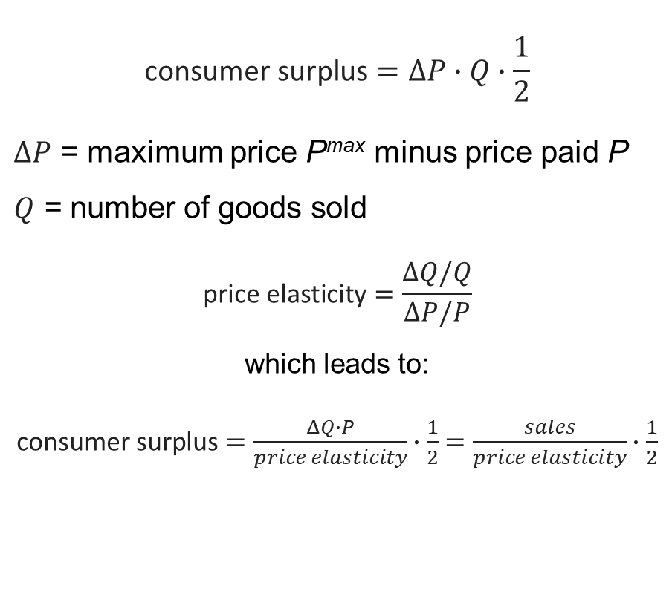
Consumer surplus
$$\text{consumer} \text{surplus}=ΔP∙Q∙\frac{1}{2}$$
$ΔP$ = maximum price P^{max} minus price paid P $Q$ = number of goods sold
$$\text{price} \text{elasticity}=\frac{ΔQ/Q}{ΔP/P}$$
which leads to:
$\text{consumer} \text{surplus}=\frac{ΔQ∙P}{price elasticity}∙\frac{1}{2}=\frac{sales}{price elasticity}∙\frac{1}{2}$

Slide 17

Calculating social and environmental value
Using the social (SVF) and environmental (EVF) value flows, you can determine social (SV) and environmental (EV) value:
$$SV=\sum_{n=0}^{N}{\frac{S{VF}_{n}}{{\left(1+r\right)}^{n}}} EV=\sum_{n=0}^{N}{\frac{{EVF}_{n}}{{\left(1+r\right)}^{n}}}$$
Year | 2022 | 2023 | 2024 | …
Social value flows (SVF), $ billions | 7.4 | 7.6 | 8.0 | …
Discount factor, 2% | 1 | 0.98 | 0.96 | …
PV (SVF) | 7.4 | 7.5 | 7.7 | …
Social value (SV) | 73.3
Year | 2022 | 2023 | 2024 | …
Environmental value flows (EVF), $ billions | -6.7 | -7.2 | -5.3 | …
Discount factor, 2% | 1 | 0.98 | 0.96 | …
PV (EVF) | -6.7 | -7.0 | -5.1 | …
Environmental value (EV) | -57.6

Slide 18
Examples
This chapter shows that SV and EV can be measured and valued
We can now calculate IV = FV + SV + EV
Ch 6 and 7 provide examples for projects - from Net Present Value (NPV) of FV to Integrated Present Value (IPV)
Ch 7 provides case study for integrated value of Inditex

Slide 19
Conclusions
Recent advances in impact measurement enable companies to measure social and environmental quantities and to multiply them by their respective shadow price
The challenge for calculating social value (SV) and environmental value (EV) is the availability of company information on S and E issues
It is important to keep the big picture by focusing on material S and E issues, and not to get lost in unnecessary detail
Remember: better to be approximately right than exactly wrong

