Slide 1
Corporate Finance for Long-Term Value
Chapter 16: Issues and payouts – changes in capital structure

Slide 2
Chapter 16: Issues and payouts – changes in capital structure
Part 5: Corporate financial policies

Slide 3
The BIG Picture
Issues raise cash from providers of capital and payouts pay cash to providers of capital
Discussion
Issues and payouts are only value relevant in imperfect markets
Financial payout ratio is payout (dividends + share buybacks) as percentage of profit
Impact of E and S on financial issues and payouts is most obvious through their impact on risk, debt capacity and cash flows
Integrated payout ratio calculates payout as percentage of integrated value flows
Caution on payouts in the presence of significant liabilities on E or S

Slide 4
Issues of financial capital
When companies need extra capital, they might issue additional capital:
Bonds – debt
Shares – equity
The initial public offering (IPO) is a company’s first equity issue in public equity markets
Subsequent equity issues are called seasoned equity offerings (SEOs)
A rights issue invites existing shareholders to purchase additional new shares in the company

Slide 5
Issues in perfect capital markets
If a company with 5 million shares raises 10 million in equity:
Assets and cash increase by 10 million
The stock price remains the same
20 / 5 = 4 value per share before issue
30 / 4 = 7.5 million outstanding shares after issue (so 2.5 million shares issued)
Leverage (debt / equity) decreases
From 0.20 (= 5 / 25) to 0.14 (= 5 / 35)
Company reduces risk
Market value balance sheet – before equity issue
F assets | 25 |  | F debt | 5
 |  |  | F equity | 20
Total assets | 25 |  | Total liabilities | 25
Market value balance sheet – after equity issue
F assets | 35 |  | F debt | 5
 |  |  | F equity | 30
Total assets | 35 |  | Total liabilities | 35

Slide 6
Cost of issues due to market imperfections
Due to the tax deductibility of interest, adding debt might increase FV until bankruptcy costs outweigh tax benefits
Optimal capital structure is where the weighted average cost of capital (WACC) is lowest
WACC
R_{u}
Minimal WACC
D/V
Move to the right: adding debt, reducing equity adds F value
Move to the left: adding equity, reducing debt adds F value

Slide 7
Cost of issues due to market imperfections
Assume that information asymmetries result in a -3% stock price reaction at announcement of the issue:
Equity (and assets) decreases by 0.6 (= 3% x 20)
Share price drops to 3.88 (= 19.4 / 5)
To raise 10 million in equity:
The company will need to issue more shares: 10 / 3.88 = 2.577 million shares
Market value balance sheet – before announcement
F assets | 25 |  | F debt | 5
 |  |  | F equity | 20
Total assets | 25 |  | Total liabilities | 25
Market value balance sheet – after announcement
-0.6
F assets | 24.4 |  | F debt | 5
 |  |  | F equity | 19.4
Total assets | 24.4 |  | Total liabilities | 24.4
-0.6
Market value balance sheet – after equity issue
F assets | 34.4 |  | F debt | 5
 |  |  | F equity | 29.4
Total assets | 34.4 |  | Total liabilities | 34.4

Slide 8
Why do companies issue capital?
Two main reasons why companies issue equity or debt despite the costs:
In need of cash for investments with NPV > negative APV (adjusted present value) of issue
Owners of privately-owned company may want to (partially) exit
Additional long-term factors for issuing equity:
Reduce leverage
Improve liquidity of shares
Enhance company image and publicity
Motivate employees and management
Explore mispricing
Disadvantages for issuing equity
High cost of issues
Loss of control and ownership
APV includes funding costs of transaction

Slide 9
Internal errors in issuing capital
The adjusted present value (APV) method judges the attractiveness of an issue
Internal errors: managers overestimate cash flows and/or underestimate risk
If APV is negative: management feels it is giving away value
Positive APV is unlikely
This APV calculation doesn’t take into consideration positive NPVs for future investments
APV components | 20% overvalued by management | 10% undervalued by management
plus: cash in | 300 | 300
minus: management's valuation of the shares | -360 | -270
minus: transaction costs | -15 | -15
sum: management's perceived APV | -75 | 15

Slide 10
External errors in issuing capital
External errors: market under- or overvalues (groups of ) companies or market indices
Corporate executives “time the market”
Examples: ‘tronics boom in the early 1960s & internet IPOs in the late 1990s
APV components | 20% overvalued by the market | 25% undervalued by the market
plus: cash in | 300 | 300
minus: management's valuation of the shares | -250 | -400
minus: transaction costs | -15 | -15
sum: management's perceived APV | 35 | -115

Slide 11
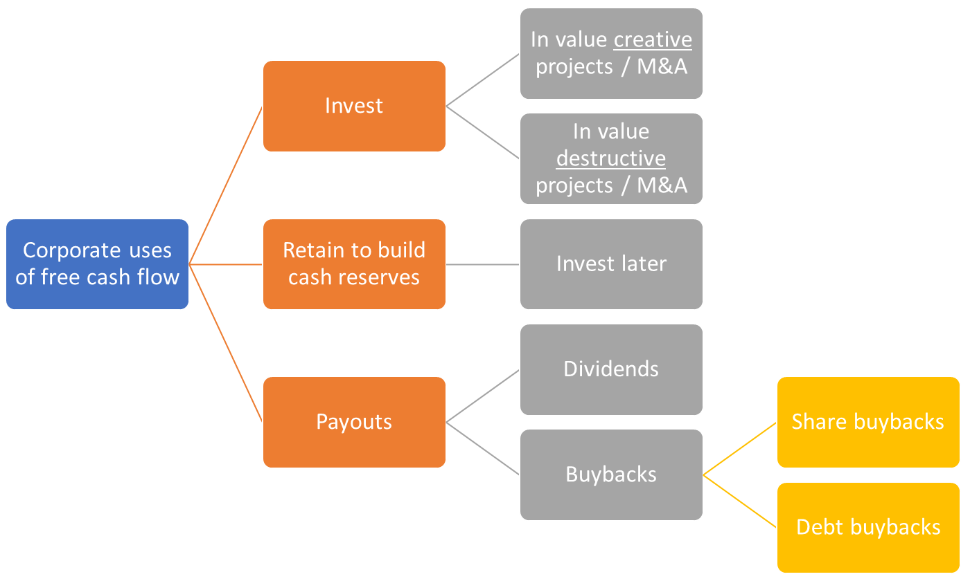
Payouts to financial capital
In payouts, companies return capital to the financiers
Payouts on equity: dividends & share repurchases / buybacks
For investors, payouts are a way to get income from invested funds
$$Payout ratio=\frac{Payouts}{Net income }$$

Slide 12
Payouts to financial capital
In perfect capital markets, dividend payment = stock price drop
Free Cash Flow (FCF) Theory: managers tend to waste FCF on negative NPV projects and overconsumption of perks (i.e., corporate jets)
Higher dividends reduce investment in value destructive projects

Slide 13
Dividends
Signaling theory: high and rising dividends signal high company quality
Lintner (1956) found that companies establish long-run target payout ratios
Managers prefer to smooth dividends
Reserve earnings from good financial years to pay dividends in bad years
Leads to negative perception of dividends cuts, with negative stock price reaction
Cash dividends are cash payments to shareholders
Repurchases / buybacks: company buys shares from its shareholders

Slide 14
Example: timeline Telenor 2020 dividend

Slide 15
Calculating dividends
Company has:
3 million shares outstanding, with a per share value of 237 (711 million / 3 million)
Dividend policy of 50% payout ratio
Most recent FY: profit of 66 million, so 33 million in dividends and 11 per share (= 33 million / 3 million)
Dividend yield of 4.6% (= 11 / 237)
F investment projects | 760 |  | F debt | 112
F cash | 63 |  | F equity | 711
Total assets | 823 |  | Total liabilities | 823
Number of shares outstanding, millions | 3
Value per share | 237
Net profits, millions | 66
Payout ratio | 50%
Total dividend paid, millions | 33
Dividend per share | 11
Dividend yield | 4.6%

Slide 16
Stock dividend and stock splits
Paying dividends with shares → not really payout
Increase in shares outstanding is corrected by falling share price
Stock splits lead to dramatic changes in shares outstanding
Undertaken for shares with high price per share
 | Value before the 15:1 stock split | Value after the 15:1 stock split
Stock market value, € billions | 26 | 26
Number of shares, millions | 80 | 1200
Value per share, € | 325 | 21.67

Slide 17
Share repurchases & taxes
Two ways to do share repurchases (also known as share buybacks):
Open market operations – a company buys back shares in the market
Tender offers – shareholders receive an offer that asks to submit (tender) a portion of their shares
Dividends are more heavily taxed than capital gains and repurchases
Tax rates differ across shareholders, with some (such as pension funds) being tax-exempt
Dividend capture theory: in absence of transaction costs, investors can trade shares so that non-taxed investors receive dividends

Slide 18
Behavioural view on payouts
Internal errors: managers may be tempted to pay too-high dividends or do too-big share repurchases due to overestimated earnings and underestimated risk
A strong rationale for paying dividends lies in catering to investor needs:
Self-control: dividends make people less reliant on self-control with trading shares
Mental accounting: segregating overall gain/loss into several components
Regret avoidance: people feel more regret over selling too early (cheaply) than not reinvesting in the same stock

Slide 19
E and S issues and payouts of financial capital
E and S affect factors (such as risk, debt capacity and cash flows) that influence whether companies will do payouts or new issues
The sudden internalisation of costs could lead to issues and payouts
Example: Bayer made dividend cuts in 2021 after litigation on E issues (Monsanto)
Internalisation over time
Rising carbon tax → invest in new technologies → reduce FCF → lower dividends

Slide 20
Example of E and S effect on dividend policy
Option 1: continue to pay dividends
Option 2: cut dividends until cash and FCF turns positive:
 | 2022 | 2023 | 2024 | 2025 | 2026 | 2027
Net profit | 140 | -45 | -58 | -33 | 76 | 187
Depreciation | 20 | 20 | 22 | 22 | 22 | 22
Capex | -25 | -86 | -94 | -67 | -23 | -23
FCF | 135 | -111 | -130 | -78 | 75 | 186
Dividend (fixed) | 60 | 60 | 60 | 60 | 60 | 60
Payout ratio | 43% | -133% | -103% | -182% | 79% | 32%
Cash position without dividend cut | 247 | 76 | -114 | -252 | -237 | -111
 | 2022 | 2023 | 2024 | 2025 | 2026 | 2027
Net profit | 140 | -45 | -58 | -33 | 76 | 187
Depreciation | 20 | 20 | 22 | 22 | 22 | 22
Capex | -25 | -86 | -94 | -67 | -23 | -23
FCF | 135 | -111 | -130 | -78 | 75 | 186
Dividend (fixed) | 60 | 0 | 0 | 0 | 0 | 60
Payout ratio | 43% | 0% | 0% | 0% | 0% | 32%
Cash position with dividend cut | 247 | 136 | 6 | -72 | 3 | 129

Slide 21
E and S issues and payouts of financial capital
Value destruction on E and S puts future cash flows at risk
This should make payouts less likely for ethical managers
However, a short-term minded manager will likely opt for payouts to “milk the cash”
A positive contribution to E and S creates value, which strengthens capital structure
Example: Novozymes – a Danish bioenergy provider
Expected positive E flows
Positive effect on financial position (due to increased demand for low carbon fuels)
Could lead to increased dividend payouts in the future

Slide 22
Issues and payouts for social (S) and natural (E) capital
The value of assets, equity and liabilities on E and S change over time
Unclear whether changes take the form of payouts or issues
Difference between F and S and/or E: cash on F balance sheet

Slide 23
Integrated view on payouts
$Payout ratio=\frac{Payouts}{Net income }$ → $Integrated payout ratio=\frac{Payouts}{Net integrated income }$
Net integrated income is derived from the integrated profit & loss account (IP&L)
 | Positive | Negative | Net | Payouts
E value flows | 1 | -12 | -11
S value flows | 9 | -2 | 7
F value flows | 6 | 0 | 6
Payout |  |  |  | 4
Financial payout ratio |  |  |  | 67% (= 4 / 6)
Net integrated flows | 16 | -14 | 2
Payout |  |  |  | 4
Integrated payout ratio |  |  |  | 200% (= 4 / 2)
Financial perspective: payout is reasonable
Integrated perspective: payout is excessive

Slide 24
E and S issues and payouts of financial capital
In case of high integrated payout ratio (>100%), cutting dividends could allow for more investment to fix negative E and S flows
Ang and Lambooy (2022) propose an integrated payout test:
Let payout policy depend on social and natural capital, on top of financial capital
Test based on financial, social and environmental metrics
Auditing rules already require companies to take provisions when they are aware of contingent social or environmental liabilities

Slide 25
Company cases
Inditex
Novozymes
 | Flows in € billions
(1) Net profit | 3.25
(2) Net positive social flows | 4.10
(3) Net negative social flows | -2.88
(4) Net negative environmental flows | -3.73
(5) Net integrated flows (= sum 1 to 4) | 0.74
(6) Dividend | 2.19
(7) Financial payout ratio (= 6 / 1) | 67%
(8) Integrated payout ratio (= 6 / 5) | 296%
 | Flows in € billions
(1) Net profit | 0.40
(2) Net environmental flows | 1.16
(3) Net integrated flows (= 1 + 2) | 1.56
(4) Dividend | 0.21
(5) Financial payout ratio (= 4 / 1) | 53%
(6) Integrated payout ratio (= 4 / 3) | 13%

Slide 26
Conclusions
Issues raise cash from providers of capital and payouts pay cash to providers of capital
Issues and payouts are only value relevant in imperfect markets
The impact of E and S on financial issues and payouts is most obvious through their impact on risk, debt capacity and cash flows
The integrated payout ratio calculates payouts as percentage of integrated value flows
Caution on payouts in the presence of significant liabilities on E or S

