Slide 1
PRINCIPLES OF
SUSTAINABLE FINANCE
Chapter 1: Sustainability and the transition challenge
Principles of Sustainable Finance © Schoenmaker and Schramade 2019 Oxford University Press

Slide 2
Overview of the book
Part I: What is sustainability and why does it matter?
Sustainability and the transition challenge
Part II: Sustainability’s challenges to corporates
Externalities - internalisation
Governance and behaviour
Coalitions for sustainable finance
Strategy and intangibles – changing business models
Integrated reporting - metrics and data
Part III: Financing sustainability
Investing for long-term value creation
Equity – investing with an ownership stake
Bonds – investing without voting power
Banks – new forms of lending
Insurance – managing long-term risk
Part IV: Epilogue
Transition management and integrated thinking
Principles of Sustainable Finance © Schoenmaker and Schramade 2019 Oxford University Press

Slide 3
Learning objectives – chapter 1
explain the planet’s social and environmental challenges
list and understand the United Nations Sustainable Development Goals
understand the transition of the economic system
explain the main functions of the financial system and how to apply them to sustainability
explain the various stages of sustainable finance
Principles of Sustainable Finance © Schoenmaker and Schramade 2019 Oxford University Press

Slide 4
Why does sustainability matter?
Principles of Sustainable Finance © Schoenmaker and Schramade 2019 Oxford University Press

Slide 5
From pre to post Industrial Revolution
Empty
world
Full
world
Technological advances dependent on fossil fuels & other raw materials
Massive production & consumption
Economic & population growth
Abundance of goods and services from nature
Club of Rome (1973):
Limits to Growth
Principles of Sustainable Finance © Schoenmaker and Schramade 2019 Oxford University Press

Slide 6
Figure 1.1 The world model
Principles of Sustainable Finance © Schoenmaker and Schramade 2019 Oxford University Press

Slide 7
Tensions mounting
Unbridled economic growth
Sustainable development
Box 1.1 Deepwater Horizon oil spill
Explosion on oil drilling rig of BP in Gulf of Mexico killed 11 workers + largest accidental marine oil spill
Caused by cost-cutting decisions and inadequate safety system
Box 1.2 Rana Plaza factory collapse
Eight-storey factory collapse in Bangladesh due to structural failure
Owners of clothing factories ignored evacuation warnings
1,129 deaths - 2,500 injured
Principles of Sustainable Finance © Schoenmaker and Schramade 2019 Oxford University Press

Slide 8
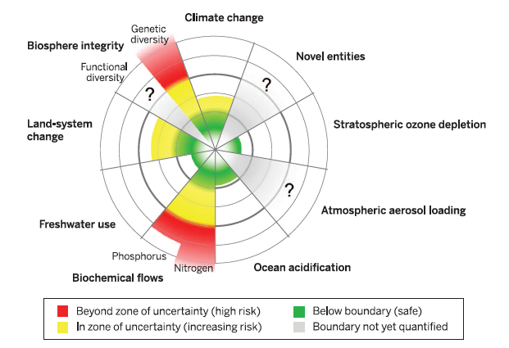
Environmental challenges: planetary boundaries
Keep planet liveable for current and future generations
Steffen et al (Science, 2015): planetary boundaries at risk being crossed
Principles of Sustainable Finance © Schoenmaker and Schramade 2019 Oxford University Press

Slide 9
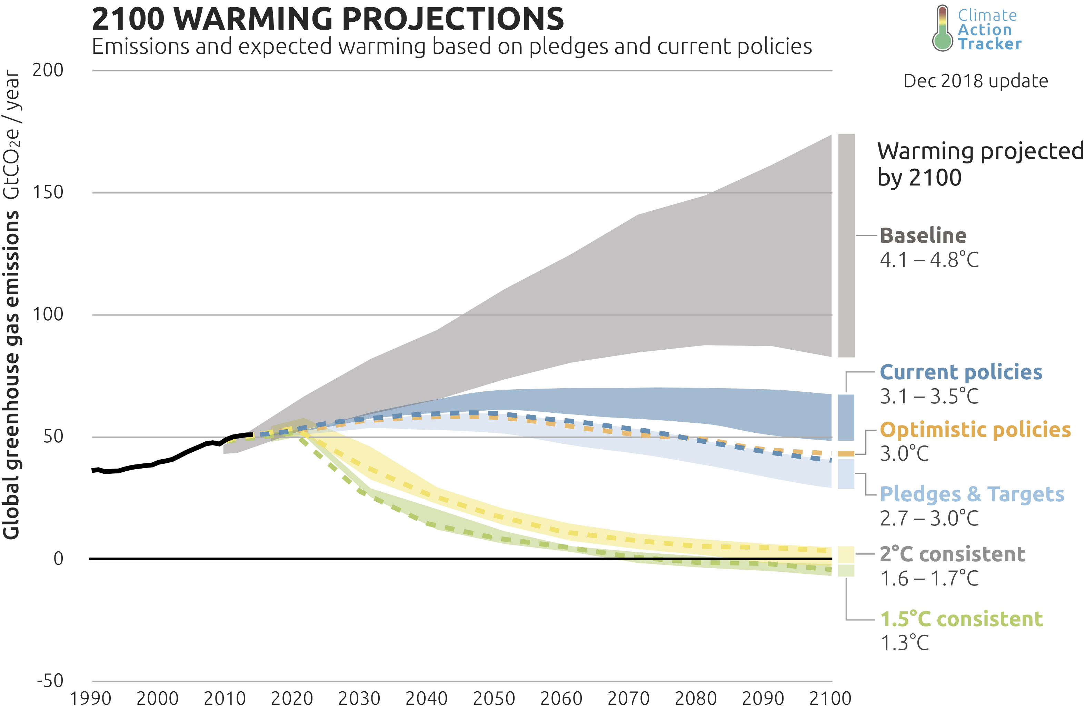
Climate policy gap

Slide 10
Climate action is urgent
1992 Earth summit Rio de Janeiro
2015 Paris COP21
Now: still too little action. Need a carbon tax!
Agreement on climate change (COP21):
Reconfirmed target to limit global warming to 2⁰ Celsius relative to pre-industrial level
Pursue efforts to limit global warming to 1.5⁰ Celsius
In 2015, budget is 900 Gt of CO₂ and current level is 40 Gt a year
Climate change is the biggest risk
United Nations Framework Convention on Climate Change (UNFCC) environmental treaty to ‘stabilise greenhouse gas concentrations in atmosphere’
Principles of Sustainable Finance © Schoenmaker and Schramade 2019 Oxford University Press

Slide 11
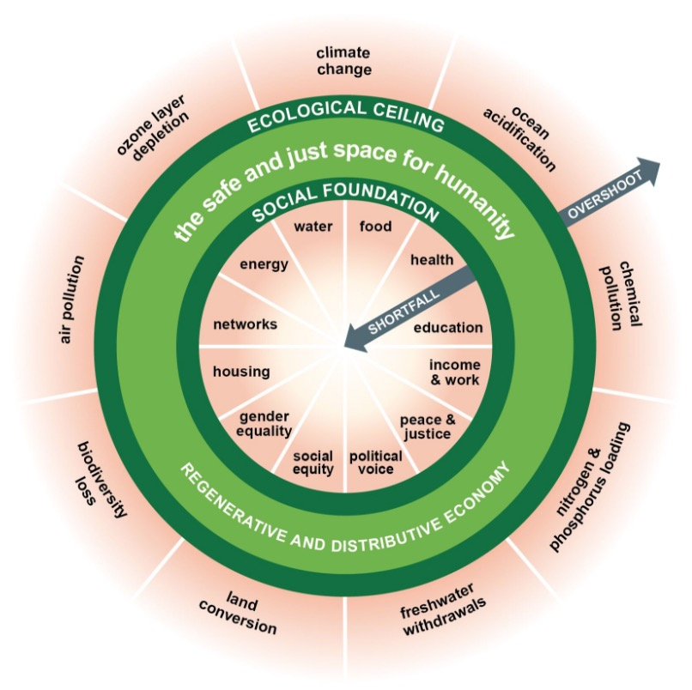
Social foundations
Social boundaries or foundations (Doughnut of Kate Raworth, 2017)
Food security (no hunger)
Adequate income (no poverty with income < $3.10 a day)
Access to health care
Access to water and clean cooking facilities
Education
Decent work
Modern energy services
Gender equality and social equity
Political voice
Many people live below these social foundations

Slide 12
Sustainable development
Sustainable development combines planetary and social boundaries:
Sustainable development means that current and future generations have the resources needed, such as food, water, healthcare and energy, without stressing processes within the Earth system
To guide transformation, the United Nations has developed the 2030 Agenda for Sustainable Development
17 UN Social Development Goals (SDGs) to stimulate action
Principles of Sustainable Finance © Schoenmaker and Schramade 2019 Oxford University Press

Slide 13
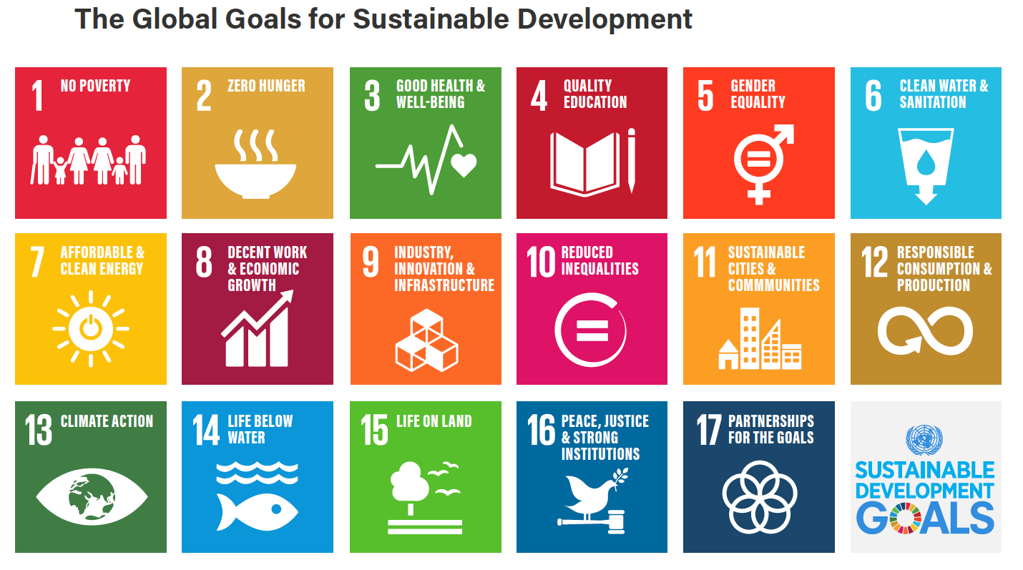
Global goals for sustainable development

Slide 14
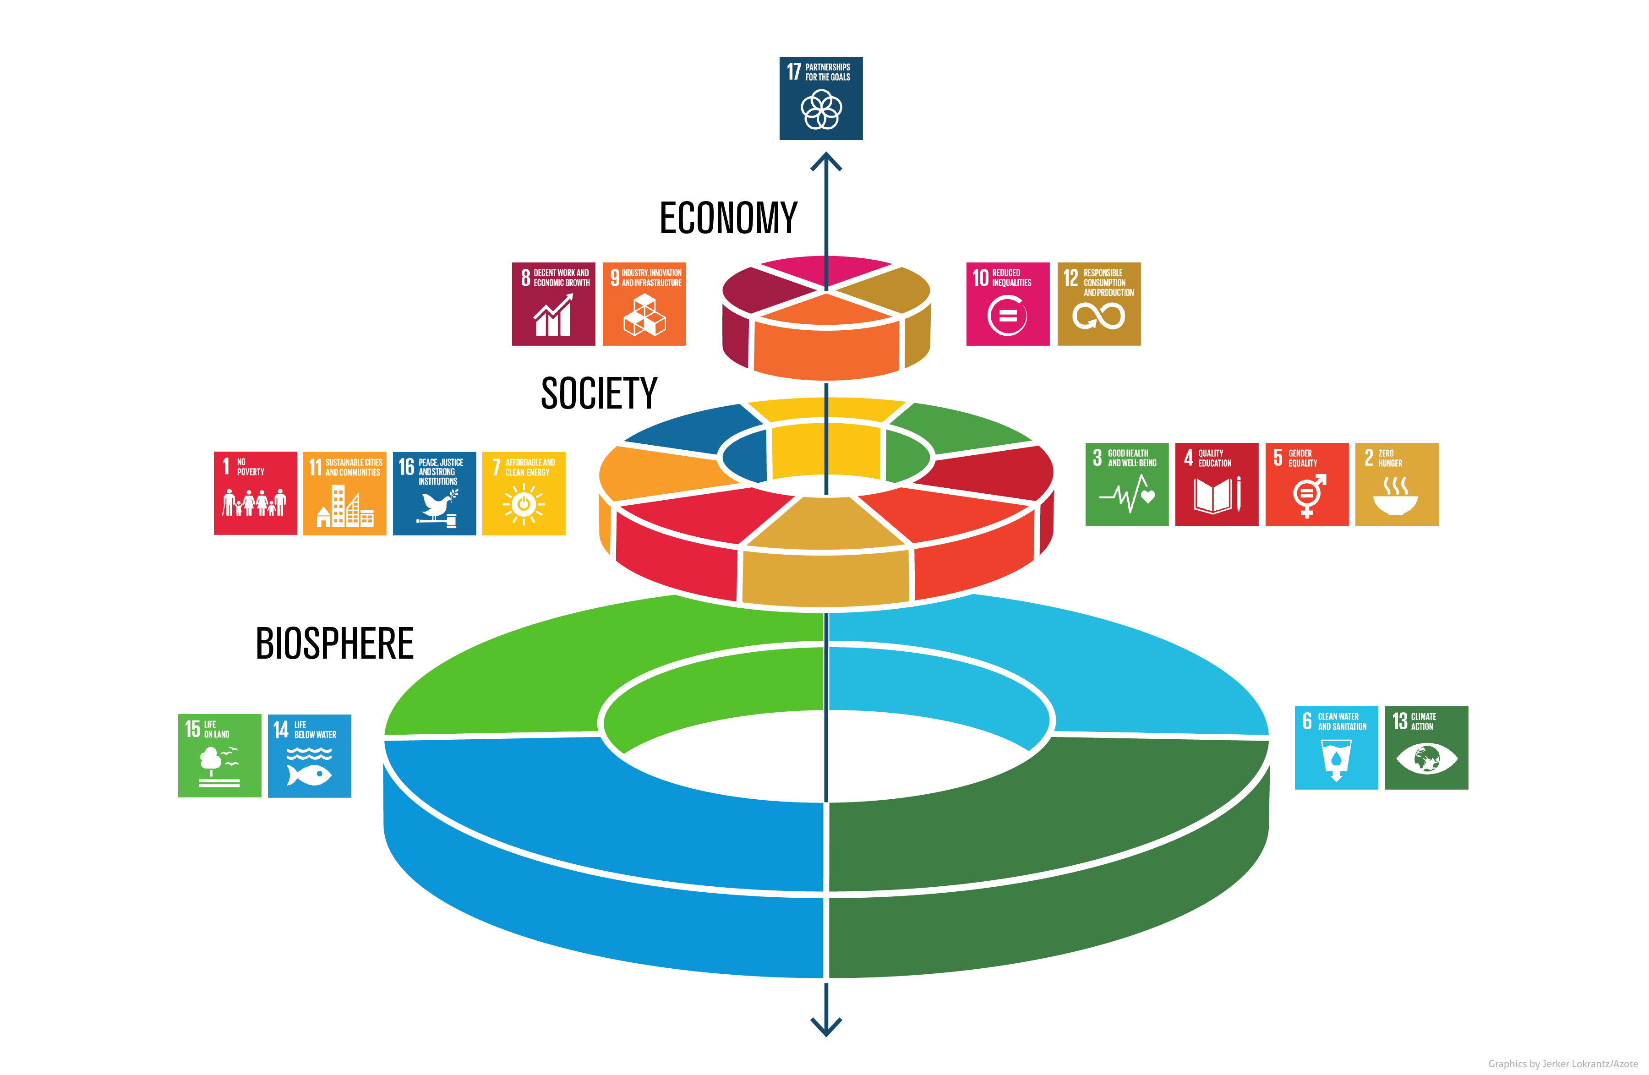

Slide 15
Systems approach
Tempting to address challenges at each level
Need for a holistic system perspective
Adaptive capacity of system (e.g. eco-system or production process)
But cross-system interactions and uncertain thresholds
Example: global warming -> extreme weather events affecting vulnerable countries -> economic downturn and poverty upturn
We need a guide for trade-offs between economic, social and ecological goals
Finance can help in decision-making on trade-offs
Principles of Sustainable Finance © Schoenmaker and Schramade 2019 Oxford University Press

Slide 16
Role of the financial system
Principles of Sustainable Finance © Schoenmaker and Schramade 2018 Oxford University Press

Slide 17
Functions of the financial system
Levine (2015):
Allocate capital to its most productive use
Price risk for trading and valuation
Exert influence over corporates (corporate governance)
risk management can help dealing with uncertainties in future (eg. scenario analysis)
controlling and directing corporate boards (engagement) towards sustainable business practices (see Chapter 3)
can assist in making strategic decisions on the trade-offs
Principles of Sustainable Finance © Schoenmaker and Schramade 2019 Oxford University Press

Slide 18
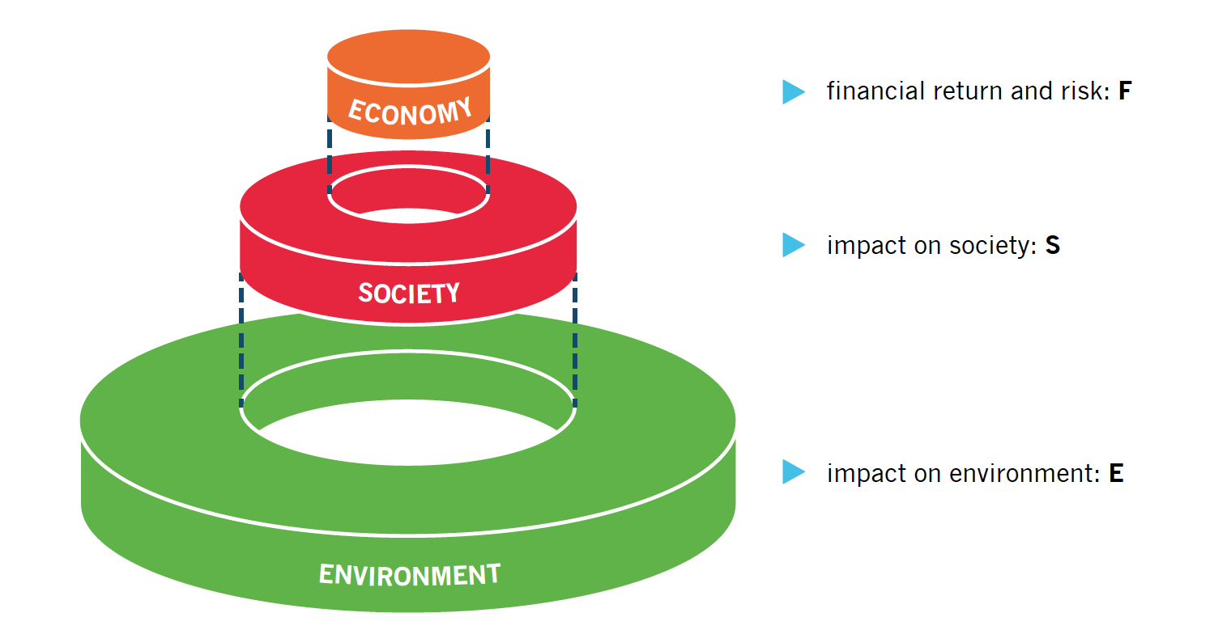
Managing sustainable development

Slide 19
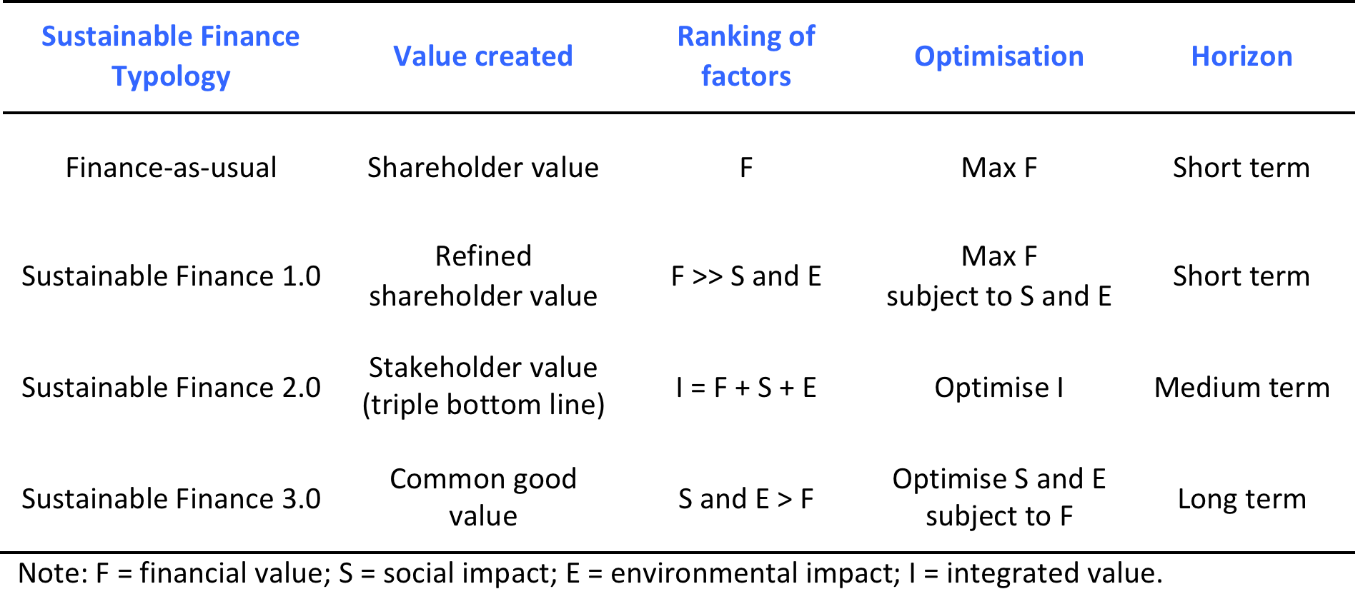
Framework for sustainable finance
Principles of Sustainable Finance © Schoenmaker and Schramade 2019 Oxford University Press

Slide 20
Finance as usual
Traditional finance textbooks
Profit maximisation -> maximise shareholder value
By looking for optimal financial risk and return combination
Only factor F
Friedman (1970): the business of business is business
Only social responsibility is making profit
Charity is private decision of citizens
Overly high discount rates (in particular for UK and US) -> evidence of myopia / short termism
Principles of Sustainable Finance © Schoenmaker and Schramade 2019 Oxford University Press

Slide 21
Sustainable Finance 1.0
Refined shareholder value
Profit maximisation, but avoiding ‘sin’ stocks (i.e. extreme negative impact like cluster-mines or tobacco)
Ranking factors: F >> S + E ( = SEV )
Profit motive is still leading
Question: does exclusion work?
Principles of Sustainable Finance © Schoenmaker and Schramade 2019 Oxford University Press

Slide 22
Sustainable Finance 2.0
Stakeholder approach
All stakeholders: employees, clients, shareholders, society, environment
Optimise integrated value: IV = F + S + E
Caveats
Not everything can be monetised (e.g. human life, destroying rain forest)
Perverse effects - high profit but extra negative impact: SEV_{t+1} ≥ SEV_{t}
Private discount factor > public discount factor (Stern, 2008)
Principles of Sustainable Finance © Schoenmaker and Schramade 2019 Oxford University Press

Slide 23
Sustainable Finance 3.0
Stewardship: working for the common good
Environmental and social challenges come first
But need to have financial viability (fair return)
Research indicates that sustainable companies are more resilient -> better able to cope with (LT) shocks, without extra (ST) costs
Principles of Sustainable Finance © Schoenmaker and Schramade 2019 Oxford University Press

Slide 24
Comparing the stages
Discussion
Pros and cons of approaches (SF 1.0, 2.0, 3.0)
Where are we now?
Debate: exclusion versus inclusion
Principles of Sustainable Finance © Schoenmaker and Schramade 2019 Oxford University Press

Slide 25
Challenges to integration of sustainability into finance
Principles of Sustainable Finance © Schoenmaker and Schramade 2019 Oxford University Press

Slide 26
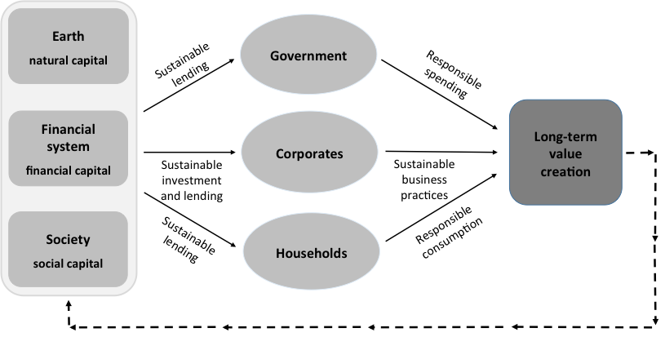
Long-term value creation (Fig 1.7)

Slide 27
Discussion: barriers
What is the most important barrier to sustainable finance?
Value: shareholder value (profit) versus common good
Horizon: short term versus long term
Principles of Sustainable Finance © Schoenmaker and Schramade 2019 Oxford University Press

Slide 28
Conclusions
Sustainable finance: from finance as a goal (profit max) to finance as a means to support transition to sustainable economy
Transition to low carbon economy
Things may move fast: air pollution California -> regulation -> electric cars / solar
Finance is about anticipating events and price them in for today’s investment decisions
Finance can thus contribute to a swift(er) transition
Need for LT patient capital
Principles of Sustainable Finance © Schoenmaker and Schramade 2019 Oxford University Press

