Slide 1
Corporate Finance for
Long-Term Value
Chapter 14: Capital market adaptability, investor behaviour and impact

Slide 2
Chapter 14: Capital market adaptability, investor behaviour and impact
Part 4: Risk, return and impact

Slide 3
The BIG Picture
How is information processed into stock prices?
Discussion
Finance adopts traditionally the efficient markets hypothesis (EMH): all information is immediately (with the speed of light) incorporated in prices
An alternative is the adaptive markets hypothesis (AMH): information is gradually (with the speed of thinking) incorporated in prices depending on the # of analysts
AMH seems more appropriate for getting sustainability into prices
Implicit markets (e.g. elections, consumers, NGOs) reveal impact information

Slide 4
Efficient markets hypothesis
Stock prices are one of the most closely followed news items, but can a pattern or price cycle be discerned?
According to the efficient markets hypothesis, there are no patterns in stock prices
  Stock prices change at random: tomorrow’s stock price has an equal chance of going up or down
  Assuming an expected monthly return of 0.5%, stock prices follow a random walk with a positive drift of 0.5% per month (the drift reflects the mean return)
The idea is that competition between investors eliminates profit opportunities

Slide 5
Efficient markets hypothesis
The efficient markets hypothesis (EMH) states that stock prices incorporate all relevant information instantaneously – with the speed of light
Fama (1970) distinguishes three forms of market efficiency:
  Weak market efficiency: prices reflect all relevant past information
  Semi-strong market efficiency: prices reflect not only information in past prices, but also all publicly available information
  Strong market efficiency: prices also reflect information gathered through fundamental analysis of the company and the economy
Securities regulations force companies to publish information that can potentially move the stock price (i) outside trading hours and (ii) as widely as possible
  Spreading rumours about companies in order to manipulate stock prices is forbidden

Slide 6
EMH: Interest rate announcements
When central banks fear that the economy is getting overheated leading to inflation, they will try to slow this down by raising interest rates
An interest rate rise has a negative impact on future profits and increases the discount factor
Central banks follow a strict protocol on announcing their interest rate policy
  The European Central Bank (ECB) has a six-week schedule for their monetary policy meetings
  In the run-up to the meeting, the market speculates on the ECB’s decision
  An unexpected interest rate rise (or decline) leads to an immediate reaction in stock prices
  Fierce competition among stock traders ensures that there is little opportunity to gain from the interest rate announcement

Slide 7
EMH: Takeovers and market efficiency
On December 1st, 2020, the Cloud computing giant, Salesforce, announced the acquisition of Slack Technologies for $27.7 billion dollars
On the announcement date, the stock price of Slack jumped 38%
There seems to have been some information
leakage prior to the announcement, given that
the stock price increased by 22%
The Cumulative Abnormal Return (CAR) shows
the deviation of Slack’s realised return from its
expected market return, amounting to 60%

Slide 8
Strong market efficiency
The strong form of market efficiency argues that fundamental analysts cannot outperform the market
  This means there is no added value from fundamental analysis, while this analysis is costly to do
Insider dealing is a criminal offence, although extremely difficult to prove in a criminal court
Company management is not allowed to give stock-price sensitive information to individual investors or small groups of investors
  Companies therefore organise analyst calls, which are widely accessible to investors, to update investors on strategy, earnings outlook, etc.

Slide 9
The paradox in efficient markets hypothesis
The efficient markets hypothesis has a contradictory element in it
  All investors will be passive, as active trading strategies and information acquisition do not pay off in informationally efficient markets
  At the same time, we need active investors to acquire and process information to update market prices
French (2008) finds that active investors spend around 70 basis points (0.7%) of the aggregate value of the market each year searching for superior returns
As active investors can ‘on average’ not increase their return with active trading strategies, they could improve their returns by 70 basis points if they switched to a passive market portfolio
In conclusion, markets can only be close to efficiency, because some profit opportunities are needed for active investors

Slide 10
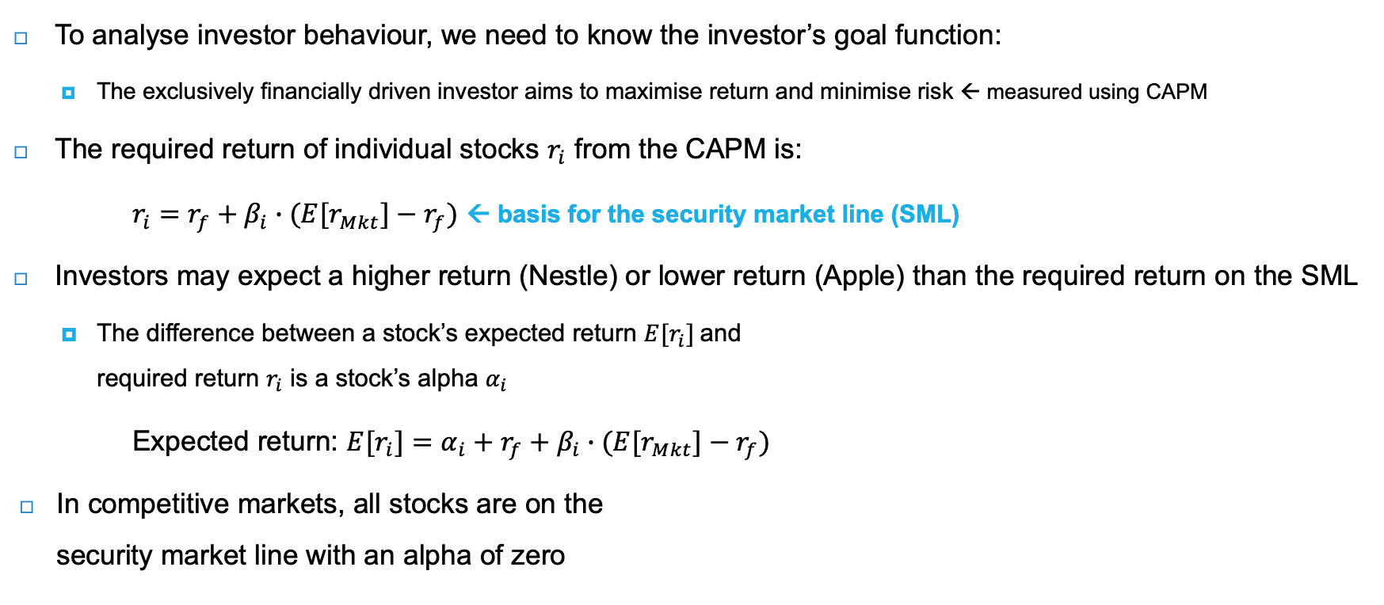
Financial investors and capital market competition
To analyse investor behaviour, we need to know the investor’s goal function:
  The exclusively financially driven investor aims to maximise return and minimise risk ← measured using CAPM
The required return of individual stocks $r_{i}$ from the CAPM is:
$r_{i}=r_{f}+β_{i}∙{(E[r}_{Mkt}]−r_{f})$ ← basis for the security market line (SML)
Investors may expect a higher return (Nestle) or lower return (Apple) than the required return on the SML
  The difference between a stock’s expected return ${E[r}_{i}]$and
  required return $r_{i}$ is a stock’s alpha $α_{i}$
Expected return: ${E[r}_{i}]=α_{i}+r_{f}+β_{i}∙{(E[r}_{Mkt}]−r_{f})$
In competitive markets, all stocks are on the
security market line with an alpha of zero

Slide 11
Behavioural finance
Are all investors acting in line with the expectations of the CAPM model?
There are two major deviations:
  Familiarity bias of individual investors, who tend to invest in a few stocks of companies they are familiar with
    Often results in portfolios with less than 10 stocks, meaning investors fail to diversify appropriately
  Excessive trading, which means investors frequently trade their stocks, giving rise to high transaction costs, which reduces net investment returns
    The annual stock turnover on the largest stock exchanges is well over 100%, which means that all shares change hands at least once every year

Slide 12
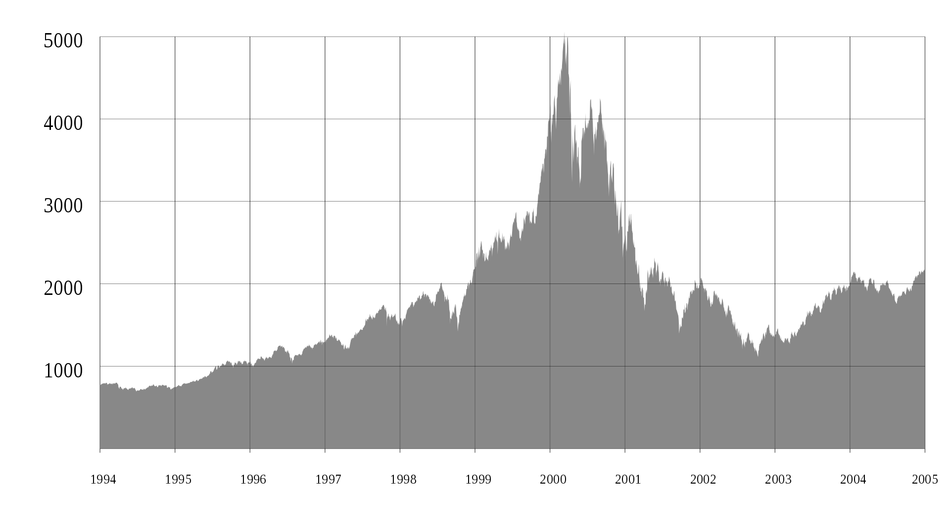
Bubbles
The pricing of stocks in CAPM is based on homogeneous expectations
What happens when investors collectively believe that the outlook is more favourable?
Shiller (2000) has coined the term irrational exuberance which refers to investor enthusiasm that drives asset prices higher than those assets' fundamentals justify
The cyclically adjusted price-to-earnings ratio (CAPE) measures over- or undervaluation of the market
  An average CAPE ratio of 15 for the 20th century, with 25 indicating significant overvaluation
Example: the dotcom bubble
  Investors had high expectations about the internet and
  valued internet companies at very high prices
  The NASDAQ increased from 750 in early 1995 to
  4700 in February 2000, when the dotcom bubble burst
The dotcom bubble, NASDAQ Composite Index, 1995-2002
Source: Nasdaq

Slide 13
The cost of social and environmental capital
Andrew Lo’s (2004; 2017) adaptive markets hypothesis states that the degree of market efficiency depends on an evolutionary model of individuals adapting to a changing environment (with the “speed of thinking”)
Unlike the efficient markets hypothesis, the adaptive markets hypothesis allows for:
  Path dependencies;
  Systematic changes in behaviour; and
  Varying risk preferences
The adaptive markets hypothesis can explain why new factors, such as social and environmental risks and opportunities, are not yet fully priced in, because not enough investors are:
  Examining these new factors
  Expecting sustainable material risks and opportunities to lead to financial effects
The question is how to get sustainability related information embedded into stock prices

Slide 14
Transition preparedness
As the UN Sustainable Development Goals are about transition, an investor needs to know how well or ill prepared an investee company is:
  Can the company’s business model be adapted to a sustainable economy?
Investors have to look at companies through a different lens, and go beyond traditional financial statement analysis
  Considering social and environmental factors in their own units
  Investigating governance and behaviour
  Assessing their impact on companies’ strategies and business models

Slide 15
Availability and quality of ESG data
Over time, sustainability reporting is expected to increase with new reporting initiatives
  EU Corporate Sustainability Reporting Directive (CSRD)
  International Sustainability Standards Board (ISSB)
With this increased information, markets will adapt and thus become more efficient
The lack of available data is currently very large, but should diminish over time in line with the adaptive markets hypothesis
  Pockets of poorly used data as inefficiencies and opportunities to be exploited
Increased attention towards socially and environmentally relevant information will reduce alpha – return on active investment exploiting market inefficiencies - to zero
Increasing availability of ESG data
Hardly available quant data
Pockets of data that can be harvested with a solid process
- Being ahead of ratings can generate alpha
Shifting data frontier
In sustainability reports soon
In sustainability reports now
Embedded in ESG ratings
Widely available quant data
Widely available qualitative information
Hardly available qualitative information

Slide 16
Limitations of ESG ratings
ESG rating agencies score thousands of companies on several sustainability metrics within the E, S, and G (governance) domains
  Agencies include: MSCI, Sustainalytics, Refinitiv, ISS, etc.
ESG ratings help indicate a company’s level of environmental, social, and governance risk
  Only indicate a company’s inward impact, not the outward ESG impact of the company
Advantage: provides investors with a quick approximation of a firm’s ESG risk
Disadvantages:
  Difficult to compare, since each rating agency uses a methodology which differs in terms of scope and measurement (Berg, Kölbel, and Rigobon, 2022)
  Ratings cannot be compared unless the company is operating in the same industry and has the same material ESG issues (as determined by the rating agency)

Slide 17
The impact perspective
The outward (or impact) perspective looks at the impact of companies on society and nature
The impact dimension embodies the social and environmental value of companies, separate from financial value
Business & financial value
Society & nature
Impact information:
Academic research
NGOs
Regulations
Rating agencies
Consultancies
Impact prices:
Direct: Consultancies
Indirect:
  Product markets
  Capital markets
  Elections
Dependencies: inward
Internalisation rate
Impacts: outward
Financial information and prices:
Capital markets

Slide 18
Impact information producers
Academic research has produced the planetary boundaries, which show how we can keep the Earth system in a stable and resilient state
The Earth Commission underpin the development of science-based targets for systems like air, land, water, and biodiversity
  Over 3,000 businesses and financial institutions are working with the Science Based Targets initiative (SBTi) to reduce their emissions in line with climate science
Non-governmental organisations (NGOs) are organisations that produce impact information, which is mostly about negative impacts
  Amnesty International publishes overviews of human rights abuses by companies and governments
  World Wildlife Fund (WWF) is the source for information on company impact on biodiversity loss
  Carbon Disclosure Project (CDP) reports on company’s carbon emissions

Slide 19
Global Witness on deforestation
Agriculture is the main cause of deforestation: cattle (beef), palm oil and soy are the most important agricultural commodities contributing to land-use linked to deforestation
An NGO - Global Witness (2021) has identified the top three companies active in these agricultural commodities:
  Cargill, the largest agricultural commodity trader of soy and beef, based in the United States
  JBS, the leading exporter of beef from South America, based in Brazil
  Wilmar, the largest refiner and trader of palm oil, based in Singapore
While the annual reports of these companies contain statements that their commodities are deforestation free, the reality is that these companies are major contributors to deforestation
  Important to critically assess the information provided by companies
Global Witness (2021) also highlights the role of banks financing these companies

Slide 20
Other impact information producers
Although the impact information produced by NGOs is highly valuable, they do not provide systematic coverage of the universe of listed companies
Reporting regulations are starting to require companies to report on impact information
The traditional credit rating agencies have started to include sustainability into their credit risk analysis
ESG rating agencies are slowly shifting from measuring ESG risks (inward) to SDG impacts (outward)
Ratings agencies complement NGOs by processing their data in a more investor friendly format for a wider investment universe
  Not yet in a systematic way that allows investors to assess the effect on EV and SV

Slide 21
Impact analysis
The Big Four accounting firms (Deloitte, KPMG, PwC and EY) have set up impact measurement divisions, which provide an integrated analysis of a company’s value covering financial, social and environmental value
Specialist impact consultants, like Impact Institute, measure impact and apply shadow prices for impact to monetise social and environmental value
A good impact analysis meets the following criteria:
  Holistic: it covers all material impacts, positive and negative; no cherry-picking
  Material: it focuses on material impacts avoiding distraction by immaterial issues
  Comprehensible: it is written in a concise and accessible way
  Assurance: it is reviewed by a certified audit firm ← crucial to avoid ‘the good news show’

Slide 22
Impact markets and pricing
Impact prices should reflect ‘true scarcity’ of resources or ‘true price’ of human right breaches
  Also called shadow prices, as they don’t reflect current market prices but ‘shadow’ true prices
Consultants, like the Impact Institute, produce regularly updated lists of impact prices for a whole range of social and environmental factors
Impact prices translate science-based targets into actionable inputs for a company’s decision-making and reporting
High impact prices, reflecting true scarcity, provide an incentive for companies to explore cheaper alternatives
  For example, renewable energy is cheaper than fossil fuels, when shadow carbon prices are applied

Slide 23
Three ‘impact’ markets
Product markets (consumers)
  Reveal consumer preferences for sustainable products and services
  A shift in demand can set into motion the transition from unsustainable to sustainable products in an industry
  Consumers’ willingness to pay for impact has so far been limited to a small part of the population
Capital markets (investors)
  Examine investor preferences for impact investing, aiming for social and environmental value creation alongside financial value creation
  Impact investing data and engagement efforts provide an indication of preferences for certain types of ‘impact-positive’ companies and where impact can be improved
Elections (voters)
  Voters reveal their preferences for policies, including sustainability policies

Slide 24
Impact performance
We simply do not know whether individual companies are doing enough, or not; nor do we know by how much they are falling short
One could pursue context-based sustainability, which connects the micro (companies in a certain sector), meso (country), and macro (system) levels to determine individual company contributions
A system approach of thresholds and allocations has three steps:
  System level: determine the thresholds that should not be crossed; these thresholds are the planetary and social boundaries
  Country level: allocate these thresholds to countries on an equal per capita basis
  Sector level: allocate resources to sectors and individual companies on a forward-looking basis

Slide 25
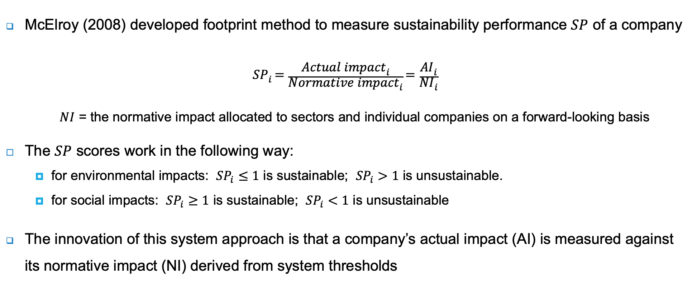
Impact performance
McElroy (2008) developed footprint method to measure sustainability performance $SP$ of a company
$${SP}_{i}=\frac{{Actual impact}_{i}}{{Normative impact}_{i}}=\frac{{AI}_{i}}{{NI}_{i}}$$
$NI$ = the normative impact allocated to sectors and individual companies on a forward-looking basis
The $SP$ scores work in the following way:
  for environmental impacts: ${SP}_{i}≤1$ is sustainable; ${SP}_{i}>1$ is unsustainable.
  for social impacts: ${SP}_{i}≥1$ is sustainable; ${SP}_{i}<1$ is unsustainable
The innovation of this system approach is that a company’s actual impact (AI) is measured against its normative impact (NI) derived from system thresholds

Slide 26
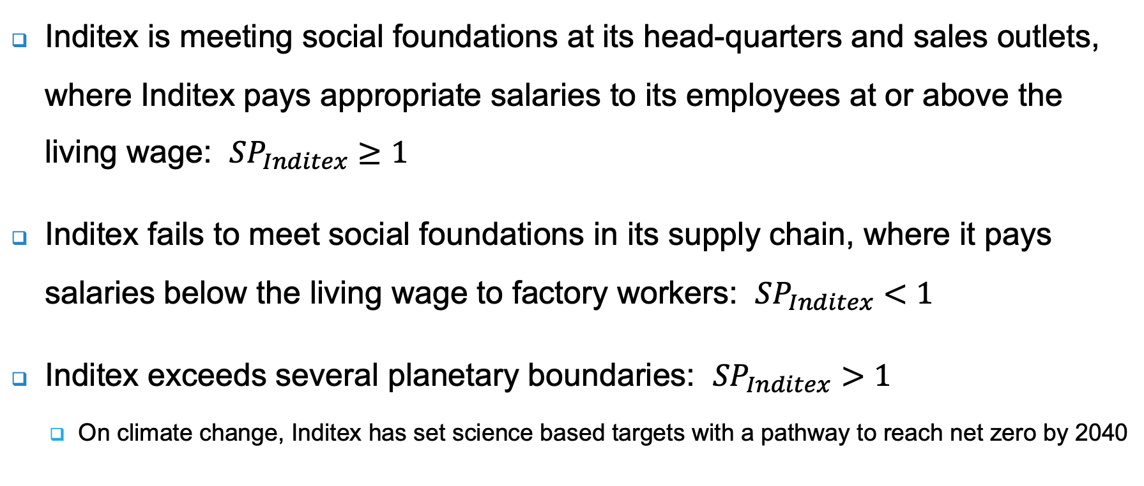
Inditex case
Inditex is meeting social foundations at its head-quarters and sales outlets, where Inditex pays appropriate salaries to its employees at or above the living wage: ${SP}_{Inditex}≥1$
Inditex fails to meet social foundations in its supply chain, where it pays salaries below the living wage to factory workers: ${SP}_{Inditex}<1$
Inditex exceeds several planetary boundaries: ${SP}_{Inditex}>1$
  On climate change, Inditex has set science based targets with a pathway to reach net zero by 2040

Slide 27
Impact investors
A new breed of impact (or integrated) investors is emerging
  Started off as a niche with specialised impact investors, but it is now expanding to mainstream investors
Pension funds, as long-term investors, have started to expand the two-dimensional financial risk-return framework (i.e., CAPM) to a three-dimensional risk-return-impact framework of integrated investing
The rationale behind this is twofold:
  Impact: long-term investors see positive impact as creating
  long-term value and negative impact as a source of future risk
  Responsibility: institutional investors feel a moral responsibility
  to invest responsibly and be accountable to stakeholders
Investment | 2016 USD trillions | 2020 USD trillions | % of market | Compound annual growth
Global AUM | 81.9 | 98.4 |  | 4.7%
Sustainable investing | 22.9 | 35.3 | 35.9% | 11.4%
- ESG integrated | 22.4 | 33.0 | 33.5% | 10.2%
- Impact investing | 0.5 | 2.3 | 2.3% | 44.7%
Source: Global Sustainable Investment Alliance (2021)
+
Financial return
Impact return
+
0
Impact return
Integrated risk
+
_

Slide 28
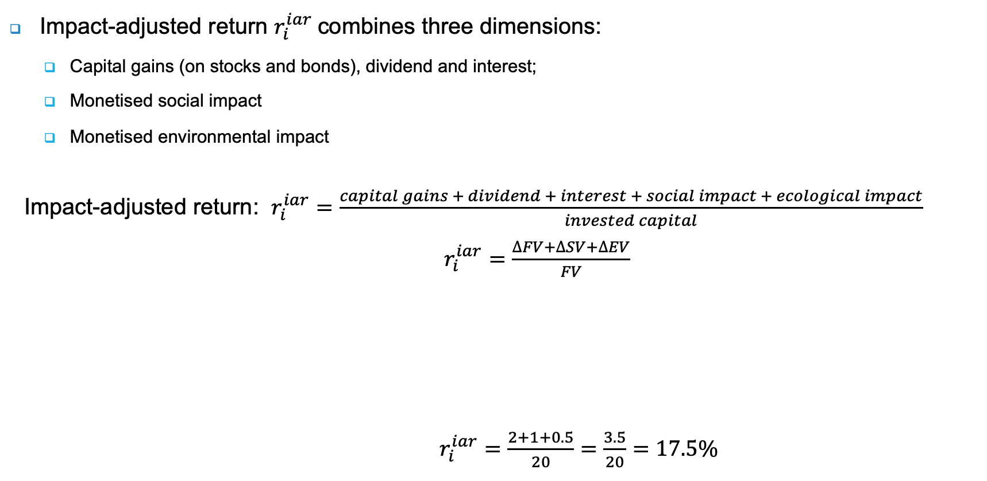
Impact-adjusted return
Impact-adjusted return $r_{i}^{iar}$combines three dimensions:
  Capital gains (on stocks and bonds), dividend and interest;
  Monetised social impact
  Monetised environmental impact
Impact-adjusted return: $r_{i}^{iar}=\frac{capital gains + dividend + interest + social impact + ecological impact}{invested capital}$ $r_{i}^{iar}$ $=\frac{∆FV+∆SV+∆EV}{FV}$
$r_{i}^{iar}=\frac{2+1+0.5}{20}=\frac{3.5}{20}=17.5\%$
Dimension | Value | △ Value | Return
Financial | 20 | 2 | 10.0%
Social | 5 | 1 | 20.0%
Environmental | 3 | 0.5 | 16.7%
Invested capital | 20 | 3.5 | 17.5%

Slide 29
Impact-adjusted return
The table below shows a mixed value creation profile: financially profitable, but still negative on social and environmental dimensions
  Panel A: financial return (10%) is higher than impact adjusted return (5%)
  Panel B: company reduces its negative environmental impact to 0 at a financial cost of 0.5, this reduces financial return (7.5%), but improves impact adjusted return (7.5%)
It becomes clear that the type of investor matters for companies: are companies encouraged to maximise shareholder value or to manage for integrated value?
 | Panel A |  |  | Panel B
Dimension | Value | △ Value | Return | Value | △ Value | Return
Financial | 20 | 2 | 10.0% | 20 | 1.5 | 7.5%
Social | -1 | 0 | 0.0% | -1 | 0 | 0.0%
Environmental | -5 | -1 | 20.0% | -5 | 0 | 0.0%
Invested capital | 20 | 1 | 5.0% | 20 | 1.5 | 7.5%

Slide 30
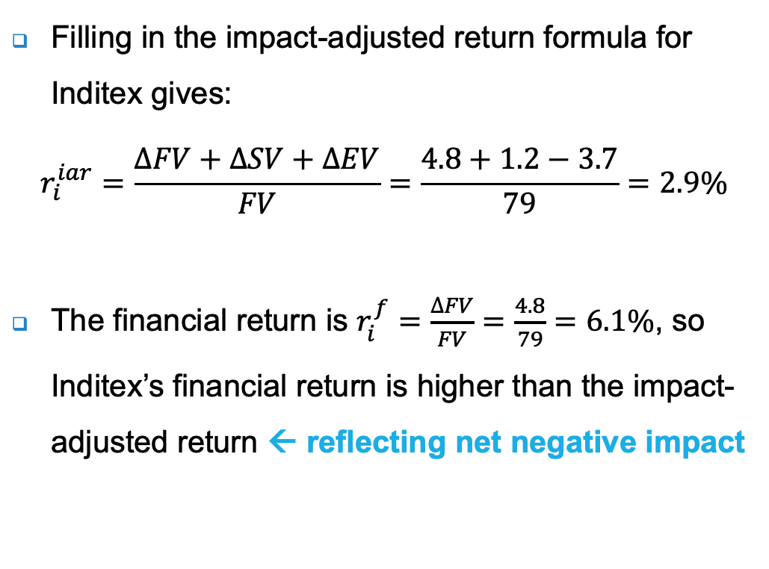
Inditex’s impact-adjusted return
Filling in the impact-adjusted return formula for Inditex gives:
$$r_{i}^{iar}=\frac{∆FV+∆SV+∆EV}{FV}=\frac{4.8+1.2−3.7}{79}=2.9\%$$
The financial return is $r_{i}^{f}=\frac{∆FV}{FV}=\frac{4.8}{79}=6.1\%$, so Inditex’s financial return is higher than the impact-adjusted return ← reflecting net negative impact
IV calculation | Value | Annual value flows
 | (Euro billions) | (Euro billions)
FV (enterprise value) | 79 | 4.8
Positive SV | 283 | 4.1
Negative SV | -173 | -2.9
Negative EV | -183 | -3.7
Invested capital | 79 | 2.3

Slide 31
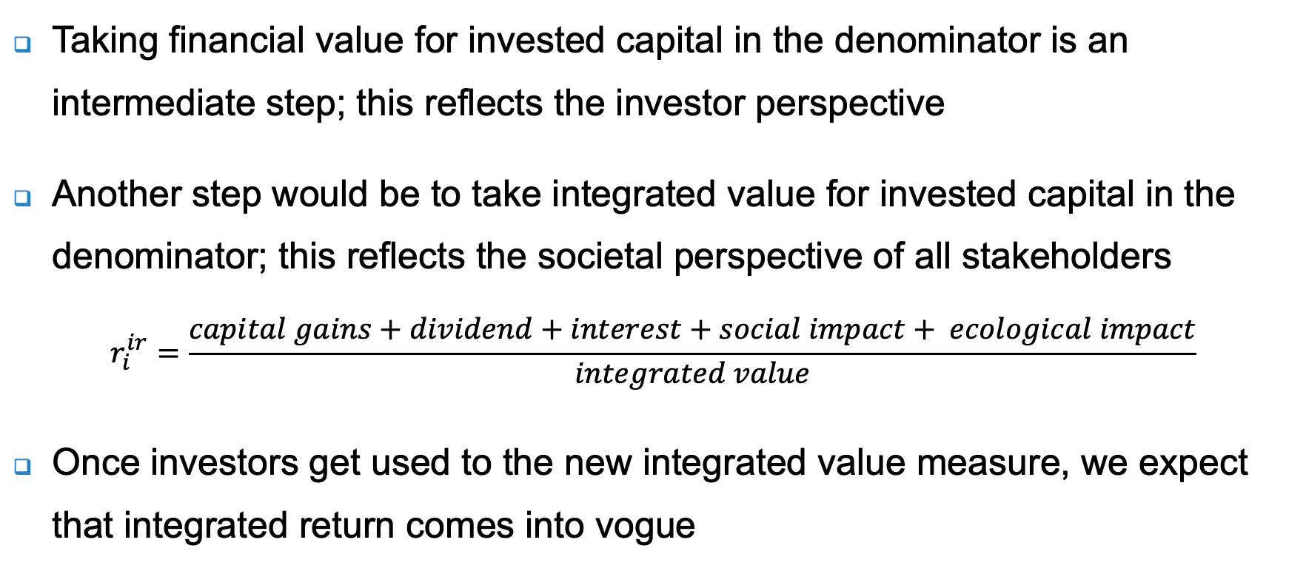
Integrated return
Taking financial value for invested capital in the denominator is an intermediate step; this reflects the investor perspective
Another step would be to take integrated value for invested capital in the denominator; this reflects the societal perspective of all stakeholders
$$r_{i}^{ir}=\frac{capital gains+dividend+interest+social impact+ ecological impact}{integrated value}$$
Once investors get used to the new integrated value measure, we expect that integrated return comes into vogue

Slide 32
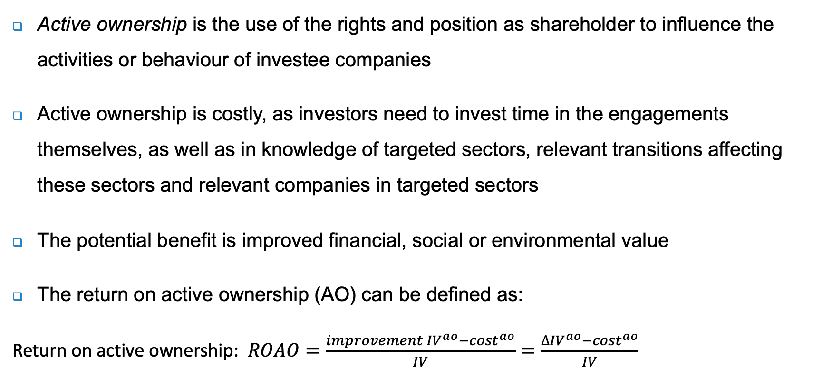
Return on active ownership
Active ownership is the use of the rights and position as shareholder to influence the activities or behaviour of investee companies
Active ownership is costly, as investors need to invest time in the engagements themselves, as well as in knowledge of targeted sectors, relevant transitions affecting these sectors and relevant companies in targeted sectors
The potential benefit is improved financial, social or environmental value
The return on active ownership (AO) can be defined as:
Return on active ownership: $ROAO=\frac{{improvement IV}^{ao}−{cost}^{ao}}{IV}=\frac{{∆IV}^{ao}−{cost}^{ao}}{IV}$

Slide 33
Conclusions
The efficient markets hypothesis states that stock prices incorporate all relevant information instantaneously and that investors cannot consistently beat the market
There is evidence that learning takes time and that adaptive markets are a better description than efficient markets
  It seems that analysts are slow to pick-up sustainability-related information
Academic research and non-governmental organisations (NGOs) play a leading role in producing information on companies’ social and environmental impact
An increasing number of investors also wants impact, resulting in different behaviour, and the need for different metrics, such as impact-adjusted and integrated returns

