Slide 1
Corporate Finance for Long-Term Value
Chapter 6: Investment decision rules

Slide 2
Chapter 6: Investment decision rules
Part 2: Discount rates and valuation methods

Slide 3
The BIG Picture
How to select investment projects?
Traditional solution
Calculate the net present value (NPV) of projects -> based on FV
Do only projects with positive NPV
New solution
Include also SV and EV to obtain Integrated Present Value (IPV)
Analyse the interactions between F, S and E in projects -> internalisation

Slide 4
Calculating financial value
The Net Present Value (NPV) method discounts cash flows at their opportunity cost of capital
NPV rule: investments with a positive NPV should be undertaken
$$NPV=\sum_{t=0}^{n}{\frac{{CF}_{n}}{{(1+r)}^{n}}}>0$$
Year | 2022 | 2023 | 2024 | 2025 | 2026 | 2027 | 2028 | 2029
Cash flow | -100 | 25 | 25 | 25 | 25 | 25 | 25 | 25
Discount factor | 1.00 | 0.91 | 0.83 | 0.75 | 0.68 | 0.62 | 0.56 | 0.51
PV(Cash flow) | -100.0 | 22.7 | 20.7 | 18.8 | 17.1 | 15.5 | 14.1 | 12.8
NPV | 21.7

Slide 5
Calculating financial value
Comparing investment projects using NPV method
Project X
Year | 2022 | 2023 | 2024 | 2025 | 2026 | 2027 | 2028 | 2029
Cash flow | -100 | 25 | 25 | 25 | 25 | 25 | 25 | 25
Discount factor | 1.00 | 0.91 | 0.83 | 0.75 | 0.68 | 0.62 | 0.56 | 0.51
PV(Cash flow) | -100.0 | 22.7 | 20.7 | 18.8 | 17.1 | 15.5 | 14.1 | 12.8
NPV | 21.7
NPV per euro invested:
21.7 / 100 = 21.7%
Project Y
NPV per euro invested:
11.65 / 50 = 23.3%
Year | 2022 | 2023 | 2024 | 2025 | 2026 | 2027 | 2028 | 2029
Cash flow | -50 | 20 | 20 | 20 | 5 | 5 | 5 | 5
Discount factor | 1.00 | 0.91 | 0.83 | 0.75 | 0.68 | 0.62 | 0.56 | 0.51
PV(Cash flow) | -50.0 | 18.2 | 16.5 | 15.0 | 3.4 | 3.1 | 2.8 | 2.6
NPV | 11.65
If project Y can be duplicated, then Y > X

Slide 6
Payback rule
Payback rule: only do an investment if its cash flows pay back the initial investment within a pre-specified period
The payback period is the number of years needed to earn back the initial investment
Advantages: ease of use
Disadvantages:
Payback period is usually arbitrarily determined
Does not account for time value of money
Makes cash flows after cut-off point irrelevant (reinforcing short-termism)

Slide 7
IRR rule
The internal rate of return (IRR) is the discount rate at which a project’s NPV equals zero
IRR Rule: do investment if IRR > opportunity cost of capital
Advantage: indicates safety
Disadvantage: not useful in comparing projects of different sizes
Year | 2022 | 2023 | 2024 | 2025 | 2026 | 2027 | 2028 | 2029
Cash flow | -100 | 25 | 25 | 25 | 25 | 25 | 25 | 25
Discount factor | 1.00 | $$\frac{1}{{(1+r)}^{1}}$$ | $$\frac{1}{{(1+r)}^{2}}$$ | $$\frac{1}{{(1+r)}^{3}}$$ | $$\frac{1}{{(1+r)}^{4}}$$ | $$\frac{1}{{(1+r)}^{5}}$$ | $$\frac{1}{{(1+r)}^{6}}$$ | $$\frac{1}{{(1+r)}^{7}}$$
PV(Cash flow) | -100.0 | ? | ? | ? | ? | ? | ? | ?
NPV | 0
Using trial and error or the IRR formula in Excel:
r = 0.163

Slide 8
IRR rule
Problem when CF sign flips several times (like project A)
Year | 2022 | 2023 | 2024 | 2025 | 2026 | 2027 | 2028 | 2029
CF project A | -200 | 110 | 110 | 110 | -60 | 110 | 110 | -300
CF project B | -150 | 30 | 30 | 30 | 30 | 30 | 30 | 30
For project A, there are two points at which NPV = 0, so there’s no unique solution

Slide 9
NPV vs IRR and payback
Preference for NPV, since:
NPVs can be added up
It is a direct measure of value created for shareholders (the manager’s primary objective)
Method | Project X | Project Y | Project Y twice | Preferred project
NPV | 21.7 | 11.6 | 23.3 | Project Y twice
IRR | 16.3% | 19.6% | 19.6% | Project Y or Project Y twice
Payback rule | 4 | 3 | 3 | Project Y or Project Y twice

Slide 10
Behavioural effects on investment decisions
People often behave irrationally in corporate investment decisions
Internal errors are misvaluations by corporate managers
Overconfidence: underestimating the risk of investments, resulting in a lower discount rate
Excessive optimism: overestimation of cash flows
Ways to spot internal errors: prematurely liquidating options, earnings missed and excessive press coverage
External errors are misvaluations by participants in financial markets
Behavioural biases, e.g., availability bias and confirmation bias

Slide 11
Overconfidence and excessive optimism
Problem
Suppose three managers assess the same project. The table (right) gives their individual estimates of project risk and expected cash flows, as well as an unbiased assessment of project risk and CFs.
What is the unbiased project value?
How much do managers A, B and C think the project is worth?
 | Unbiased | Manager A | Manager B | Manager C
Project risk | 8% | 7.5% | 8% | 7.5%
Perpetual CF | 200 | 200 | 220 | 220

Slide 12
Overconfidence and excessive optimism
Solution
What is the unbiased project value?
$$PV=\frac{CF}{r}=\frac{200}{0.08}=2500$$
How much do managers A, B and C think the project is worth?
Manager A: $\frac{200}{0.075}=2666.7$
Manager B: $\frac{220}{0.08}=2750$
Manager A: $\frac{220}{0.075}=2933.3$
 | Unbiased | Manager A | Manager B | Manager C
Project risk | 8% | 7.5% | 8% | 7.5%
Perpetual CF | 200 | 200 | 220 | 220
Overconfidence resulting in a lower risk assessment
Excessive optimism resulting in a higher CF projection
Both overconfidence and excessive optimism = highest overvaluation

Slide 13
Integrated investment decision rules
Three ways to prioritise investments:
Constrained PV: includes S and E in own units as budget constraint for example: net zero CO₂ emissions; positive health effects
Expanded PV: expresses S and E in monetary values and adds to FV for example: CO₂ emissions x shadow carbon price; health effects x shadow price
Integrated PV: balances FV, SV and EV in formula: $IPV = FV +b∗SV+c∗EV$ with $b, c>0$

Slide 14
Constrained PV
S and/or E function as a budget constraint to the standard NPV on F
Project A contributes to becoming neutral but has a negative NPV, so fails on the constrained PV criterion
Project B and C have positive NPVs but do not contribute to becoming neutral, so also fail on the constrained PV criterion
Project | Investment, € millions | NPV F, € millions | CO₂ emitted, millions | CO₂ stored, millions | NPV≥0? | Contribution to CO₂ emissions ≤0?
A | 70 | -50 | 0 | 1 | no | yes
B | 100 | 200 | 0.2 | 0 | yes | no
C | 20 | 250 | 0.2 | 0 | yes | no

Slide 15
Constrained PV
Combining projects might lead to value creation
Combing both A with B and A with C contribute to becoming carbon neutral and have a positive NPV, so can both be accepted
A with C has a higher NPV compared to A with B, so A with C is preferred
Potential issues: netting pros and cons & including other E and S issues
Project | Investment, € millions | NPV F, € millions | CO₂ emitted, millions | CO₂ stored, millions | NPV≥0? | Contribution to CO₂ emissions ≤0?
A | 70 | -50 | 0 | 1 | no | yes
B | 100 | 200 | 0.2 | 0 | yes | no
C | 20 | 250 | 0.2 | 0 | yes | no
A+B | 170 | 150 | 0.2 | 1 | yes | yes
A+C | 90 | 200 | 0.2 | 1 | yes | yes

Slide 16
Expanded PV
Expresses S and E in monetary values to arrive at SV and EV and then shows these in addition to the standard NPV
Project A and C combined looks much better than any individual project, being strongly positive on all three value dimensions
Project | Investment, € millions | NPV F, € millions | E in own units net CO₂ reduction | EV (€ millions) net CO₂ reduction at 200 Euro/ton | S in own units quality life years added | SV (€ millions) quality life years added at 110k Euro/life
A | 70 | -50 | 1.0 | 200 | - | 0
B | 100 | 200 | -0.2 | -40 | 2,500 | 275
C | 20 | 250 | -0.2 | -40 | 4,000 | 440
A+C | 90 | 200 | 0.8 | 160 | 4,000 | 440

Slide 17
Integrated PV = IPV
SV and EV are not only separately calculated but also added and weighted, along with the NPV to arrive at an integrated value creation number
Simple integrated present value decision model: $IPV=FV+SV+EV>0$
Project | FV | SV | EV | IPV=FV+SV+EV
A | -50 | 0 | 200 | 150
B | 200 | 275 | -40 | 435
C | 250 | 440 | -40 | 650
A+C | 200 | 440 | 160 | 800

Slide 18
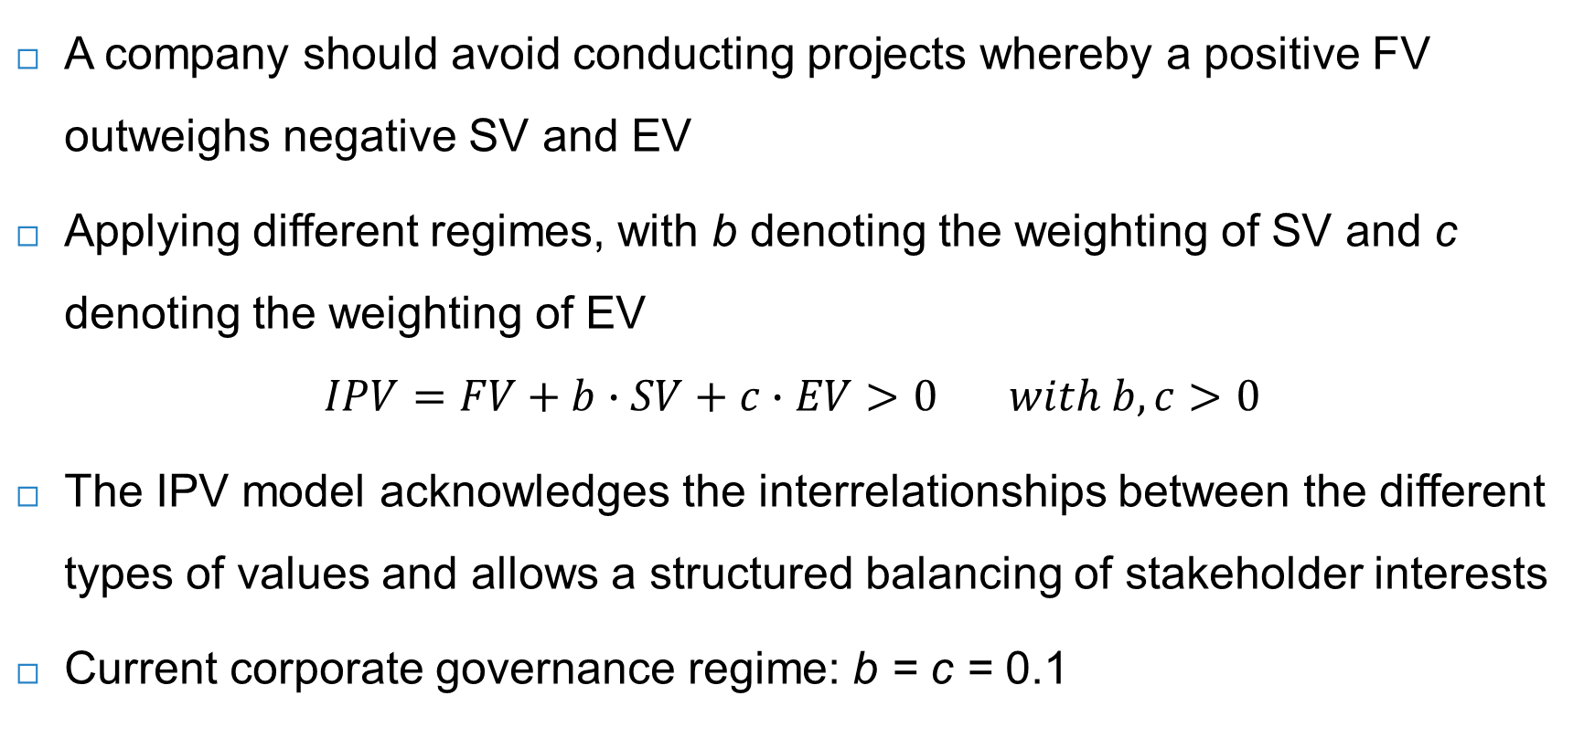
IPV
A company should avoid conducting projects whereby a positive FV outweighs negative SV and EV
Applying different regimes, with b denoting the weighting of SV and c denoting the weighting of EV
$$IPV=FV+b∙SV+c∙EV>0 with b,c>0$$
The IPV model acknowledges the interrelationships between the different types of values and allows a structured balancing of stakeholder interests
Current corporate governance regime: b = c = 0.1

Slide 19
IPV
Intermediate case: b = c = 0.5
Full case: b = c = 1
Which project to choose?
Intermediate case: choose project L
Full case: choose project M
Project | FV | SV | EV | IPV = FV+0.5*SV+0.5*EV | IPV=FV+SV+EV
K | 50 | -50 | -20 | 15 | -20
L | 30 | 30 | -40 | 25 | 20
M | 10 | 60 | -40 | 20 | 30

Slide 20
Internalisation
The three value dimensions (FV, SV and EV) are created jointly, and with similar drivers, and therefore interact and affect each other
Taking a dynamic perspective is very important: do not assume the current conditions will last forever, but acknowledge that they can change
Current loss-making entities may become profitable as their positive externalities get priced
Profitable entities with large negative externalities face the risk of those externalities being (partly) internalised

Slide 21
Internalisation
Project | FV | SV | EV | IPV = FV+0.5*SV+0.5*EV
X | 80 | -20 | -50 | 45
Y | -20 | -30 | 40 | -15
Z | -40 | -50 | 60 | -35
Internalisation due to carbon tax, so FV absorbs 75% of EV
Project | FV (old) | SV | EV | FV (new) = FV (old) + 0.75*EV | IPV with internalisation | IPV without internalisation
X | 80 | -20 | -50 | 42.5 | 7.5 | 45
Y | -20 | -30 | 40 | 10 | 15 | -15
Z | -40 | -50 | 60 | 5 | 10 | -35
With internalisation, project Y becomes more attractive

Slide 22
Internalisation
The probability of internalisation estimates to what extent externalities are likely to be translated into FV effects, driven by transition processes
Expected IPV of project Y under varying probabilities of internalisation
IPV with internalisation | Probability of internalisation | IPV without internalisation | Probability of no internalisation | Expected IPV
15 | 0% | -15 | 100% | -15
15 | 10% | -15 | 90% | -12
15 | 20% | -15 | 80% | -9
15 | 30% | -15 | 70% | -6
15 | 40% | -15 | 60% | -3
15 | 50% | -15 | 50% | 0
15 | 60% | -15 | 40% | 3
15 | 70% | -15 | 30% | 6
15 | 80% | -15 | 20% | 9
15 | 90% | -15 | 10% | 12
15 | 100% | -15 | 0% | 15

Slide 23
Conclusions
When making investment decisions, companies need to be able to compare various investment opportunities - NPV, payback period and IRR
Combining NPV with E and S: constrained PV, expanded PV and integrated PV
F, S and E all weigh in and can be prioritised – ideally informed by the company’s purpose and value creation profile
Internalisation can happen, thereby shifting EV or SV to FV in positive or negative ways

