Slide 1
PRINCIPLES OF
SUSTAINABLE FINANCE
Chapter 11: Insurance –
managing long-term risk
Principles of Sustainable Finance © Schoenmaker and Schramade 2019 Oxford University Press

Slide 2
Overview of the book
Part I: What is sustainability and why does it matter?
Sustainability and the transition challenge
Part II: Sustainability’s challenges to corporates
Externalities - internalisation
Governance and behaviour
Coalitions for sustainable finance
Strategy and intangibles – changing business models
Integrated reporting - metrics and data
Part III: Financing sustainability
Investing for long-term value creation
Equity – investing with an ownership stake
Bonds – investing without voting power
Banks – new forms of lending
Insurance – managing long-term risk
Part IV: Epilogue
Transition management and integrated thinking
Principles of Sustainable Finance © Schoenmaker and Schramade 2019 Oxford University Press

Slide 3
Learning objectives – chapter 11
explain the nature of insurance business
identify the physical risk of catastrophes
appreciate the liability risk for environmental hazards
understand the basics of catastrophe modelling
explain the function of micro-insurance
Principles of Sustainable Finance © Schoenmaker and Schramade 2019 Oxford University Press

Slide 4
Insurance and catastrophe risk
Principles of Sustainable Finance © Schoenmaker and Schramade 2019 Oxford University Press

Slide 5
Large claims: catastrophes
Heavy-tailed distribution
Principles of Sustainable Finance © Schoenmaker and Schramade 2019 Oxford University Press

Slide 6
Catastrophes: the most costly insurance losses

Slide 7
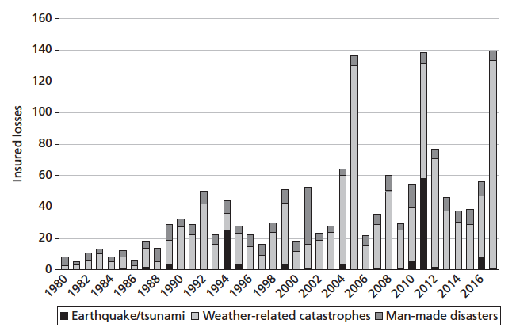
Insured catastrophe losses are rising
Principles of Sustainable Finance © Schoenmaker and Schramade 2019 Oxford University Press

Slide 8
How to share risk of catastrophe?
Individual insurers cannot bear large losses on their own
Cat bond: corporate bond that allows issuer to skip payments if accident happens in return for higher return
Government programme: for example, flood risk
Reinsurance: slicing in layers and divide among more insurers
Principles of Sustainable Finance © Schoenmaker and Schramade 2019 Oxford University Press

Slide 9
Why does sustainability matter to insurance?
Principles of Sustainable Finance © Schoenmaker and Schramade 2019 Oxford University Press

Slide 10
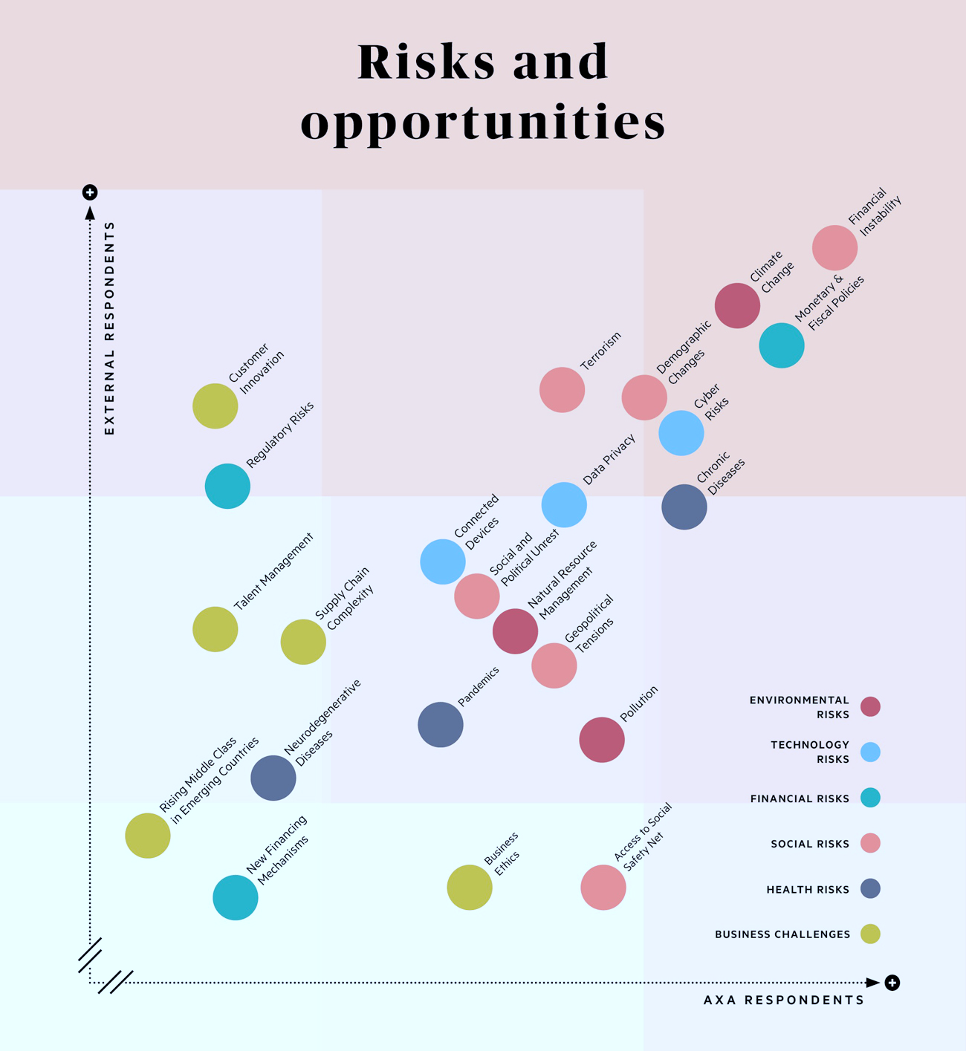
AXA’s materiality matrix
Notes:
The tools are there to make the connection

Slide 11
Swiss Re’s climate change policy
Advancing its understanding of climate change risks, quantifying and integrating it into its risk management and underwriting frameworks
Developing products and services to mitigate or adapt to climate risk
Raising awareness about climate change risks through public dialogue, and advocating a worldwide policy framework for climate change
Tackling its own carbon footprint and ensuring transparent, annual emissions reporting
Principles of Sustainable Finance © Schoenmaker and Schramade 2019 Oxford University Press

Slide 12
Sustainability scores of Allianz (by RobecoSAM)
Principles of Sustainable Finance © Schoenmaker and Schramade 2019 Oxford University Press
Notes:
The tools are there to make the connection

Slide 13
Managing long-term catastrophe risk
Principles of Sustainable Finance © Schoenmaker and Schramade 2019 Oxford University Press

Slide 14
Catastrophe model
1. The hazard component estimates the extent and intensity of the natural catastrophe
2. The vulnerability component assesses the relative damage to the assets (like property and infrastructure)
3. The exposure component is split between building values, contents values and business interruption values
4. The financial loss component translates the physical damage into total monetary loss before the application of insurance
5. The platform component integrates the four model components
Principles of Sustainable Finance © Schoenmaker and Schramade 2019 Oxford University Press

Slide 15
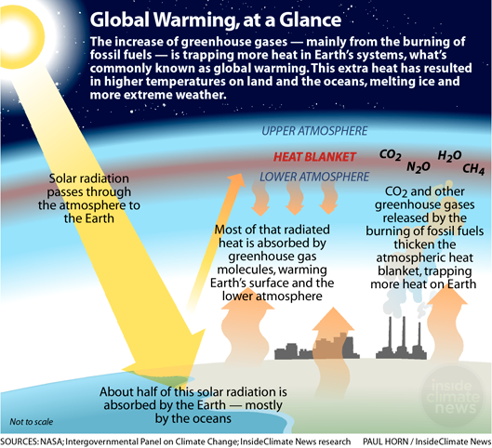

Slide 16
Climate change intensifies natural hazards
Temperature change (heat waves)
Sea-level rise
Droughts
Hurricanes (tropical cyclones)
Heavy rainfall
Flooding
Landslides
Principles of Sustainable Finance © Schoenmaker and Schramade 2019 Oxford University Press

Slide 17
Projections by the IPCC
Upper line: the highest carbon emission scenario
Lower line: most stringent carbon emission reduction scenario (‘only’ +2⁰ Celsius)
Principles of Sustainable Finance © Schoenmaker and Schramade 2019 Oxford University Press

Slide 18
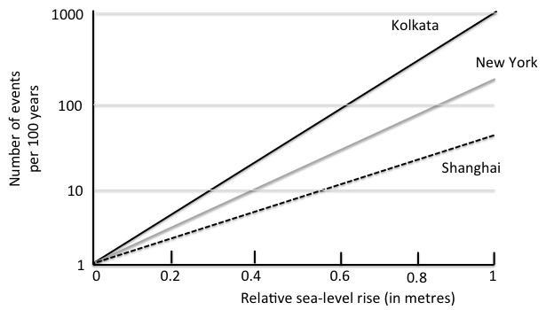
Sea-level rise
Increase of frequency of present 100-year events with rising sea levels
Principles of Sustainable Finance © Schoenmaker and Schramade 2019 Oxford University Press
Notes:
The tools are there to make the connection

Slide 19
Mitigation and adaptation
Mitigating strategies
Reducing carbon emissions very important to reduce climate change
But even if global temperature stabilised, sea-level will rise as the deep ocean warms slowly
Adaptation to minimise disruptions
Insurance provides financial risk transfer, but not against physical impact
Also disaster risk reduction measures: early warning, education, etc.
Low and middle-income countries more affected by adverse weather events
Global climate risk pool to help these countries at macro level
But can only insure extreme events that strongly exceed trend line
Principles of Sustainable Finance © Schoenmaker and Schramade 2019 Oxford University Press

Slide 20
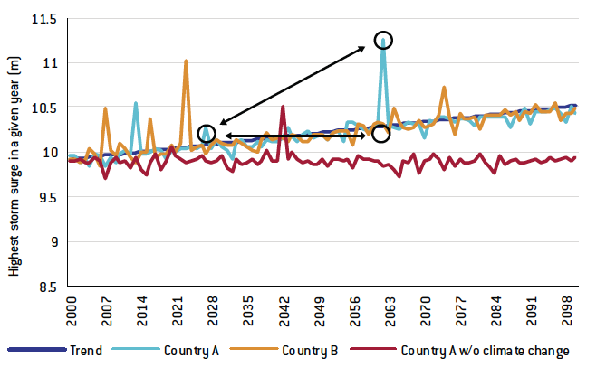
Climate risk pool for annual storm-surge
Principles of Sustainable Finance © Schoenmaker and Schramade 2019 Oxford University Press

Slide 21
Micro-insurance
Micro-insurance: financial protection of low-income people and micro-enterprises
Health risks (illness, injury, death) and property risks (damage or loss)
Wide variety of micro-insurance risks (e.g. crop insurance, health insurance)
Helps to deal with unexpected shocks avoiding the poverty trap
Suppliers
Commercial insurers
Community-based organisations and cooperatives
Microfinance institutions
Impact
Economic: micro-insurance firms are difficult to sustain + make profitable
Social: improved access to healthcare + reduced catastrophic expenditures
Principles of Sustainable Finance © Schoenmaker and Schramade 2019 Oxford University Press

Slide 22
Conclusions
Insurers play key role in managing catastrophe risk
Mitigation to reduce emissions
Adaption to deal with natural hazards
And managing liability risks
Long-term impact of climate change is uncertain
Catastrophe models to capture LT trends of natural hazards
Projected sea-level rise increases, for example, flooding of coastal areas
Micro-insurance can protect low-income individuals against shocks
Principles of Sustainable Finance © Schoenmaker and Schramade 2019 Oxford University Press
Notes:
The tools are there to make the connection

