Slide 1
Innovating for sustainable business a DSM story
Dimitri de Vreeze
Royal DSM
Member of the Managing Board

Slide 2
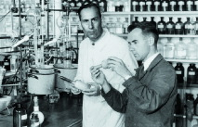
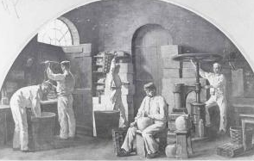
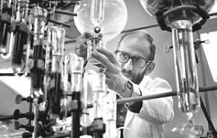
Building on an impressive history
“One DSM”
Vitamins & Omega’s
Carotenoids
Premixes for food & feed
Enzymes
Minerals
Cultures & Yeasts
Nutraceuticals
Pharma products & services
Anti-infectives
Cellulosic bioethanol
Biomedical materials
Bio-plastics
High Performance Plastics
Polyamides and precursors
Resins for coatings and composites
Functional Materials
Solar – advanced surfaces
Hoffman La Roche’s Vitamins (1930s)
chemical synthesis & biotechnology
Life Sciences
Gist-Brocades (1869)
biotechnology
Materials Sciences
DSM (1902)
energy, chemistry & polymer technology
Page 14

Slide 3
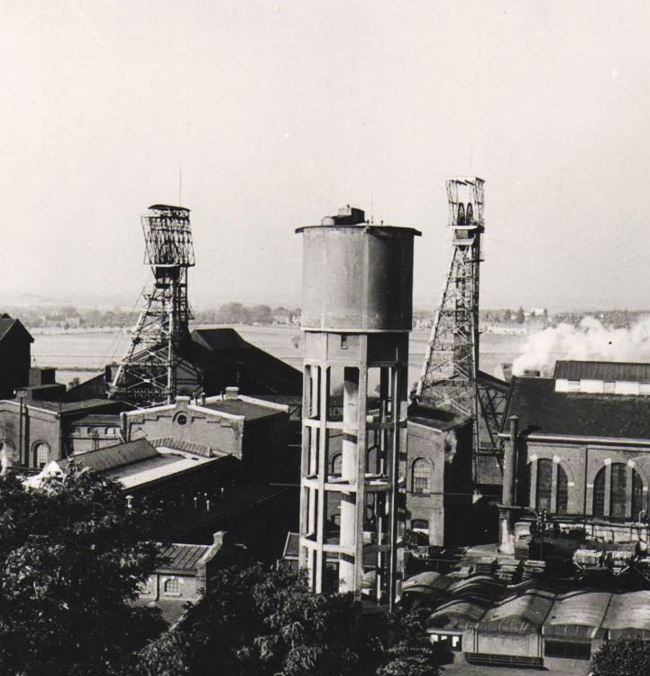
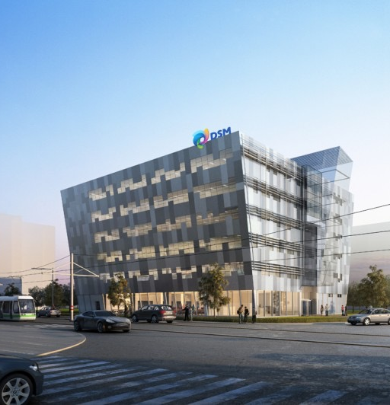
Mature company with long history
Page 15
Notes:
I work at a cooperation.
We have been around for over 100 years.
We are perceived as very mature, a solid part of society, at least of Dutch society.
We pride ourselves on knowing our markets, our customers, the future of our customers, and we have the right resources in place to make this future happen.
It sounds like we can be confident that we can continue down this path as long as we can maintain it, right? Wrong. There is a saying that goes: “Innovation is anything, but business as usual.”

Slide 4
Age not a guarantee for success
Page 16
Notes:
Just as with humans, experience and age are no guarantee for future success. The world changes, and the learning curves of big companies like DSM are based on old assumptions.

Slide 5
DSM at a glance*
Global presence ~24,500 employees worldwide
Listed at Euronext NYSE Share price quintupled in 25 years
Sustainability leader Top ranking Dow Jones Sustainability Index
Sales ~ €10 billion
EBITDA ~ €1.3 billion
DSM is a global Life Sciences and Materials Sciences company active in health, nutrition and materials
DSM delivers innovative solutions that nourish, protect and improve performance in global markets such as food and dietary supplements, personal care, feed, medical devices, automotive, paints, electrical and electronics, life protection, alternative energy and bio-based materials
* 2013 numbers total DSM
Page 17

Slide 6
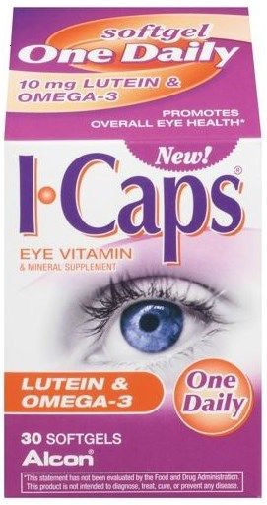
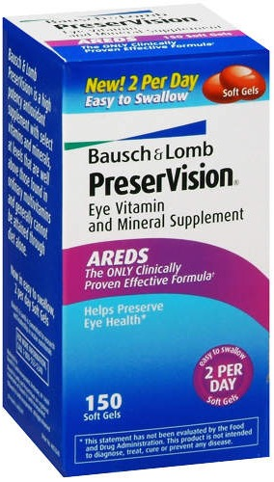
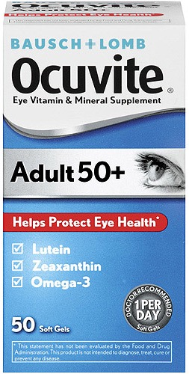
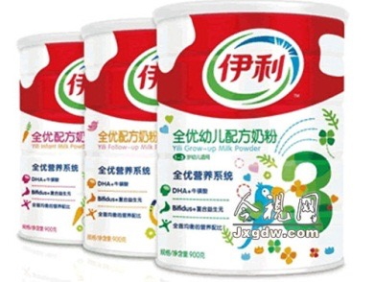
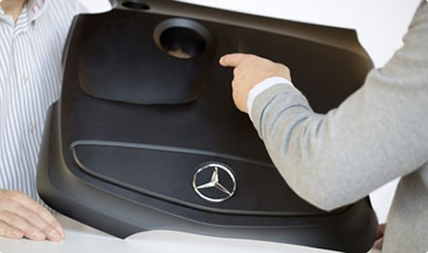
Leader in Health, Nutrition and Materials
Health
Nutrition
Materials
Leading supplier of nutritional ingredients (including vitamins, carotenoids, poly-unsaturated fatty acids, food/feed enzymes, cultures, yeasts, nutraceuticals) for the feed, food and personal care industries
Leading solution provider in sustainable high performance materials for the automotive, electrics and electronics and building & construction industries
Recognized top innovator, active in biomedical materials, advanced biofuels, bio-based chemicals and advanced surfaces for solar systems
Page 18

Slide 7
Growth driven by global megatrends
Aging population
Population growth
Resources constraints
Healthcare costs
Urbanization
Energy security
Food security
Wealth
Sustainability
Health
Nutrition
Materials
Page 19

Slide 8
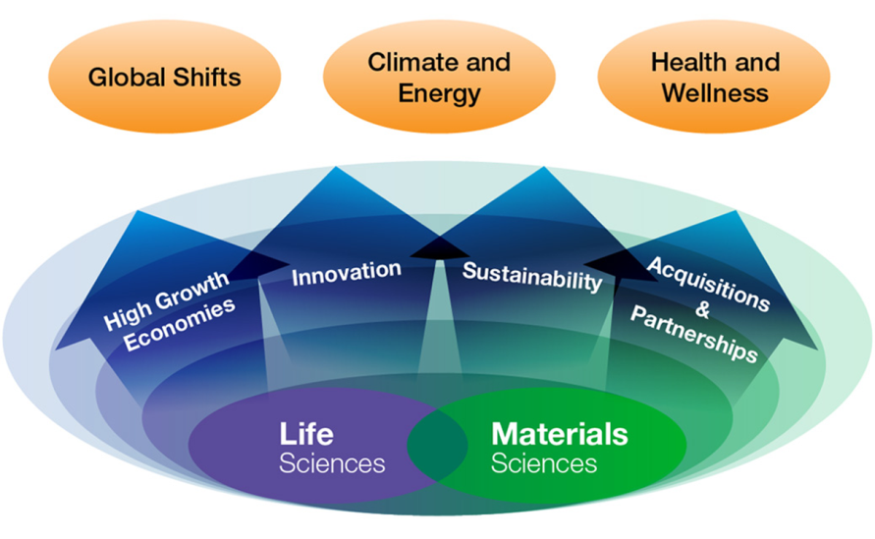
DSM in motion: driving focused growth
DSM’s strategic commitment to sustainability: People - Planet - Profit: creating value along three dimensions
Page 20

Slide 9
2015 targets
Profit targets 2015
EBITDA margin 14% - 15%
ROCE 11% - 12%
Strategic target 2015
Organic sales growth 5%-7% annually
High Growth Economies sales about 45% of total sales
Innovation sales 20% of total sales
ECO+ sales towards50% of total sales
Page 21
Page 34

Slide 10
Aligned with clear sustainability aspirations
Sustainability aspirations 2011 – 2015 |  | 2013
Dow Jones Sustainability Index | Top ranking (“SAM Gold Class”) | Gold class per 2014
Eco+ (innovation) | at least 80% of pipeline is ECO+ | >95%
Eco+ (running business) | from ~34% towards 50% | 45%
Energy efficiency | 20% improvement in 2020, compared to 2008 | 13% improvement
Greenhouse Gas Emissions | -25% (absolute) by 2020, compared to 2008 | 2013: 2% increase
Employee Engagement Survey | towards High Performance Norm | 2013: 71% favorable
Diversity People+ | Women in executive positions 21% DSM People LCA | 2013: 11% Draft framework in place
Page 22
Page 35

Slide 11
Sustainability anchored in Short Term Incentives
50%
Financial Goals
20% EBITDA
15% Gross Free Cash Flow
15% Net Sales Growth
50% Sustainability & Individual Goals
10% Eco+ products
10% Safety
10% Employee Engagement Index
20% Individual: Quantitative & Qualitative Measures
Financial Threshold
Minimum performance threshold for STI payout
(set annually by Supervisory Board)
Page 23

Slide 12
As well as in Long Term Incentives Management
50%
Financial Goals
25% Total Shareholder Return
25% Return on Capital Employed (ROCE)
25% Green House-Gas Emissions (GHGE) reductions
50% Sustainability Goals
25% Energy Efficiency Improvement (EEI)
Page 24

Slide 13
Value creation for all stakeholders
People – Planet - Profit
People+: Product solutions creating measurable better impact on people’s live than competing alternatives
ECO+: Product solutions creating more value with less environmental impact than competing alternatives
Our mission is to create brighter lives for people today and generations to come
Page 25
Page 39

Slide 14
Remember ? Did you know?
1/3 of food goes to waste
1/3 of water used for irrigation is lost
10 earths for energy demand in 2050
1,5 hour of what the sun brings the earth ?
There will be a 2nd China in 10 years …. ?
An opportunity !!
Page 27

Slide 15
Biobased economy: “back to the future” 生物科技：“回到未来”
Oil consumption （石油消耗）
1000
2000
3000
A brief
moment
in history
Living off the land
Living off the land
Innovation to play a major role in the transition
from fossil resources to renewable resources
创新在转变中起到关键作用
从化石基能源到可再生能源
Page 28
Notes:
The fossil age has been characterized by unprecedented economic, technological, scientific and societal advances. However in 250 years from now the world could be described as “addicted to non-renewable resources out of the ground”. So what options do we have when we run out of (affordable) fossil resources?
In fact only one: we will need to go back (back to the future) to living off the land again: starting to rediscover the use of renewable resources that nature provides: the land, the sun, the wind and the sea (water). We will move from a fossil-based economy to a renewables-based economy.

Slide 16
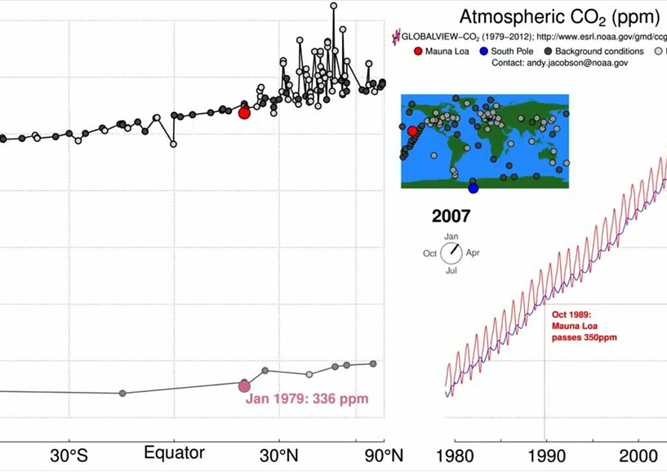

Slide 17
Sustainability is a strong business driver
Well on track towards 2015 aspiration of 50%
More than 90% of DSM’s innovation pipeline is ECO+, strongly driving a greener portfolio
ECO+ sales have grown ~10%/year since 2010
ECO+ sales have significantly higher contribution margins versus non-ECO+ sales
Sustainable solutions delivering higher growth and higher margins
Bio-based Coating Resins
Page 31
Notes:
3 questions for Rob van Leen / Gerard:
Please give us a list with larger examples contributing to the almost 2bn sales from innovation:
examples / photo’s of projects > euro 25m
For these large innovations, Feike requires:
short description
Market size
DSM’s potential
Margin potential
Check with Rob / Gerard : the 20% target by 2015: is that still achievable?
,

Slide 18
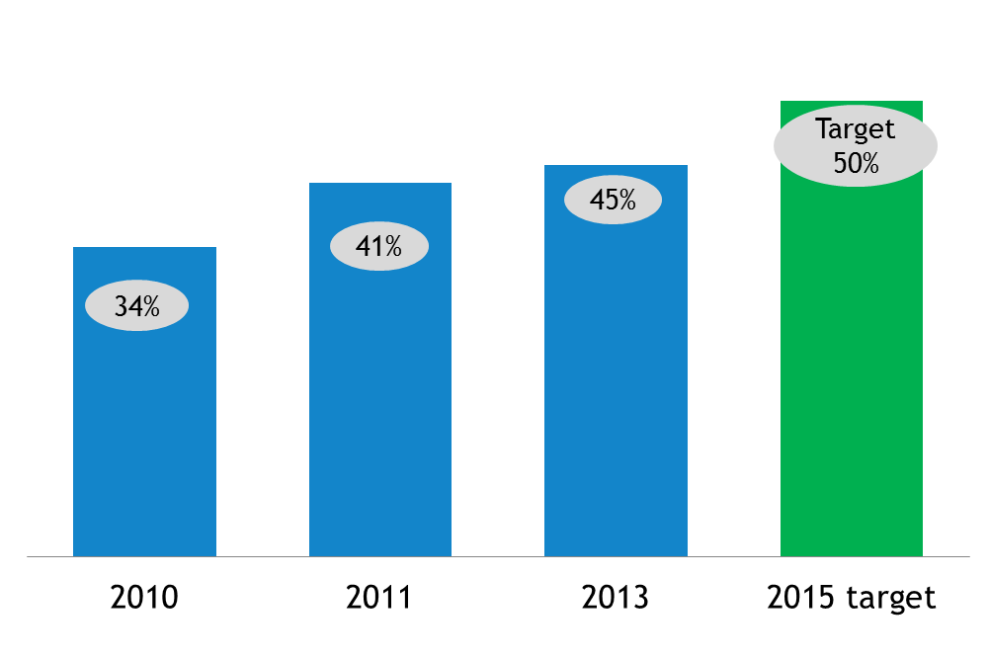
Sustainability as a strong business driver
Share of ECO+ solutions in running portfolio to 45% in 2013
ECO+ sales have grown ~10%/year since 2010
ECO+ sales have ~10% higher contribution to margins versus non-ECO+ sales
ECO+ solutions delivering higher growth and higher margins
Page 32

Slide 19
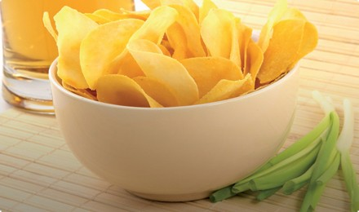
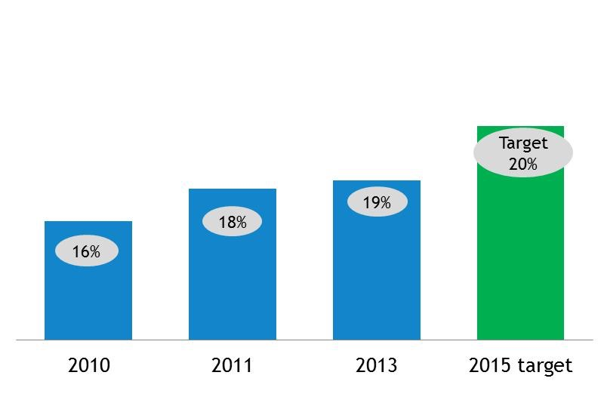
Innovation strongly contributes to DSM’s growth
DSM’s innovation activities are focusing on products & solutions that nourish, protect and improve performances, within existing businesses
Next to that, DSM invests in new emerging innovation platforms, instrumental in turning innovations in major businesses
Maxarome® replacing salt, reducing health risks, whilst maintaining a good taste
Innovation Sales (as % of total sales)
BluCure™ cobalt-free technology for composites eliminates exposure of workers to cobalt
Innovation is our passion
Page 33

Slide 20
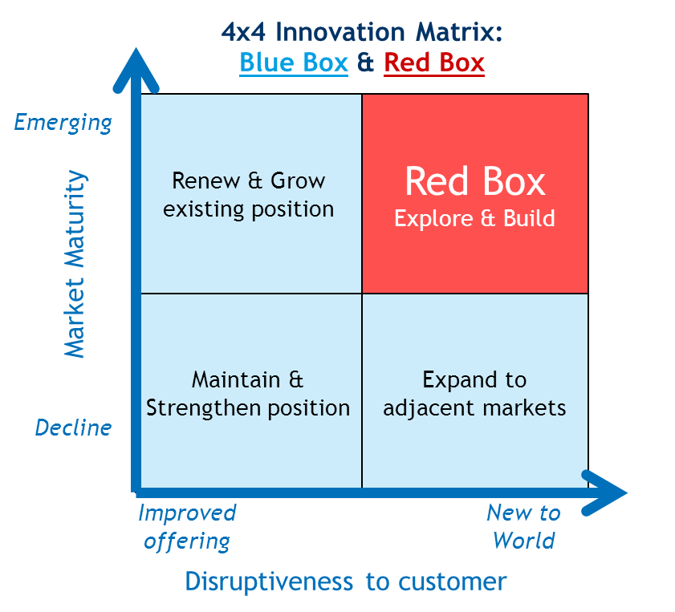
Further intensifying (open) innovation
Discovery
Concept
Incubation
Expansion
Running Business
New themes LS
Biomed. Actamax
Stevia
HyD®
Human
EcoPaxx
Next Gen
AR Coating / Solar
Dyneema®
Diamond
Biomed Drug Delivery
Biofuels
New themes MS
BluCure
CleanCow
Bio-chemicals
Radical innovation (“Red box activities”) represents ~25% of DSM’s total innovation
R&D / Innovation will be intensified further in 2014/2015, including more open Innovation
Innovation creating sustainable future value
Page 35

Slide 21
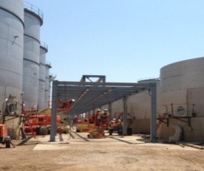
Three attractive innovation platforms established
DSM Biomedical
Innovative materials that deliver more advanced clinical procedures and improved patient outcomes
DSM Bio-based Products & Services
DSM Bio-based Products & Services
Advanced Enzymes and Yeast platforms: enabling Advanced Bio-Energy and Bio-based chemicals
DSM Advanced Surfaces
Smart coatings and surface technologies to boost performance in the solar industry
Bringing Life Sciences and Materials Sciences competences together
Page 36

Slide 22
Page 37

Slide 23
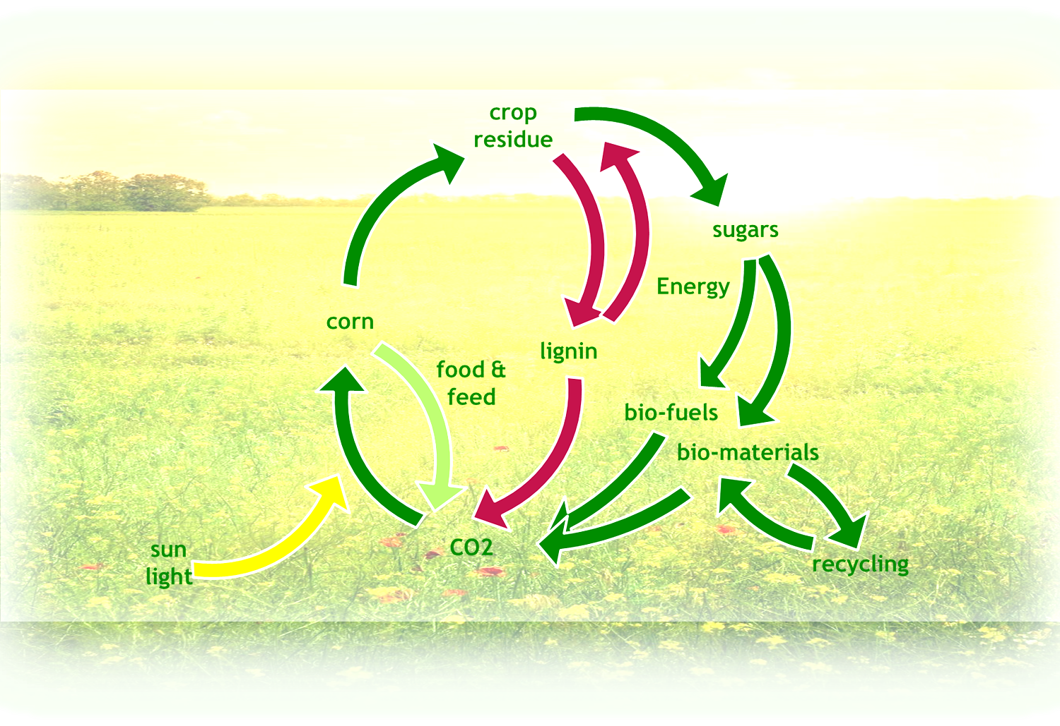
Co-creating a bio-based circular economy
Closing the loop: Producing Food, Energy and Materials
Page 38

Slide 24
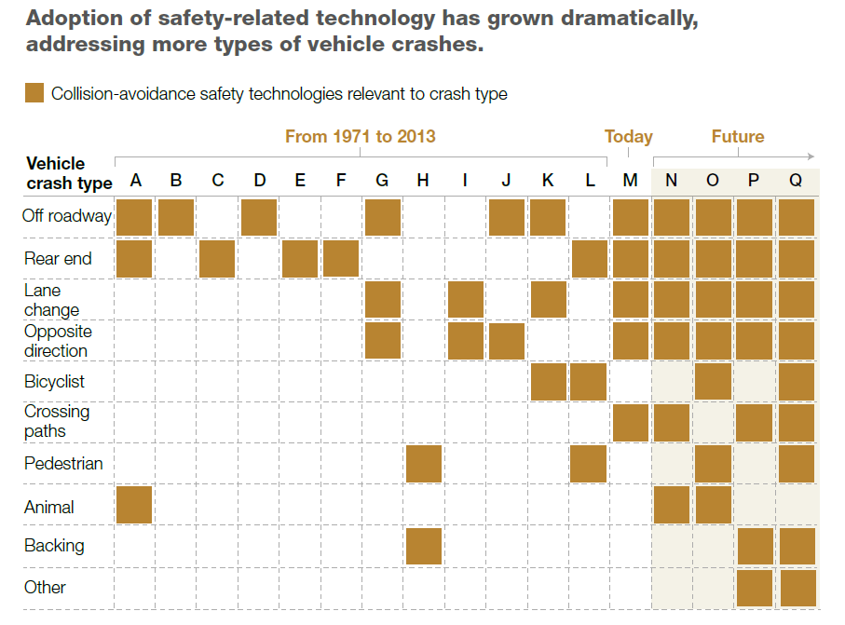
Safety
Page 40

Slide 25
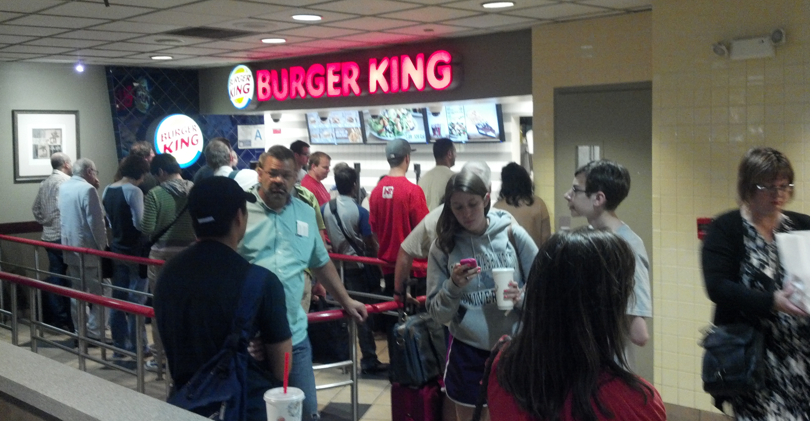
Shouldn’t we be looking for solutions for REAL societal issues?
Page 41
Notes:
Innovation has to make sure that we are developing products for REAL societal issues. If the purpose of innovation is not to find solutions for real societal challenges, we might end up with products that no one really is waiting for.

Slide 26
Sustainable partnerships to combat malnutrition
Offering tailored nutritional solutions to fight hunger and malnutrition around the world
DSM - UN World Food Program partnership strengthened to combat global malnutrition: double number of beneficiaries to 30 million per year by 2015
DSM is engaged in various nutrition partnerships, including: Scaling Up Nutrition movement (SUN), US Agency for International Development (USAID), Mercy Corps’ food cart social enterprise KeBAL, World Vision International, Partner for Food Solutions
People, Planet, Profit:
We cannot be successful in a world that fails
Page 42

