Slide 1
Corporate Finance for
Long-Term Value
Chapter 11: Case Study Integrated Valuation: Inditex

Slide 2
Chapter 11: Case Study Integrated Valuation: Inditex
Part 3: Valuation of companies

Slide 3
The BIG Picture
A case study of Inditex to show how integrated valuation can be done
Findings
Strategy and business model of fast fashion is built on high sales with new collections based on strong consumer brand (FV, SV⁺)
At the cost of workers in supply chain (SV⁻) and environment (cotton, pollution, burning) (EV⁻)
Integrated valuation reflect these facts: SV⁺, SV⁻ and EV⁻ components larger than FV
Many assumptions needed in analysis as company information on sustainability is very limited

Slide 4

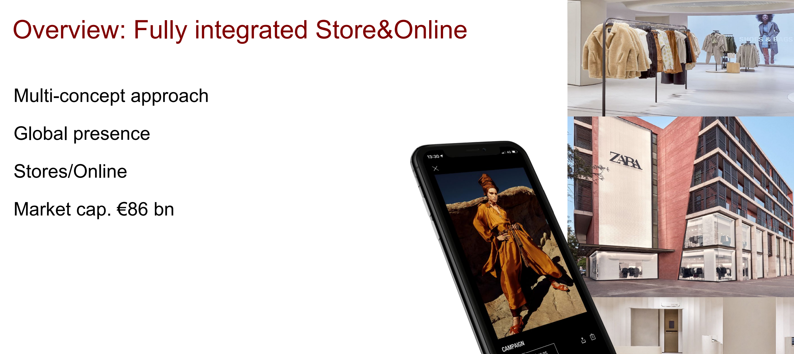
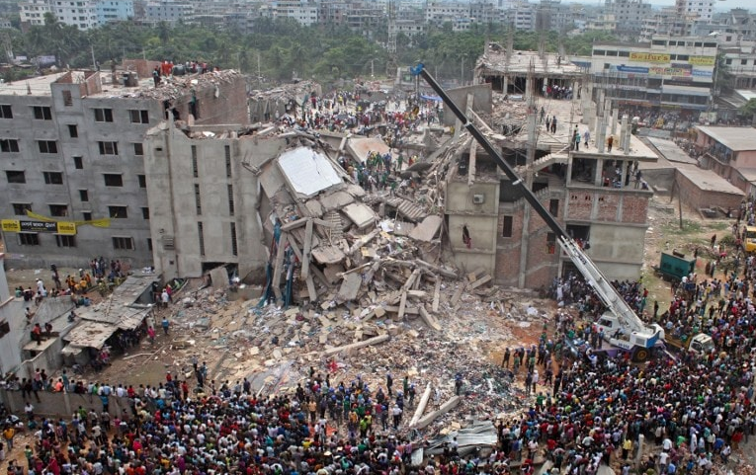
Inditex case study
Notes:
SV and EV almost zero in shareholder model

Slide 5
The company
Industria de Diseño Textil (translated: ‘Textile Design Industry’) is a Spanish clothing company
Biggest fashion group in the world with 7,200 stores in 93 countries
IPO in 2001 with a €9 billion valuation
Most sales (60%) in Europe, specifically Spain (25%), with presence in APAC (25%) and the Americas (14%)

Slide 6
Company value drivers: sales
 | 2011 | 2012 | 2013 | 2014 | 2015 | 2016 | 2017 | 2018 | 2019 | 2020
Sales (€ billions) | 13.8 | 15.9 | 16.7 | 18.1 | 20.9 | 23.3 | 25.3 | 26.1 | 28.2 | 20.4
Sales growth | 10.4% | 15.2% | 5.0% | 8.4% | 15.5% | 11.5% | 8.6% | 3.2% | 8.0% | -27.7%
Inditex has produced consistent growth numbers during the 2010s
The lower growth towards the end of the decade could indicate a fading growth profile
Due to the Covid-19 pandemic, Inditex saw a staggering drop in sales globally in 2020

Slide 7
Company value drivers: profitability
 | 2011 | 2012 | 2013 | 2014 | 2015 | 2016 | 2017 | 2018 | 2019 | 2020
EBIT (€ millions) | 2,522 | 3,117 | 3,070 | 3,198 | 3,677 | 4,021 | 4,314 | 4,357 | 4,772 | 1,507
EBIT margin | 18.3% | 19.6% | 18.4% | 17.7% | 17.6% | 17.3% | 17.1% | 16.7% | 16.9% | 7.4%
EBITDA (€ millions) | 3,258 | 3,913 | 3,926 | 4,103 | 4,699 | 5,083 | 5,277 | 5,457 | 7,598 | 4,552
EBITDA margin | 23.6% | 24.6% | 23.5% | 22.7% | 22.5% | 21.8% | 20.9% | 20.9% | 26.9% | 22.3%
Inditex’s profitability has been remarkably consistent throughout the last decade
The company’s EBITDA has also performed well, although decreasing slightly over time
The growth in EBITDA compared to EBIT in 2019 indicates an increase in depreciation due to a sizeable growth in assets

Slide 8
Company value drivers: capital
 | 2011 | 2012 | 2013 | 2014 | 2015 | 2016 | 2017 | 2018 | 2019 | 2020
Total Assets | 10,959 | 12,890 | 13,756 | 15,377 | 17,357 | 19,621 | 20,231 | 21,684 | 28,391 | 26,418
Sales / Assets | 1.26 | 1.23 | 1.21 | 1.18 | 1.20 | 1.19 | 1.25 | 1.20 | 0.99 | 0.77
Capex | -1,349 | -1,599 | -1,351 | -1,847 | -2,416 | -2,396 | -833 | -1,875 | -2,377 | 2,514
Capex / Sales | 9.8% | 10.1% | 8.1% | 10.2% | 11.6% | 10.3% | 3.3% | 7.2% | 8.4% | -12.3%
Except for 2020, Inditex showed a strong financial performance over the past decade
Assets grew faster than sales as shown by the falling sales-to-assets ratio, potentially indicating reduced efficiency
In 2020, capex was negative indicating divestment of assets

Slide 9
Business model
Customer value proposition
Fashionable clothing at decent prices
Profit formula
Sales/IC > 1
Hence high ROIC
Key resources and processes
8 brands
Double digit EBIT margin driven by scale & efficiency
In their own words (AR, p44): “to offer our customers fashion items that meet the most demanding design, safety, sustainability and quality standards, at affordable prices.”
Integrated but outsourced supply chain
“Over time, we have developed a unique business model characterised by flexibility, integration, sustainability, creativity and innovation. Key to our management is the ongoing, centralised analysis of information on business development.” (AR p44)
Frequent new collections
Driven by frequently issuing new collections, produced in an outsourced supply chain, to minimise costs and maintain high ROIC

Slide 10
Purpose
A company’s purpose is the reason for its existence, grounded in the way it creates value for its clients and other stakeholders
Inditex does not explicitly state their purpose in their reporting, although implicitly mention it on their website:
“Our workforce never loses sight of the customer. We work to create value beyond profit, putting people and the environment at the centre of our decision-making, and always striving to do and be better. It is fundamental to how we do business that our fashion is Right to Wear.”
Conclusion: Inditex’ purpose is a question mark, and so is the fit of the purpose with what stakeholder want and what is needed for navigating transitions

Slide 11






Stakeholders & Stakeholder Impact Map
The stakeholders of Inditex (as identified by the company)
Customers
Employees
Suppliers
Community
Environment
Shareholders
Source: Adapted from Inditex Annual Report 2020, page 42
Stakeholders | Goals | Helped or hurt?
Customers | Fast fashion at low prices | They get it – they are the company’s focus of attention
Own employees | Decent pay & working conditions | Reasonably, they meet the official standards
Employees elsewhere in the chain | Decent pay & working conditions | Poor wages & working conditions, left to local suppliers
Suppliers | Profitability, growth and stability | Profitability and growth probably better than alternatives, but not stability: unreliable as orders are easily cancelled
Nature (Inditex: environment) | Operate within planetary boundaries | Hurt by high GHG emissions and waste
Investors (Inditex: shareholders) | High financial returns | So far, yes
Governments (Inditex: community) | Economic activity & taxes | Yes
Note: Authors’ assessments. We identify roughly the same stakeholders as Inditex does, but some with different labels as the scope is slightly different
Main frictions as a result of business model

Slide 12
Financially material sustainability issues
Overview of the issues that Inditex deems material:
  Ethical behaviour and governance
  Risk management and control systems
  Stakeholder engagement
  Responsible communication
  Value chain transparency and traceability
  Responsible purchasing practices
  Value creation
  Innovation
  Customer orientation
  Diversity, equality and inclusion
  Quality of employment
  Human rights
  Safe and healthy environments
  Talent management
  Socially sustainable production environments
  Climate change
  Environmental footprint minimisation
  Protection of natural resources
  Product sustainability
  Circularity

Slide 13
External impacts
External impacts are very important to society:
  What kind of positive and/or negative external impacts does the company generate?
  To what extent does the company report about these external impacts?
  Can they be quantified, or even be priced?
Companies can compile impact-weighted accounts:
  Impact-weighted P&L
  Impact-weighted balance sheet
Impact Economy Foundation gives guidance in its Impact-Weight Accounts Framework (IWAF)

Slide 14
External impacts
Key impact categories | Likely positive or negative | Problematic if substantially negative
Profit | P
Salaries | P
Interest payments | P
Taxes | P
Payments to suppliers | P
Payments from clients | N
Cost of capital | N
Change in fixed assets | ?
Client value of products | P
Client value of services | N/A
Value of impact materials | N | potentially
Creation of intellectual capital | P
Wellbeing of employment | ? | potentially
Key impact categories | Likely positive or negative | Problematic if substantially negative
Value to employees due to training and experience | P
Effects on human health | N | potentially
Occupational health & safety incidents | N | potentially
Time invested by employees | N
Contribution to/limitation of climate change | N | potentially
Contribution to/limitation of pollution* | N | potentially
Contribution to/limitation of availability of scarce natural resources** | N | potentially
Contribution to/limitation of poverty | Both | potentially
Contribution to/limitation of human rights violations | N | potentially

Slide 15
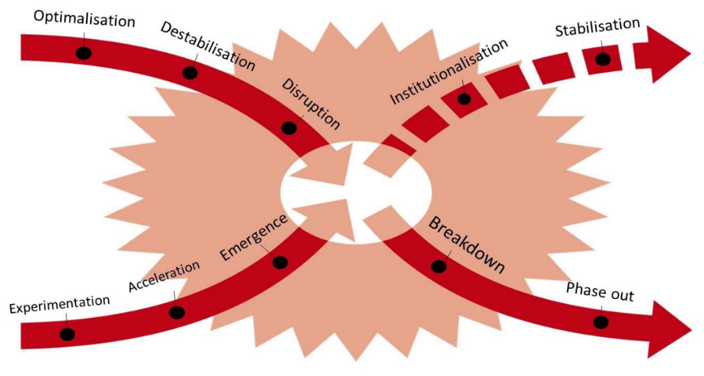
Transition
Inditex’ negative external impacts are the main sources of the company’s transition risks and opportunities
X-curve of transition:
Responsible & circular fashion at fair & real prices
Fast fashion at the lowest prices
Burning of unsold clothing
Cancellations of already produced orders
Social and environmental short-cuts
Responsible fashion (Patagonia)
Second hand fashion
Recycled clothing
Rented clothing
Source: Adapted from Loorbach, Frantzeskaki, and Avelino (2017)

Slide 16
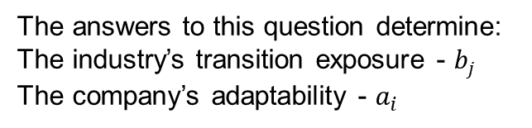
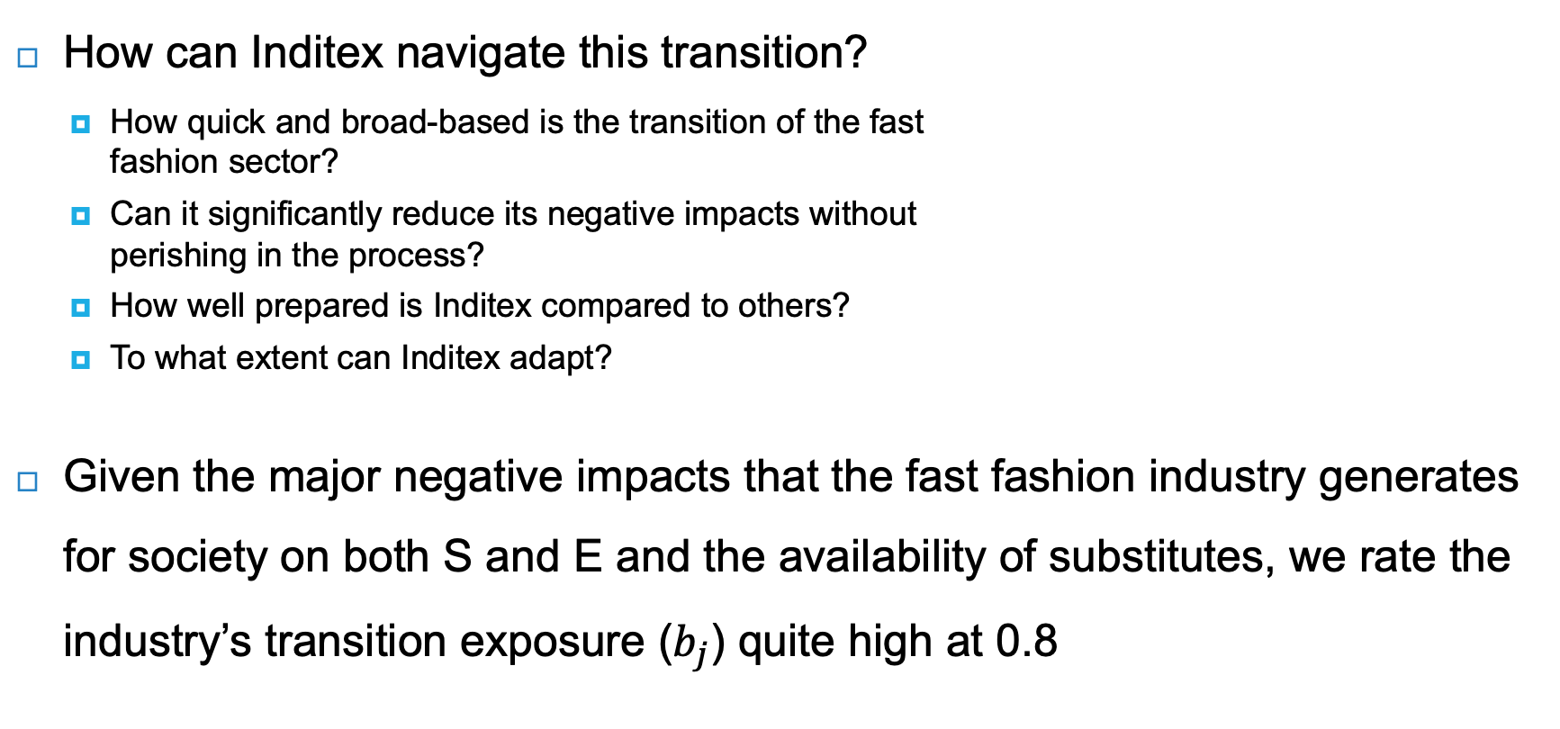
Transition preparedness
How can Inditex navigate this transition?
  How quick and broad-based is the transition of the fast
  fashion sector?
  Can it significantly reduce its negative impacts without
  perishing in the process?
  How well prepared is Inditex compared to others?
  To what extent can Inditex adapt?
Given the major negative impacts that the fast fashion industry generates for society on both S and E and the availability of substitutes, we rate the industry’s transition exposure ($b_{j}$) quite high at 0.8
The answers to this question determine:
The industry’s transition exposure - $b_{j}$
The company’s adaptability - $a_{i}$

Slide 17
Management
Management has been very successful in growing the company in a profitable way
The key question is whether management can rethink and redesign the business model to suit the transition
The company’s reporting suggests that management is still partly in denial, but strategic thinking tends to be ahead of reporting
Recently, there has been a change in management, with the founder’s daughter becoming the new chairwoman

Slide 18
Valuation of Inditex’ financial value using DCF
Peer group’s P/E ratio
Company’s EPS
Method: reverse-engineer the DCF to the current stock price (the market’s opinion)

Slide 19
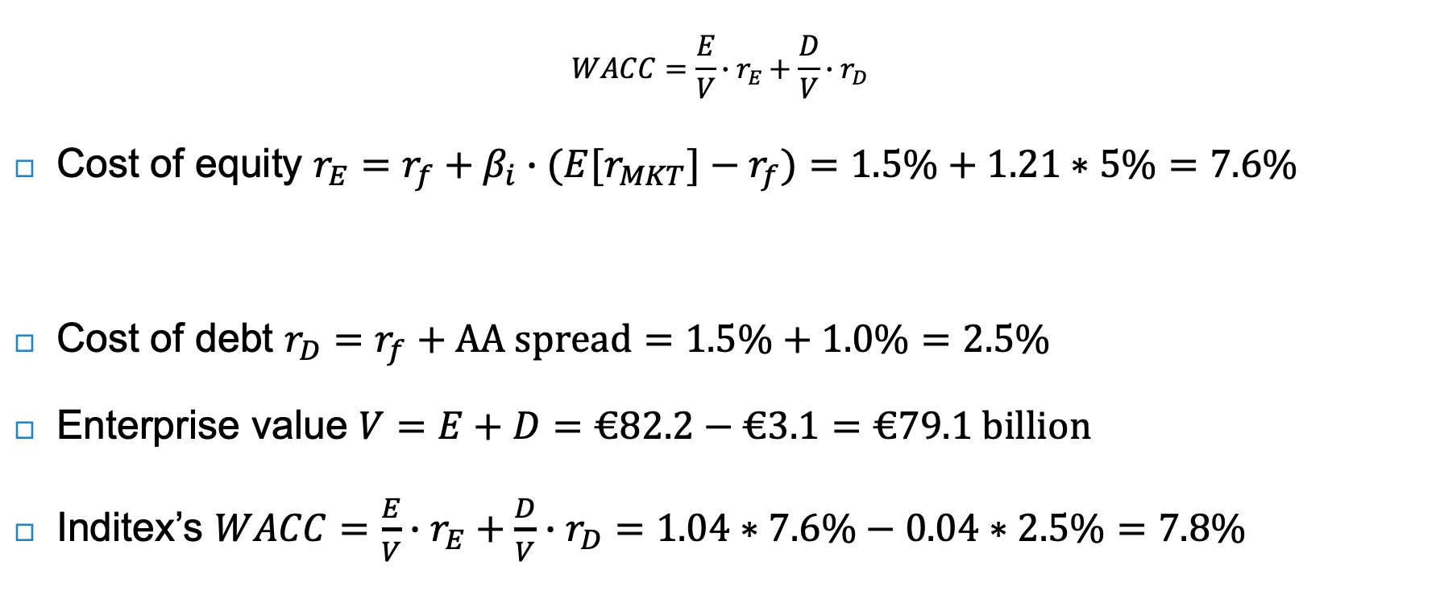
Calculating Inditex’s cost of capital
$$WACC=\frac{E}{V}∙r_{E}+\frac{D}{V}∙r_{D}$$
Cost of equity $r_{E}=r_{f}+β_{i}∙{(E[r}_{MKT}]−r_{f})=1.5\%+1.21∗5\%=7.6\%$
Cost of debt $r_{D}=r_{f}+\text{AA} \text{spread}=1.5\%+1.0\%=2.5\%$
Enterprise value $V=E+D=€82.2−€3.1=€79.1 billion$
Inditex’s $WACC=\frac{E}{V}∙r_{E}+\frac{D}{V}∙r_{D}=1.04∗7.6\%−0.04∗2.5\%=7.8\%$
Company beta
Explained in Chapter 12
Risk-free rate
Market premium

Slide 20
Transition valuation scenarios
Qualitative transition scenarios can be deep and multifaceted, allowing management to identify new pathways for navigating transition
Valuation scenarios need to be simple for quantification that makes intuitive sense
 | Effective global climate mitigation by 2030 (successful transition) | Mere climate adaptation, no serious mitigation by 2030 (unsuccessful transition)
Company is well prepared for climate mitigation | Scenario 1a: serious investment in recycling and in rental models; cutback on new collections; more ownership in the value chain | Scenario 2a: strategy as in 1a, but with less payoff
Company is ill prepared | Scenario 1b: continued to operate in business-as-usual mode, missed trends, and paid high price | Scenario 2b: strategy as in 1b, but at no penalty

Slide 21
Transition valuation scenarios
To get a scenario weighted valuation, probabilities must get assigned to each scenario
Assumption: 40% probability of effective global climate mitigation and 60% probability that Inditex is prepared for the transition
Scenario | DCF fair value per share | Probability | Main value driver assumptions (baseline from the basic scenario: 4.5% growth; 16.5% EBIT margin; 4% capex/sales)
1a (Well prepared; successful transition) | €28.4 | 24% (60%*40%) | 3 years of 3% growth rate, then back to 4.5% 3 years of 13% margins, then 20% 3 years of 6% capex/sales, then back to 4%
1b (Ill prepared; successful transition) | €10.4 | 16% (40%*40%) | -20% growth in 2023 and -15% growth in 2024, then 0% onwards* 3 years of 8% margins, then 11%
2a (Well prepared; unsuccessful transition) | €22.5 | 36% (60%*60%) | 10 years of 3% growth rate 3 years of 13% margins, then back to 16.5% 3 years of 6% capex/sales, then back to 4%
2b (Ill prepared; unsuccessful transition) | €31.9 | 24% (60%*40%) | 6% sales growth 18% margins
Overall | €24.2
Below Inditex share price (as of January 2021), suggesting that the company is overvalued

Slide 22
Valuing S and E at Inditex
At present, information on E and S is often limited or missing, making valuation difficult
To arrive at SV and EV, three steps need to be taken:
  Materiality assessment: determine important S and E factors
  Quantification: express these factors in their own units (Q)
  Monetisation: express these factors in money with shadow prices (SP)

Slide 23
E and S in their own units
E factors | Unit
Contribution to/limitation of climate change | Tonnes of CO2 equivalent emissions
Contribution to/limitation of pollution | Tonnes of waste, by waste type; Tonnes of nitrogen & phosphorus used; Litres of freshwater used; etc.
Contribution to/limitation of availability of scarce natural resources | Number of forest acres converted; MSA reduction due to corporate activities, etc.
Projecting future performance using historical numbers and targets
Based on relation with other company KPIs and the company’s activity levels
Using the volume-component of sales as a proxy
Inditex only has emission targets:
  Scope 1 and 2: 90% reduction by 2030
  Scope 3: 20% reduction by 2050
Don’t ask: what’s in the company’s annual report?
Ask: what should be in the company’s annual report that is currently not there?
Double materiality: inwardly and outwardly material social and environmental factors should be included
S factors | Unit
Client value of products & services | Client surplus (value - paid for)
Wellbeing of employment | Life satisfaction scores
Value to employees due to training and experience | Additional income
Effects on human health | Quality life years added or lost
Occupational health & safety incidents | Quality life years added or lost
Contribution to/limitation of poverty | Wage gap
Contribution to/limitation of human rights violations | Forced / underaged / discriminated / harassed workers

Slide 24
E and S in their own units
Production & energy use | 2017 | 2018 | 2019 | 2020 | 2021 | 2022 | 2023 | 2024 | 2025 | 2026 | 2027 | 2028 | 2029 | 2030 | 2031
Garments placed on the market (in thousands of tonnes) | 511.2 | 528.8 | 545.0 | 450.1 | 607.7 | 604.7 | 601.6 | 598.6 | 595.6 | 592.7 | 589.7 | 586.7 | 583.8 | 580.9 | 578.0
change |  | 3% | 3% | -17% | 35.0% | -0.5% | -0.5% | -0.5% | -0.5% | -0.5% | -0.5% | -0.5% | -0.5% | -0.5% | -0.5%
Global energy consumption (GJ) | 6.8 | 7.1 | 6.8 | 4.6 | 6.1 | 5.9 | 5.8 | 5.6 | 5.5 | 5.4 | 5.2 | 5.1 | 5.0 | 4.8 | 4.7
change |  | 4% | -4% | -33% | 33.0% | -2.5% | -2.5% | -2.5% | -2.5% | -2.5% | -2.5% | -2.5% | -2.5% | -2.5% | -2.5%
Energy needs covered with renewables | 41% | 45% | 63% | 81% | 83.0% | 85.0% | 87.0% | 89.0% | 91.0% | 93.0% | 95.0% | 97.0% | 97.0% | 97.0% | 97.0%
Fossil-based energy consumption (GJ) | 4.0 | 3.9 | 2.5 | 0.87 | 1.03 | 0.89 | 0.75 | 0.62 | 0.49 | 0.38 | 0.26 | 0.15 | 0.15 | 0.15 | 0.14
change |  | -3% | -35% | -66% | 19% | -14% | -16% | -18% | -20% | -24% | -30% | -42% | -3% | -2% | -3%
E | 2017 | 2018 | 2019 | 2020 | 2021 | 2022 | 2023 | 2024 | 2025 | 2026 | 2027 | 2028 | 2029 | 2030 | 2031
Contribution to climate change
Scope 1 + 2 emissions (T CO2eq), millions | 0.49 | 0.51 | 0.35 | 0.12 | 0.14 | 0.12 | 0.10 | 0.09 | 0.07 | 0.05 | 0.04 | 0.02 | 0.02 | 0.02 | 0.02
Change |  | 4% | -31% | -65% | 19.0% | -14.0% | -15.5% | -17.5% | -20.2% | -24.2% | -30.4% | -41.5% | -2.5% | -2.5% | -2.5%
Scope 3 emissions (T CO2eq), millions | na | na | 20.15 | 14.89 | 19.80 | 19.31 | 18.82 | 18.35 | 17.89 | 17.45 | 17.01 | 16.59 | 16.17 | 15.77 | 15.37
change |  |  |  | -26% | 33.0% | -2.5% | -2.5% | -2.5% | -2.5% | -2.5% | -2.5% | -2.5% | -2.5% | -2.5% | -2.5%
Scope 3 as a % of total emissions | na | na | 98.3% | 99.2% | 99.3% | 99.4% | 99.4% | 99.5% | 99.6% | 99.7% | 99.8% | 99.9% | 99.9% | 99.9% | 99.9%
Total emissions (T CO2eq), millions |  |  | 20.50 | 15.01 | 19.95 | 19.43 | 18.93 | 18.44 | 17.96 | 17.50 | 17.05 | 16.61 | 16.19 | 15.79 | 15.39
 |  |  |  | -27% | 33% | -3% | -3% | -3% | -3% | -3% | -3% | -3% | -3% | -3% | -3%
Contribution to pollution | ? | ? | ? | ? | ? | ? | ? | ? | ? | ? | ? | ? | ? | ? | ?
Contribution to availability of scarce natural resources | ? | ? | ? | ? | ? | ? | ? | ? | ? | ? | ? | ? | ? | ? | ?
Contribution to nitrogen & phosphorus cycles | ? | ? | ? | ? | ? | ? | ? | ? | ? | ? | ? | ? | ? | ? | ?
Contribution to deforestation | ? | ? | ? | ? | ? | ? | ? | ? | ? | ? | ? | ? | ? | ? | ?
Freshwater use | ? | ? | ? | ? | ? | ? | ? | ? | ? | ? | ? | ? | ? | ? | ?
Contribution to biodiversity loss | ? | ? | ? | ? | ? | ? | ? | ? | ? | ? | ? | ? | ? | ? | ?
S | 2017 | 2018 | 2019 | 2020 | 2021 | 2022 | 2023 | 2024 | 2025 | 2026 | 2027 | 2028 | 2029 | 2030 | 2031
Client value of products & services | ? | ? | ? | ? | ? | ? | ? | ? | ? | ? | ? | ? | ? | ? | ?
Wellbeing of employment | ? | ? | ? | ? | ? | ? | ? | ? | ? | ? | ? | ? | ? | ? | ?
Value to employees due to training and experience | ? | ? | ? | ? | ? | ? | ? | ? | ? | ? | ? | ? | ? | ? | ?
Effects on human health | ? | ? | ? | ? | ? | ? | ? | ? | ? | ? | ? | ? | ? | ? | ?
Occupational health & safety incidents | ? | ? | ? | ? | ? | ? | ? | ? | ? | ? | ? | ? | ? | ? | ?
Contribution to poverty | ? | ? | ? | ? | ? | ? | ? | ? | ? | ? | ? | ? | ? | ? | ?
Contribution to human rights violations | ? | ? | ? | ? | ? | ? | ? | ? | ? | ? | ? | ? | ? | ? | ?

Slide 25
E and S in monetary terms
Impact Weighted Accounts Framework (IWAF) provides monetisation factors / shadow prices
Number of units x shadow price = monetary value
Key impact categories | Monetisation factor
Wellbeing of employment | $2,647 per life satisfaction point (scale 0-100)
Effects on human health | $119,000 per DALY (disability adjusted life year)
Occupational health & safety incidents | Fatal occupational accidents: $3,540,000 per accident Occupational injuries with breach of H&S standards: $3,840 per accident
Contribution to/limitation of climate change | $224 per tonne of CO₂ equivalent (eq)
Contribution to/limitation of pollution – air pollution | Human toxicity: $119,000 per DALY Nitrogen deposition NH₃ from animal husbandry: $18.10/kg NH₃ eq Particulate Matter (PM) formation: $75/kg PM2.5 eq
Contribution to/limitation of pollution – water pollution | Freshwater eutrophication: $290/kg P eq to freshwater Marine eutrophication: $20.10/kg N eq to marine water
Contribution to/limitation of availability of scarce natural resources | Land occupation – tropical forest $3,030/(MSA*ha*yr) Land occupation – other forest $1,450/(MSA*ha*yr) Scarce blue water use $1.49/m³
Contribution to/limitation of poverty | Underpayment in the value chain – Wage gap of workers earning below minimum wage $1.56 per $1 of wage gap
Contribution to/limitation of human rights violations | Underage workers – below minimum age (12 or 13) for light work in non-hazardous economic work $21,600/child FTE Forced workers – $17.200/FTE Harassment – workers who experienced severe physical sexual harassment $85,800/worker Lack of freedom of association $527/violation

Slide 26
E flows and EV for climate change
Scope 3 emissions are assumed to be 50% attributable to Inditex and 50% to their supply chain
Carbon price is projected to increase by 3.5% each year
E flows (climate change) | 2020 | 2021 | 2022 | 2023 | 2024 | 2025 | 2026 | 2027 | 2028 | 2029 | 2030 | 2031
Contribution to climate change
Total emissions (T CO2eq), millions | 15.0 | 19.9 | 19.4 | 18.9 | 18.4 | 18.0 | 17.5 | 17.0 | 16.6 | 16.2 | 15.8 | 15.4
Percentage attributable to Inditex | 50% | 50% | 50% | 50% | 50% | 50% | 50% | 50% | 50% | 50% | 50% | 50%
Attributed emissions | 7.5 | 10.0 | 9.7 | 9.5 | 9.2 | 9.0 | 8.7 | 8.5 | 8.3 | 8.1 | 7.9 | 7.7
Carbon price, Euro | 138 | 204 | 211 | 218 | 226 | 234 | 242 | 250 | 259 | 268 | 278 | 287
change in carbon price |  | 47% | 3.5% | 3.5% | 3.5% | 3.5% | 3.5% | 3.5% | 3.5% | 3.5% | 3.5% | 3.5%
Cost of emissions (CO2eq), Euro billions | -1.04 | -2.03 | -2.05 | -2.06 | -2.08 | -2.10 | -2.12 | -2.13 | -2.15 | -2.17 | -2.19 | -2.21
Cost of negative EV capital |  | 2.2%
Terminal Value (TV) |  |  |  |  |  |  |  |  |  |  |  | -100.5
Period |  | 1 | 2 | 3 | 4 | 5 | 6 | 7 | 8 | 9 | 10 | 10
Discount factor |  | 0.98 | 0.96 | 0.94 | 0.92 | 0.90 | 0.88 | 0.86 | 0.84 | 0.82 | 0.80 | 0.80
Present value (PV) |  | -2.0 | -2.0 | -1.9 | -1.9 | -1.9 | -1.9 | -1.8 | -1.8 | -1.8 | -1.8 | -82.6
Sum of PV, Euro billions |  | -101.3

Slide 27
True price of jeans
Besides emission data, the required E and S data is lacking
Using the true price of jeans, as determined by the Impact Institute (2019), the relative E and S values can be estimated
 | Cotton cultivation | Denim textile production | Jeans manufacturing | Transport | Total
GHG emissions as a percentage of E | 2% | 12% | 0.5% | 0.1% | 15%
S as a percentage of E | 33% | 140% | 30% | 0% | 202%
Assuming an average sales price per jeans of €80: | Cotton cultivation | Denim textile production | Jeans manufacturing | Transport | Total
GHG emissions/sales price | 0.3% | 1.6% | 0.1% | 0.0% | 2%
Other E/sales price | 6% | 6% | 0% | 0% | 12%
S/sales price | 5% | 19% | 4% | 0% | 28%
S excluding 50% of bonded labour/sales price | 4% | 12% | 4% | 0% | 20%

Slide 28
Calculating EV
To calculate total EV:
  Either do 6x value of GHG emissions impacts – 2% of GHG / sales vs. 12% other E / sales
    GHG impact as a percentage of sales is much higher for Inditex (7%) than for jeans example
  Use 12% of total sales ← preferred
  Assume 4% annual improvement, 50% attribution to Inditex and discount rate of 2.2%
Results in total EV of
– € 182.5 billion
 | Cotton cultivation | Denim textile production | Jeans manufacturing | Transport | Total
GHG emissions as a percentage of E | 2% | 12% | 0.5% | 0.1% | 15%
S as a percentage of E | 33% | 140% | 30% | 0% | 202%
Assuming an average sales price per jeans of €80: | Cotton cultivation | Denim textile production | Jeans manufacturing | Transport | Total
GHG emissions/sales price | 0.3% | 1.6% | 0.1% | 0.0% | 2%
Other E/sales price | 6% | 6% | 0% | 0% | 12%
S/sales price | 5% | 19% | 4% | 0% | 28%
S excluding 50% of bonded labour/sales price | 4% | 12% | 4% | 0% | 20%
E flows | 2020 | 2021 | 2022 | 2023 | 2024 | 2025 | 2026 | 2027 | 2028 | 2029 | 2030 | 2031
Cost of emissions (CO2eq), attributed, euro billions | -1.04 | -2.03 | -2.05 | -2.06 | -2.08 | -2.10 | -2.12 | -2.13 | -2.15 | -2.17 | -2.19 | -2.21
Cost of other E issues as a percentage of sales | 12.0% | 11.5% | 11.1% | 10.6% | 10.2% | 9.8% | 9.4% | 9.0% | 8.7% | 8.3% | 8.0% | 7.7%
Sales, euro billions | 20.4 | 29.6 | 30.9 | 32.3 | 33.8 | 35.3 | 36.9 | 38.5 | 40.3 | 42.1 | 44.0 | 45.9
Cost of other E issues | -2.45 | -3.41 | -3.42 | -3.43 | -3.44 | -3.45 | -3.46 | -3.47 | -3.49 | -3.50 | -3.51 | -3.52
Percentage attributable to Inditex | 50% | 50% | 50% | 50% | 50% | 50% | 50% | 50% | 50% | 50% | 50% | 50%
Cost of other E issues attributed, euro billions | -1.22 | -1.70 | -1.71 | -1.71 | -1.72 | -1.73 | -1.73 | -1.74 | -1.74 | -1.75 | -1.75 | -1.76
Total E flows, Euro billions | -2.26 | -3.73 | -3.76 | -3.78 | -3.80 | -3.82 | -3.85 | -3.87 | -3.89 | -3.92 | -3.94 | -3.97
Cost of negative EV capital |  | 2.2%
Terminal Value (TV) |  |  |  |  |  |  |  |  |  |  |  | -180.5
Period |  | 1 | 2 | 3 | 4 | 5 | 6 | 7 | 8 | 9 | 10 | 10
Discount factor |  | 0.98 | 0.96 | 0.94 | 0.92 | 0.90 | 0.88 | 0.86 | 0.84 | 0.82 | 0.80 | 0.80
Present value (PV) |  | -3.7 | -3.6 | -3.5 | -3.5 | -3.4 | -3.4 | -3.3 | -3.3 | -3.2 | -3.2 | -148.4
Sum of PV, euro billions |  | -182.5

Slide 29
Calculating negative SV
To calculate negative SV:
  Start with 28% of total sales from true price of jeans
    Number is inflated by very high price for bonded labour, to be conservative we reduce this by 50%
  Arrive at negative S impacts of 20.3% of total sales
  Assume 4% annual improvement, 50% attribution to Inditex and discount rate of 2.2%
Results in total negative SV of
– € 137.2 billion
 | Cotton cultivation | Denim textile production | Jeans manufacturing | Transport | Total
GHG emissions as a percentage of E | 2% | 12% | 0.5% | 0.1% | 15%
S as a percentage of E | 33% | 140% | 30% | 0% | 202%
Assuming an average sales price per jeans of €80: | Cotton cultivation | Denim textile production | Jeans manufacturing | Transport | Total
GHG emissions/sales price | 0.3% | 1.6% | 0.1% | 0.0% | 2%
Other E/sales price | 6% | 6% | 0% | 0% | 12%
S/sales price | 5% | 19% | 4% | 0% | 28%
S excluding 50% of bonded labour/sales price | 4% | 12% | 4% | 0% | 20%
Negative S flows | 2020 | 2021 | 2022 | 2023 | 2024 | 2025 | 2026 | 2027 | 2028 | 2029 | 2030 | 2031
Negative S flows as a percentage of sales | 20.3% | 19.5% | 18.7% | 18.0% | 17.2% | 16.6% | 15.9% | 15.3% | 14.6% | 14.1% | 13.5% | 13.0%
Sales, Euro billions | 20.4 | 29.6 | 30.9 | 32.3 | 33.8 | 35.3 | 36.9 | 38.5 | 40.3 | 42.1 | 44.0 | 45.9
Cost of negative S issues | 4.14 | 5.77 | 5.78 | 5.80 | 5.82 | 5.84 | 5.86 | 5.88 | 5.90 | 5.91 | 5.93 | 5.95
Percentage attributable to Inditex | 50% | 50% | 50% | 50% | 50% | 50% | 50% | 50% | 50% | 50% | 50% | 50%
Cost of neg. S issues attributed, Euro billions | 2.07 | 2.88 | 2.89 | 2.90 | 2.91 | 2.92 | 2.93 | 2.94 | 2.95 | 2.96 | 2.97 | 2.98
Total negative S flows, Euro billions | -2.07 | -2.88 | -2.89 | -2.90 | -2.91 | -2.92 | -2.93 | -2.94 | -2.95 | -2.96 | -2.97 | -2.98
Cost of negative SV capital |  | 2.2%
Terminal Value (TV) |  |  |  |  |  |  |  |  |  |  |  | -135.3
Period |  | 1 | 2 | 3 | 4 | 5 | 6 | 7 | 8 | 9 | 10 | 10
Discount factor |  | 0.98 | 0.96 | 0.94 | 0.92 | 0.90 | 0.88 | 0.86 | 0.84 | 0.82 | 0.80 | 0.80
Present value (PV) |  | -2.8 | -2.8 | -2.7 | -2.7 | -2.6 | -2.6 | -2.5 | -2.5 | -2.4 | -2.4 | -111.2
Sum of PV, Euro billions |  | -137.2

Slide 30
Calculating positive SV
To calculate positive SV:
Taxes paid of 4.3% of sales:
  Corporate tax expense (3.7% of sales)
  Property and environmental taxes (0.6% of sales)
Consumer surplus of 7.2% of sales:
  Assuming a price elasticity of demand of 3.452
  50% attribution to Inditex and 50% to supply chain
Wellbeing of employment of 2.3% of sales:
  Assuming two life satisfaction points of € 4,813
  Multiplied by workforce gives € 694 million
Results in total positive SV of
€ 282.9 billion
Positive S flows | 2020 | 2021 | 2022 | 2023 | 2024 | 2025 | 2026 | 2027 | 2028 | 2029 | 2030 | 2031
Paid taxes, Euro billions | 0.5 | 1.3 | 1.3 | 1.4 | 1.5 | 1.5 | 1.6 | 1.7 | 1.7 | 1.8 | 1.9 | 2.0
% of sales | 2.2% | 4.3% | 4.3% | 4.3% | 4.3% | 4.3% | 4.3% | 4.3% | 4.3% | 4.3% | 4.3% | 4.3%
Consumer surplus, Euro billions | 1.5 | 2.1 | 2.2 | 2.3 | 2.4 | 2.6 | 2.7 | 2.8 | 2.9 | 3.0 | 3.2 | 3.3
% of sales | 7.2% | 7.2% | 7.2% | 7.2% | 7.2% | 7.2% | 7.2% | 7.2% | 7.2% | 7.2% | 7.2% | 7.2%
Wellbeing of employment, Euro billions | 0.7 | 0.7 | 0.7 | 0.8 | 0.8 | 0.8 | 0.9 | 0.9 | 0.9 | 1.0 | 1.0 | 1.1
% of sales | 3.4% | 2.3% | 2.3% | 2.3% | 2.3% | 2.3% | 2.3% | 2.3% | 2.3% | 2.3% | 2.3% | 2.3%
Total Positive S flows, Euro billions | 2.6 | 4.1 | 4.3 | 4.5 | 4.7 | 4.9 | 5.1 | 5.3 | 5.6 | 5.8 | 6.1 | 6.4
% of sales | 12.9% | 13.9% | 13.9% | 13.9% | 13.9% | 13.9% | 13.9% | 13.9% | 13.9% | 13.9% | 13.9% | 13.9%
Cost of positive SV capital |  | 2.2%
Terminal Value (TV) |  |  |  |  |  |  |  |  |  |  |  | 290.0
Period |  | 1 | 2 | 3 | 4 | 5 | 6 | 7 | 8 | 9 | 10 | 10
Discount factor |  | 0.98 | 0.96 | 0.94 | 0.94 | 0.90 | 0.88 | 0.86 | 0.84 | 0.82 | 0.80 | 0.80
Sum of PV, Euro billions |  | 282.9

Slide 31
Integrated value
S in its own units
Prices on S units
SV
E in its own units
Prices on E units
EV
F value drivers
Sales growth
Margins
Capital
FV
IV

Slide 32

Calculating Inditex’s integrated value
Assuming the basic IV model with equal weights ($b=c=1$), we arrive at an integrated value of €42 billion
IV calculation (equal weights) | Value (Euro billions)
FV (enterprise value) | 79
Positive SV | 283
Negative SV | -137
Negative EV | -183
IV (integrated value) | 42

Slide 33
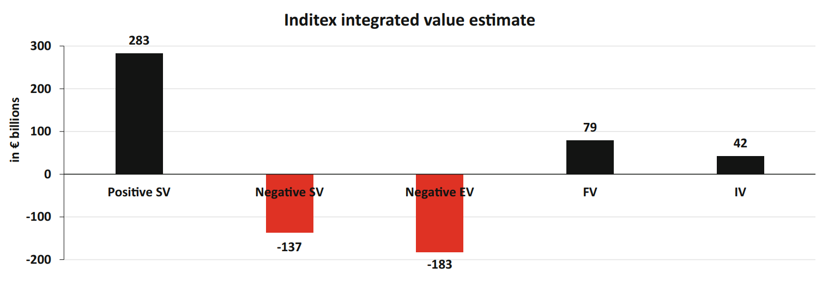
Key components of integrated valuation
1. Consumer surplus
2. Employment
3. Taxes
Strong consumer brand
Integrated value for society
Underpayment in Asian garment factories
Environmental pollution: cotton, production, burning, transport
Notes:
SV and EV almost zero in shareholder model

Slide 34

Shareholder model vs. integrated model
Integrated model with equal weights ($b=c=1$)
Shareholder model with $b=c=0.01$

Slide 35
Future value creation profiles
Projections of company’s future value creation profile answer key questions:
  What is the path to a healthy business where FV, SV and EV are all > 0?
  Is Inditex doing the right things to be on that healthy path?

Slide 36
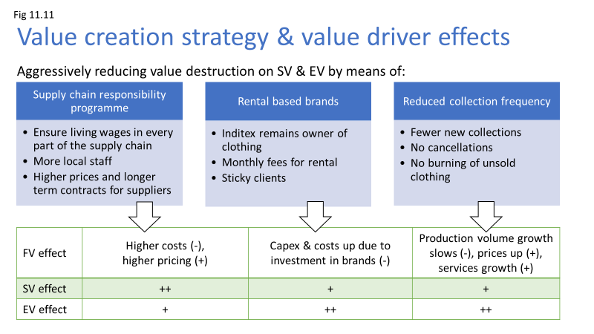
Communicating on integrated value
Hypothetical investor presentation slide for Inditex

Slide 37
Conclusions
This analysis of Inditex shows that it is possible to (roughly) estimate a company’s SV and EV from the outside
The language of business is money, and by expressing S and E in monetary terms, we make them visible, and more likely to be managed
Much crucial data is missing, forcing us to make a lot of assumptions
Despite imprecise estimates, the analysis is valuable:
  To companies: it shows where the problems and trade-offs are
  On a system level: gives an indication of the kind of data that is needed

