Slide 1
Corporate Finance for Long-Term Value
Chapter 2: Integrated Value Creation

Slide 2
Chapter 2: Integrated Value Creation
Part 1: Why corporate finance for long-term value?

Slide 3
The BIG Picture
Many companies are currently value destructive on SV and EV
Solution
Corporate strategy is starting point for value creation
Challenge 1: incorporate social and environmental goals in strategy
Challenge 2: move from static to dynamic perspective
Envisage transition pathways towards value creation on SV and EV
A company’s transition preparedness is key determinant of its long-term value

Slide 4
What is value creation?
In financial terms, value creation is defined as an increase in the net present value (NPV) of a company’s projects
FV is often generated at the expense of SV and EV as resources are depleted without sufficient investments in maintaining them
Responsible companies manage for integrated value creation (profit and impact) rather than merely shareholder value (profit)

Slide 5
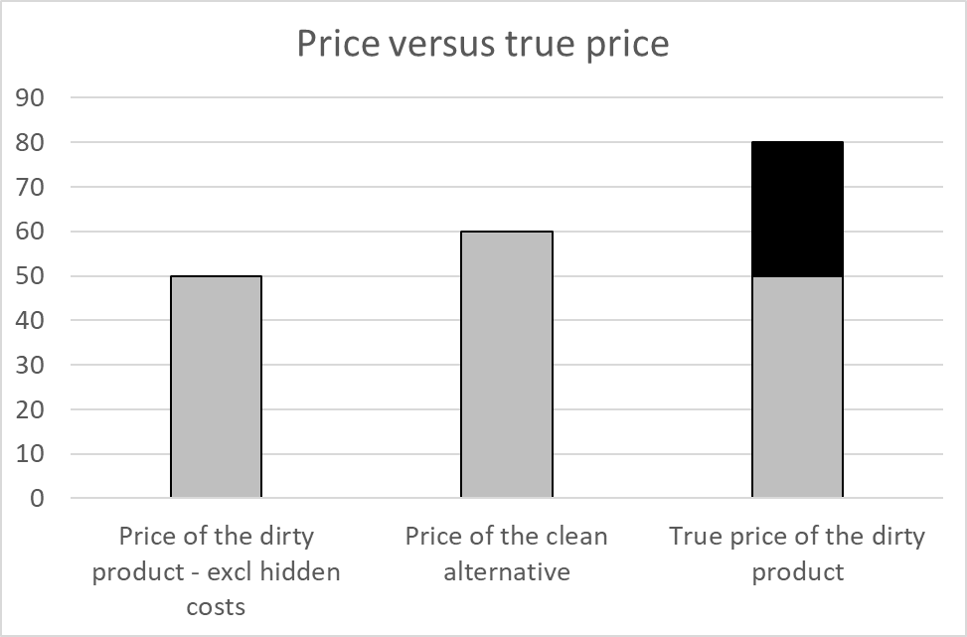
The alignment of FV, SV and EV
External impacts (also called externalities) are costs or benefits that are created by organisations or persons but whose costs are borne by society as a whole
A way to improve the alignment between FV, SV and EV is to ensure that companies charge true prices or integrated prices (prices that include all hidden costs)
Source: True Price (2020)

Slide 6
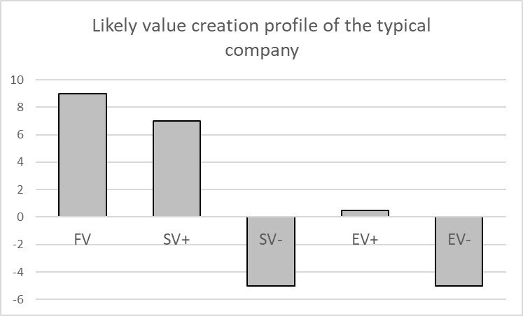
The alignment of FV, SV and EV
Currently, many companies are value destructive on SV or EV
For society and the economy to operate within social and planetary boundaries, we need companies on aggregate to stop being value destructive on SV and EV

Slide 7
Why is it in companies’ interest to manage for integrated value?
If company management neglects SV or EV, that will hurt long-term FV as well
Ethical case - license to operate -> corporate responsibility
US survey shows that 63% of US citizens (including 71% of millennials) expect companies to contribute to social and environmental challenges (Cone Communications, 2017)
Companies that create FV at the expense of SV or EV are likely to lose their license to operate at some stage (Kurznack et al, 2021)
Business case – long-term value creation
Companies that create value on SV and EV are more likely to be value creative on FV in the long run as well
As external impacts are being internalised, they affect FV

Slide 8
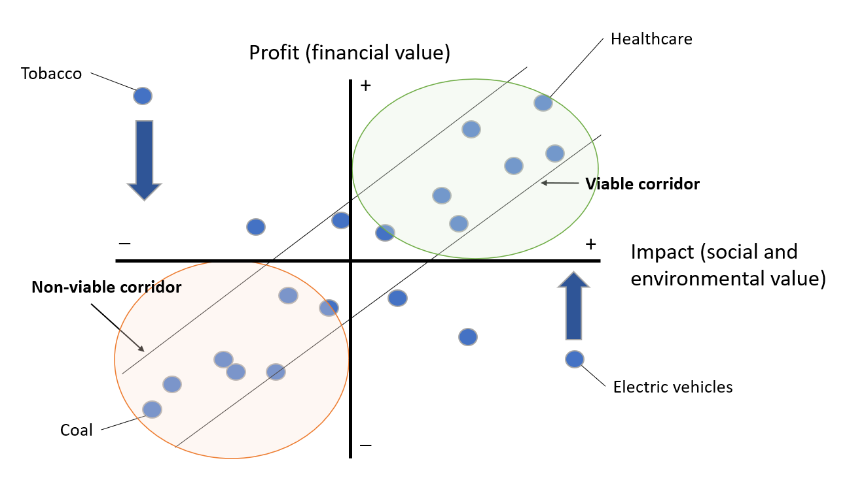
Long-term alignment of profit and impact

Slide 9
Internalisation
Rationally, some companies are better off if they can continue to externalise their large costs on SV and EV, if:
Companies are not interested in double materiality (see slide below)
There is no threat of internalisation
We distinguish four driving forces behind the internalisation of SV and EV into FV:
License to operate
Regulation and taxation
Technological advancement
Customer preferences

Slide 10
Forced internalisation
When internalisation happens it’s not necessarily the worst polluters that are hit hardest
The impact depends on the company’s preparedness and the relative size of its external impacts versus alternatives
The relationship between integrated prices and integrated profits is not linear. An integrated price can lead to higher costs for a producer and still increase profits

Slide 11
Forced internalisation
Conclusion: mining company 5 was least prepared and 3 most prepared

Slide 12
Key players in internalisation
Several players are relevant for internalisation – their roles are largely complementary
Government: prime mover setting regulation and taxation; also active role (e.g. initial investor) to accelerate sustainability transitions
Investors: can incorporate ESG in lending + invest decisions; engagement with companies to speed up transitions to sustainable business models and/or exit (see Chapter 3)
Companies: can incorporate costs of externalities into business practices -> managing for integrated value (this book)
Consumers: may buy sustainable products and services; sharing / peer-to-peer economy, where consumers mutualise access to products instead of ownership
Civil society: non-governmental organisations (NGOs) can raise awareness of S + E issues through public voice in the media -> to stimulate other players to act (see Chapter 14)

Slide 13
Double materiality
The concept of double materiality means that one is mindful of the company’s relation with society and nature in both directions:
Company’s dependencies on society and nature (inward)
Company’s impact on society and nature (outward)
Finance typically cares about the first (ESG risk) and ignores the second (impact)
Solution: steering on integrated value (profit and impact)

Slide 14
Value Creation Matrix

Slide 15
Value Creation Matrix -> transition

Slide 16
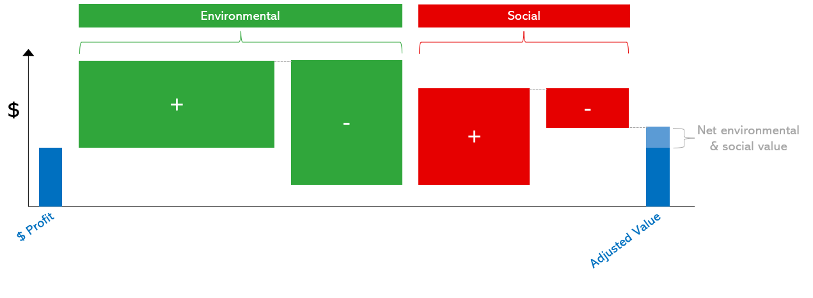
Measuring historical value creation
Measuring SV or EV takes a three-step process:
Determine material S and E issues
Quantify the S and E issues in their own units (Q)
Put a monetary value on those S and E units through shadow prices (P)
Source: Adapted from True Price (2014)

Slide 17
Estimating future value creation
Future value destruction can be estimated by extrapolating its units and shadow price
It is not only important to understand whether companies are value creative or value destructive on SV, EV, and FV
But it is also important to understand how to create or destroy such value and how they perform versus peers
 | 2022 | 2023 | … | 2030
Expected units (1)
Shadow price (2)
Expected value destruction (3)=(1)x(2)

Slide 18
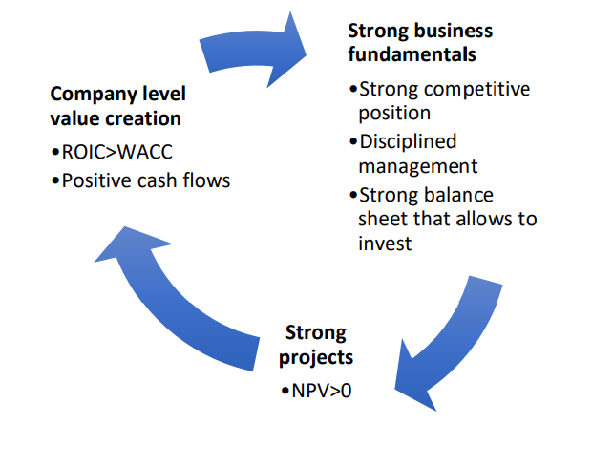
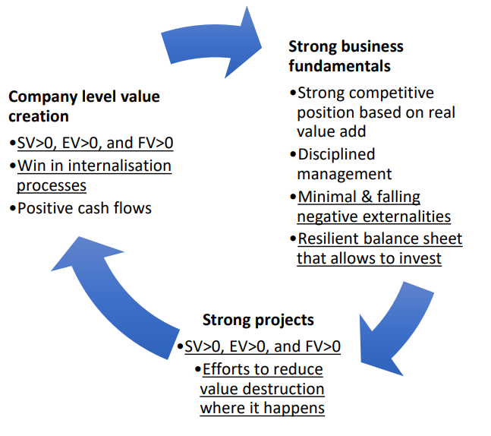
Value management
Value management (FV only)
In the integrated view:

Slide 19
Intangible assets in financial reporting
Significant parts of FV do not appear on corporate balance sheets.
The financial value of companies has shifted from tangible assets (land, buildings & machinery, and financial assets) to intangibles (human capital, intellectual property (IP), processes, data and innovation)
Tangible assets (on-balance)
Cash
Intangible assets (on-balance)
Property, plant & equipment
Innovation power
Human capital
Non-capitalised brands
Etc.
Brands
Licenses
Etc.
Intangible resources (off-balance)
Goodwill

Slide 20
SV and EV in reporting
SV and EV tend to be almost completely off-balance sheet
This is only partly mitigated by sustainability reporting
Companies need to be held more accountable and take more accountability to perform integrated reporting
This allows investors and other stakeholders to make reasonable estimates of companies’ value creation profiles

Slide 21
Corporate Value Creation Profile

Slide 22
Where does value come from?
Since integrated value means that FV, SV and EV need to be positive, this raises the question of what to prioritise and how to balance these types of value
Choice of parameters a and b by company board; FV has parameter 1
𝐼𝑉 = 𝐹𝑉 + 𝑎 ∙ 𝑆𝑉 + 𝑏 ∙ 𝐸𝑉
How do companies know what to focus on?
Focus and balancing should depend on the company’s:
Purpose
Area(s) of value destruction

Slide 23
Purpose
A company finds focus in its mission or purpose (Mayer, 2018)
Why and for what does the company exist?
What societal need does it serve?
What value does it provide for its customers?
How does it do that in the best way?
What type of value should it focus on, without losing sight of the other types?

Slide 24
Strategy
Based on its mission, focus, and competitive landscape, a company can build its strategy
A strategy can be described as the plan chosen to achieve a desired future state
Hambrick and Fredrickson (2001) claim a strategy needs to have five parts:
Arenas: in which markets is the company going to be active?
Vehicles: how is it going to get there?
Differentiators: how can the company win in the marketplace?
Staging: what will be the speed and sequence of moves?
Economic logic: how can returns be obtained?

Slide 25
Business model
Johnson et al. (2008) argue that a successful business model has three components:
Customer value proposition: helps customers perform a specific ‘job’
Profit formula: generates value for the company
Key resources and processes: the people, technology, products, facilities, equipment and brand required to deliver the value proposition
To change a company’s value creation profile on FV, SV and EV, this involves strategic changes to the components of its business model

Slide 26
Stakeholder impact maps
Stakeholder impact maps can be used to investigate what a company’s most material issues are
It outlines the company’s main stakeholders, their main goals, and the way the company helps them (positive impact) or hurts them (negative impact)
 | Stakeholder group 1 | Stakeholder group 2 | Stakeholder group 3 | Stakeholder group 4
Goals
How the company helps those goals
How the company hurts those goals

Slide 27
Stakeholder impact map for a pharmaceutical company
 | Patients | Governments | Shareholders | Employees | Doctors & hospitals | Insurers
Short term goals | Survival, affordability & accessibility | Reduce healthcare costs | Maximise financial return | Good work-life balance and pay | Doctors get sweeteners; hospitals minimise costs | Minimise costs
Long term goals | Better health outcomes at decent price | Better health outcomes at decent price | Maximise financial return | Personal development & financial security | Better health outcomes at decent price | Better health outcomes at decent price
Positive impact | Treatment & possibly cured | Population health | High prices & high growth, new drugs drive share price | Remuneration & job fulfilment | Good treatment outcomes | Fewer other costly treatments
Negative impact | High cost | Fees (prices) paid | High R&D costs, high risk | Potential company reputation | High prices | High prices
Frictions

Slide 28
Stakeholder impact map for a social media company
 | Users | Advertisers | Shareholders | Employees | Governments
Short term goals | Connect & share | Get more customers | Maximise financial return | Good work-life balance and pay | Control of information, data security; battle distorted news
Long term goals | A good life | Better understanding of customer needs | Maximise financial return | Personal development & financial security | Protect the state and the people
Positive impact | Connect people, widen their opportunity to express themselves | Reach users in a targeted way, save costs elsewhere | High growth drives share price | Remuneration & job fulfilment | Reach people
Negative impact | Privacy, addiction |  | Unease at value (valuation) | Potential company reputation | Might affect public opinion in a way that undermines government
Frictions
Frictions

Slide 29
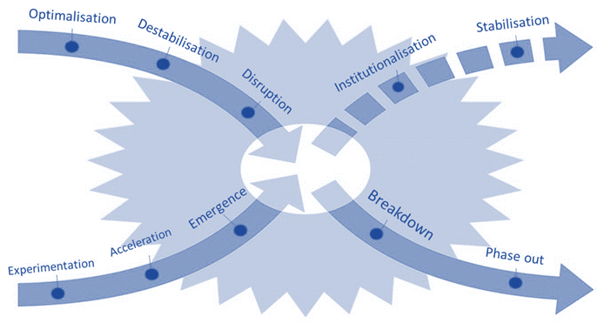
Transition
The move from a negative social and/or negative value to a positive value profile across all three value dimensions is often part of a wider transition in the economy.
Transition is about transformational change rather than incremental change
The x-curve of transition dynamics
Source: Adapted from Loorbach, Frantzeskaki and Avelino (2017).

Slide 30
Transition
The SDG agenda sets the stage for the transition to a sustainable and inclusive economy, with several identified transitions:
Climate – Energy transition: Moving from the use of fossil fuels to renewable energy
Raw Materials – Circular Economy: Redesign and recycle products leading to less use of raw materials and fewer carbon emissions
Biodiversity – Healthy Food and Regenerative Agri- and Aquaculture: Trend towards healthy food production with respect for land and water
Labour practices – Social Transition: Trend towards decent labour practices across the value chain of production

Slide 31
Transition and value
Transitions can have major implications for company value
A company that adapts in a timely manner to the new world can realise its integrated value potential
In contrast, a company that follows a business-as-usual path and fails to adapt can lose its value and go bankrupt

Slide 32
Transition and value
The formula to estimate expected transition losses ETL_{ij} for company i in sector j is:
$${ETL}_{ij}={EAT}_{ij}∙{PT}_{j}∙{LGT}_{i}$$
$$=b_{j}∙V_{i}∙{PT}_{j}∙(1−a_{i})$$
${EAT}_{ij}$ = exposure to transition = $b_{j}∙V_{i}$, where $b_{j}$ = level of transition in sector j, and $V_{i}$ = value of company i
${PT}_{j}$ = probability of transition in sector j
${LGT}_{i}$ = loss given transition = $\left(1−a_{i}\right)$, where $a_{i}$ = company i’s adaptability to transition

Slide 33
Example of car market
A car market where b_{car} = 1

Slide 34
Can Volkswagen catch up?
And where a_{VW} = 0.4

Slide 35
Potential VW losses?
${ETL}_{i,j}=b_{j}∙V_{i}∙{PT}_{j}∙(1−a_{i})$
${ETL}_{i,j}=1∙V_{VW}∙1∙\left(1−0.4\right)=0.6∙V_{VW} →$ 60% of VW’s value
Conclusion:
$a_{i}$ - adaptability or transition preparedness is a key factor for company valuation
Need fundamental analysis to assess parameters $b_{j}$ and $a_{i}$

Slide 36
Transition pathways
When a company is value destructive on any type of value (FV, SV, or EV) it needs to find a credible transition pathway in line with social and planetary boundaries towards positive value

Slide 37
Steering your company on integrated value
Goals: Companies should steer according to FV, SV and EV in an integrated way. This is the process of optimising the company’s integrated value.
Constraints: Companies need to survive the transitions in the market and also need to operate within social and planetary boundaries
With a future-proof business model, companies can attract funding and avoid bankruptcy

Slide 38
Conclusions
Creating value on FV, SV and EV requires a clear view of all types of value creation
Internalisation shifts the burdens of externalities back from society to the companies
If companies’ FV depends on the exploitation of an external impact, that FV will be affected when internalisation occurs
Stakeholders can use the Value Creation Matrix to identify value creation on SV and EV
Based on companies’ purpose and area(s) of value destruction, companies can adjust their strategy and business model
In the case of serious value destruction, companies should be able to outline a credible transition pathway

