Slide 1
Corporate Finance for Long-Term Value
Chapter 3: Corporate Governance

Slide 2
Chapter 3: Corporate Governance
Part 1: Why corporate finance for long-term value?

Slide 3
The BIG Picture
Current corporate finance maximises financial value from financial shareholder perspective, ignoring social and environmental externalities
Single objective facilitates accountability in corporate governance
Solution
Expand company objective from FV to IV (= FV + SV + EV)
Include current and future generations as stakeholders, alongside shareholders
Broaden board diversity and expertise to deal with expanded objective
Accountability: single integrated value measure facilitates accountability
Incentives: include social and environmental KPIs in performance pay

Slide 4
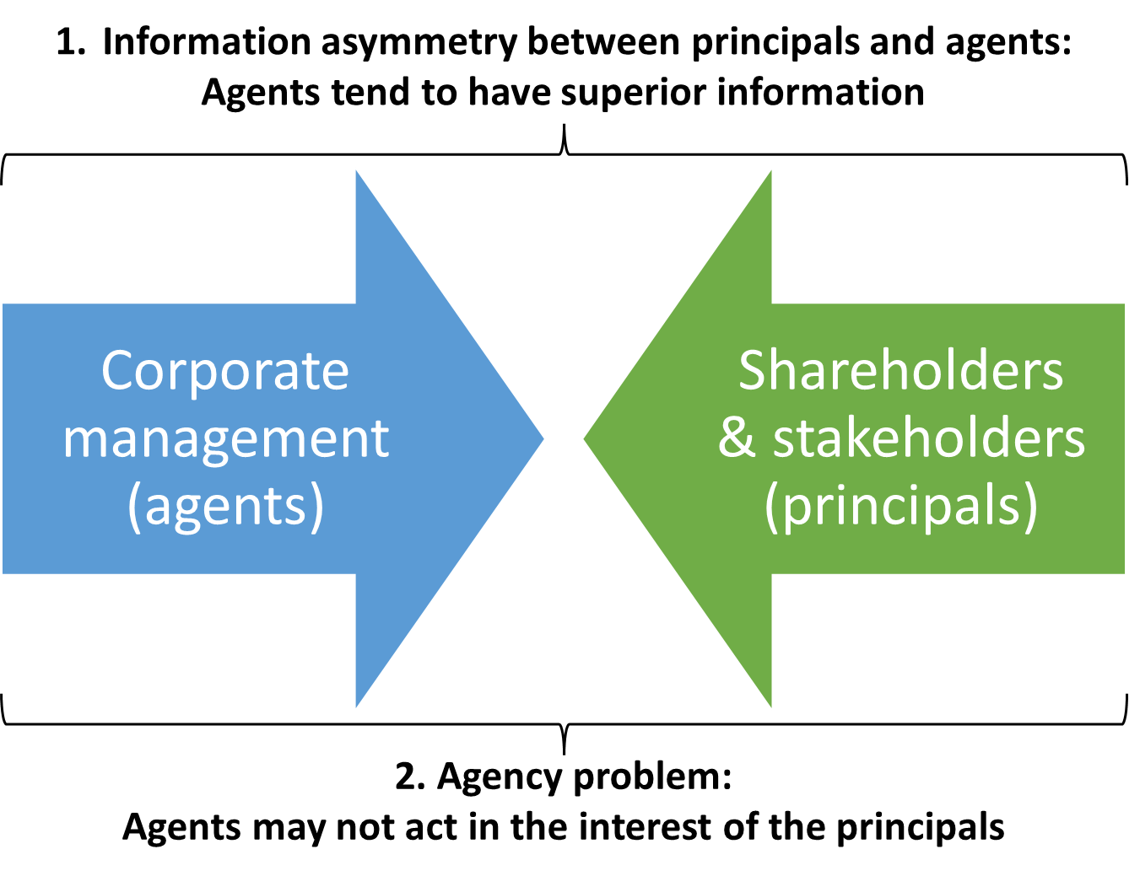
Core problems in corporate governance
Corporate governance refers to the mechanisms, relations and processes by which a company is controlled and directed
At the core of corporate governance there are two problems:
Information asymmetry between principals and agents
Agency problem: agents may not act in interest of principals

Slide 5
Shareholder model
Agency theory focuses on conflicts between owners (shareholders) as principals and managers as agents
Accountability of managers and the scope for correction (removal of management)
Managers might be incentivised to focus on short-term profits
Common law countries (i.e., US, UK, Canada): dispersed shareholders & active trading in stock markets
Civil law countries (i.e., Europe, Asia): controlling shareholders, less active market for corporate control and management is held less accountable

Slide 6
Stakeholder model
Stakeholder model argues that managers should balance the interests of all stakeholders, including financial agents (shareholders and debtholders) and social agents (employees, consumers, suppliers)
System of co-determination: both shareholders and employees can appoint representatives to a company’s board
Corporate governance codes define best practices in corporate governance
Codes have started to address the narrow shareholder perspective and short-termism
In NL and UK, codes include long-term value creation for stakeholders as a corporate objective

Slide 7
Governance and company value
Well-run companies are better able to realise their long-term value potential by making better (investment) decisions
Strong correlation between company-level governance and the broad institutional setting of a country
Corporate scandals reveal classical agency problems in companies across the world:
Americas: Collapse of Enron in 2001
Asia: Olympus-scandal in 2011
Europe: Volkswagen-scandal in 2015

Slide 8
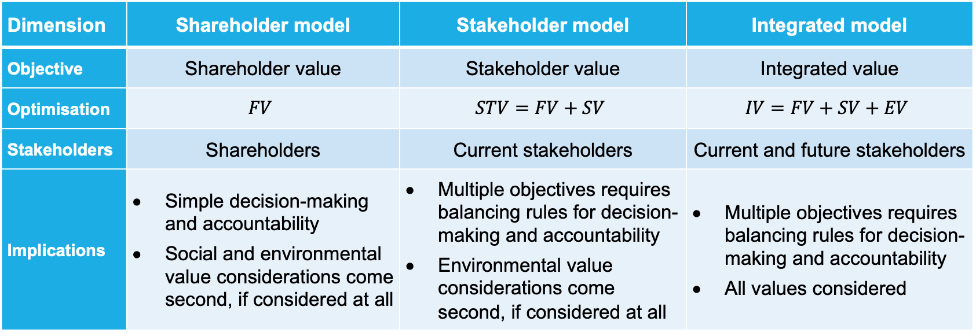
Comparing corporate governance models
Dimension | Shareholder model | Stakeholder model | Integrated model
Objective | Shareholder value | Stakeholder value | Integrated value
Optimisation | $$FV$$ | $$STV=FV+SV$$ | $$IV=FV+SV+EV$$
Stakeholders | Shareholders | Current stakeholders | Current and future stakeholders
Implications | Simple decision-making and accountability Social and environmental value considerations come second, if considered at all | Multiple objectives requires balancing rules for decision-making and accountability Environmental value considerations come second, if considered at all | Multiple objectives requires balancing rules for decision-making and accountability All values considered

Slide 9
Objective of the firm
Shareholder value (Friedman, 1970; Jensen, 2002)
Division of labour: companies -> FV; governments -> SV + EV
But two problems
externalities happen at level of companies (part of business model)
regulation cannot effectively capture all externalities
Shareholder welfare (Hart and Zingales, 2017; 2022)
Pro-social shareholders (which put weight on welfare of others) to address externalities
But also two problems
shareholder preferences not representative for stakeholder preferences
free-rider problem -> underprovision

Slide 10
Objective of the firm (2)
Stakeholder value (Freeman, 1984; Magill, Quinzii and Rochet, 2015)
Current stakeholders: financial and social (employees, customers, suppliers)
But also two problems
multiple objectives -> need for balancing rules
future generations (environmental stakeholders) not included
Integrated value (Schoenmaker and Schramade, 2019; 2023)
Inclusion of all stakeholders: current and future
But also problem
multiple objectives -> need for balancing rules
Solution: integrated value as objective IV = FV + SV + EV

Slide 11
How can interests be balanced?
Directors should act according to the company’s purpose (Mayer, 2018; 2021)
By making corporate values explicit, management becomes accountable to deliver on corporate purpose
Edmans (2020) argues that value is only created when the social benefits exceed the social opportunity costs
Three interrelated principles to deliver value to stakeholders:
Multiplication: do social benefits exceed private costs?
Comparative advantage: does the company deliver more value than other companies?
Materiality: are the benefitted stakeholders material to the company?

Slide 12
Integrated measure for societal value
Basic model for integrated value (IV):
$IV=FV+b∙SV+c∙EV$
FV = financial value SV = social value EV = environmental value b = weighting of social value c = weighting of environmental value
(FV is weighted at 1)
Allows for a structured balancing of stakeholder interests
Board should set parameters (b and c) in advance and in dialogue with stakeholders
Current regime is characterised by a very small weighting of social and environmental value (b = c = 0.1)

Slide 13
Organisational forms of companies
Public company
Main corporate vehicle (especially in UK and US)
Private Company
Financed by debt and/or private equity
Gaining in importance due to fewer agency problems
Governmental organisation (state-owned or government intervention)
Public objective
Efficiency problems due to lacking profit motive

Slide 14
Organisational forms of companies (2)
B corporation
Company certified as meeting social and environmental standards
Social enterprise
Non-profit with focus on societal impact
Cooperation / Cooperative
Created by groups of people (customers, suppliers, employees) working together for common benefit instead of profit
Number of certified B corps

Slide 15
Role of institutional investors
Institutional investors are financial institutions that manage investments for clients
Investment funds, pension funds, insurance companies, etc.
Growing role: from 67% of GDP in 1990 to 230% of GDP in 2016
Two choices for action to influence investee companies:
Voice (or direct intervention): engage with management or vote at AGMs
Exit (or divest): (threaten to) leave
Rise of passive investments limits impact of voice or exit

Slide 16
Managing stakeholders' interests
How to include the interests of the various stakeholders in board decision-making?
EU is most advanced in including interest of current and future stakeholders in legislation
EU Sustainable Finance strategy:
1. Strengthening sustainability disclosure
4. Fostering sustainable corporate governance
2. Taxonomy of green investments
3. Clarifying investors’ duties regarding sustainability

Slide 17
Sustainability disclosure & taxonomy
EU’s Corporate Sustainability Reporting Directive (CSRD), effective 2025
Requires companies to disclose information on S and E issues
Helps stakeholders evaluate the sustainability performance of companies
Encourages these companies to develop a responsible approach to business
EU Green Taxonomy
Classification system that establishes a list of environmentally sustainable economic activities
Creates security for investors, protects investors from greenwashing and helps companies to plan its transition
Expansion to (1) cover gray and brown investments (detrimental to sustainability); and (2) include social activities

Slide 18
Board mechanisms at company level
1. Formal stakeholder models
5. Incentive mechanisms
2. Board mandates for sustainability
4. Stakeholder council
3. Board composition and expertise
Formal stakeholder models: Focus on particular stakeholder interests
Board mandates for sustainability: Makes sustainability an explicit board priority
Board composition and expertise: Representative and diverse boards are more sensitive to company’s societal impact
Stakeholder council: A council that discusses the sustainability performance of the company
Incentive mechanisms: Executive compensation can include social and environmental KPIs to make management accountable for sustainability performance

Slide 19
Future design
Developed in Japanese local politics, future design aims to solve the dilemma between current and future stakeholders
In stakeholder councils, designated people take on the role of future generations
People who become members of an ‘imaginary future generation’ truly change their lines of thought and points of view, becoming clearly aware of the interests of future generations
Very important to get voice of young/future generation in boards

Slide 20
Conclusions
Corporate governance is about controlling and directing the company
Shareholder model: financial value maximisation
Stakeholder model: includes current stakeholders
Integrated model: includes current and future stakeholders
The balancing of the interests of various stakeholders is central to corporate governance
Integrated value can provide guidance on dealing with trade-offs between the interests of various stakeholders

