Slide 1
Corporate Finance for Long-Term Value
Chapter 4: Discount rates and scarcity of capital

Slide 2
Chapter 4: Discount rates and scarcity of capital
Part 2: Discount rates and valuation methods

Slide 3
The BIG Picture
Discounting reflects the time value of money
Also other components: premium for market risk, credit risk, liquidity risk
Financial discount rates are used for FV and depend on
supply and demand of funds in financial markets
government policies + central banks setting ST interest rates
Social discount rates are used for SV and EV
Company’s counterparties are societal stakeholders: employees, clients, suppliers, environment (= current + future generations)
Big question: should current and future generations be treated equal?

Slide 4
Demand and supply of financial funds
Investor-savers
Households
Financial markets and intermediaries
User-spenders
Households
Companies
Governments
Companies
Governments
A large supply of funds relative to demand lowers the price or discount rate of financial capital
Financial markets are influenced by
Government policies: regulations to ensure a proper functioning of financial markets
Central banks setting short-term interest rates

Slide 5
Time value of money
People prefer money today over money tomorrow due to inflation and opportunity costs
The difference in value between money now and money in the future is called the time value of money
The difference is calculated with a discount rate, which is the interest rate r used to determine the present value (PV) of future cash flows
The discount factor is the factor by which a future cash flow over n periods must be multiplied to obtain the PV:
discount factor = $\frac{1}{{(1+r)}^{n}}$

Slide 6
Net Present Value (NPV)
Net Present Value (NPV) is the present value of a stream of cash flows
Example with a discount rate of r = 0.03 = 3%
Calculation for discount factor in 2024 (n = 2): 1 / (1 + 0.03)² = 1 / 1.0609 = 0.943
PV of cash flow in 2024 = 30 x 0.943 = 28.3
Year | 2022 | 2023 | 2024 | 2025 | 2026 | 2027 | 2028
Cash flow | -1,000 | 30 | 30 | 30 | 30 | 30 | 1,030
Discount factor | 1 | 0.971 | 0.943 | 0.915 | 0.888 | 0.863 | 0.837
PV | -1,000 | 29.1 | 28.3 | 27.5 | 26.7 | 25.9 | 862.6
NPV | 0

Slide 7
Arbitrage and law of one price
Arbitrage = the buying and selling of ‘equivalent’ or ‘similar’ goods in different markets to benefit from price differences (exceeding transaction costs)
Arbitrage opportunity = situation in which it is possible to make a profit from an investment without taking risk (‘free lunch’)
Arbitrage only works if the law of one price does not hold, which says that the same product should sell at the same price
Finance predicts that arbitrage profits (NPVs) will often be zero: competition between investors will quickly result in the adjustment of prices of over- or under-priced securities

Slide 8
Law of one price in Finance
Finance predicts that arbitrage profits (NPVs) will often be zero: competition between investors will quickly result in the adjustment of prices of over- or under-priced securities
Law of one price is underlying many calculations and valuations -> two securities that generate the same payoff must cost the same
Yields of bonds with same maturity, credit risk and liquidity risk (Ch8)
Modigliani-Miller theorem on capital structure (Ch15)
Options pricing – put-call parity (Ch19)
Etc.

Slide 9
Principal financial markets
Money market - for short-term funds up to one year
Bond markets - most important segment of the market for debt securities, with a maturity of more than one year
Equity markets – companies issue equity to raise funds
Derivatives market - financial instruments whose value is derived from the value of the underlying financial instruments
Foreign exchange market – determines relative currency value

Slide 10
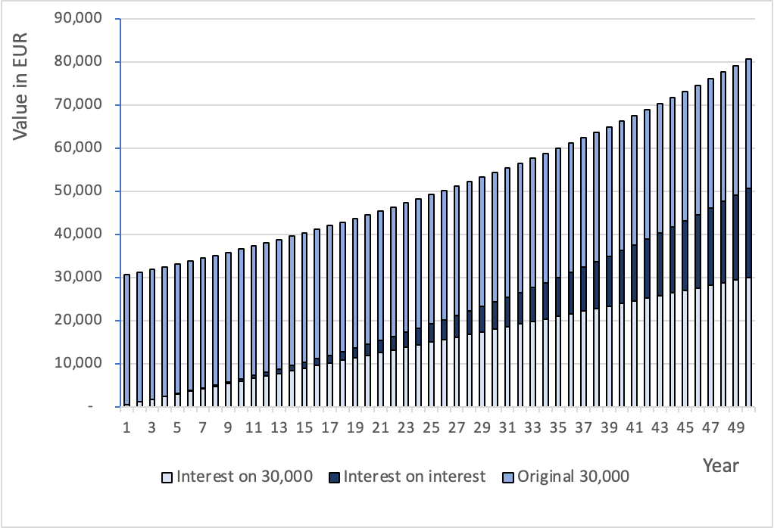
Compounding
Compounded interest is the interest received over the interest already stored in saving accounts
Capital with and without compounding
 | 2% not compounded |  |  | 2% compounded
Year | Capital | Return |  | Capital | Return
1 | 30,000 | 600 |  | 30,600 | 600
2 | 30,000 | 600 |  | 31,212 | 612
3 | 30,000 | 600 |  | 31,836 | 624
4 | 30,000 | 600 |  | 32,473 | 637
5 | 30,000 | 600 |  | 33,122 | 649
..
49 | 30,000 | 600 |  | 79,164 | 1,552
50 | 30,000 | 600 |  | 80,748 | 1,583
Value composition with compounding returns
Return from different compounding rates
Annual | Years
return | 10 | 20 | 30 | 40 | 50
2% | 36,570 | 44,578 | 54,341 | 66,241 | 80,748
4% | 44,407 | 65,734 | 97,302 | 144,031 | 213,201
8% | 64,768 | 139,829 | 301,880 | 651,736 | 1,407,048

Slide 11
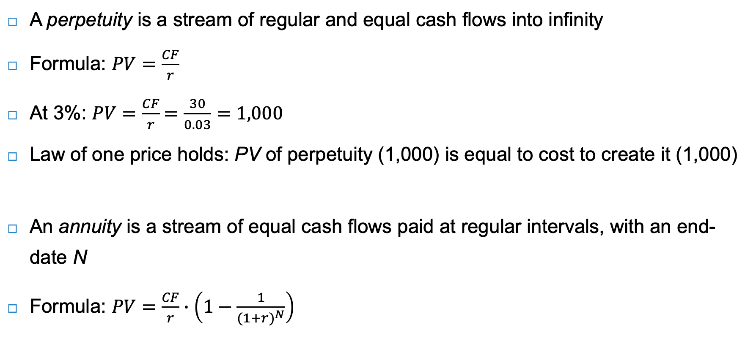
Perpetuities & Annuities
A perpetuity is a stream of regular and equal cash flows into infinity
Formula: $PV=\frac{CF}{r}$
At 3%: $PV=\frac{CF}{r}=\frac{30}{0.03}=1,000$
Law of one price holds: PV of perpetuity (1,000) is equal to cost to create it (1,000)
An annuity is a stream of equal cash flows paid at regular intervals, with an end-date N
Formula: $PV=\frac{CF}{r}∙\left(1−\frac{1}{{(1+r)}^{N}}\right)$

Slide 12
Opportunity cost of capital
What discount rate should investors use when discounting their expected cash flows?
The opportunity cost of capital is the best available return on an investment that has risk and conditions similar to the cash flows to be discounted
There are many determinants of discount rates, split into:
Components that drive government bond yields (benchmark rate)
Components that drive the premium:
corporate bond premium
equity premium

Slide 13
Benchmark – government bonds
The highest quality government securities are considered ‘risk-free’
Market discount rates are the benchmarks against which discount rates are determined
Yields of government bonds are influenced by expected short-term interest rates and the term premium
Risk-averse investors demand a term premium (or risk premium) for investments in long-term bonds
The term premium leads to a positive term spread, which is the difference between yields for bonds with longer maturity and yields for bonds with shorter maturity

Slide 14
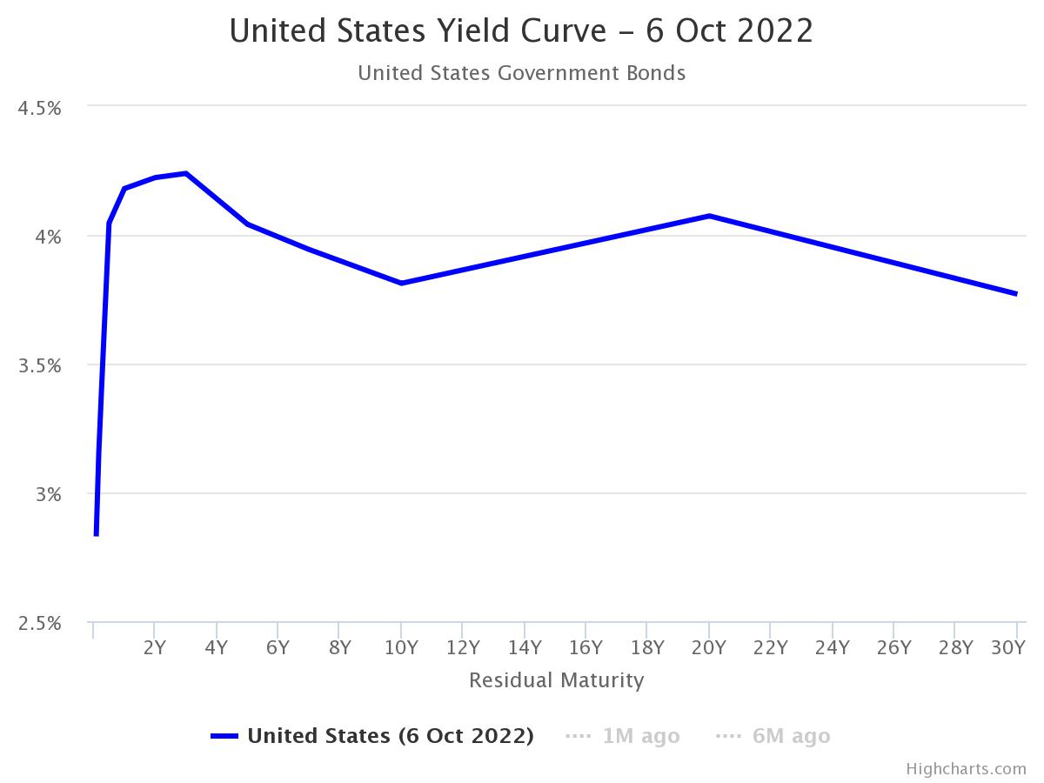
Government bond yield curve
A positive term spread reflects what is often called a ‘normal’ yield curve
A yield curve is a visualisation of the term structure, which is the relation between yields (in %) and maturities (in years) of otherwise similar bonds

Slide 15
Credit risk
Apart from interest rate expectations and the term premium, credit risk and liquidity also influence government bond yields
Credit risk premium is the spread between the yield of a particular bond and the yield of a bond with similar characteristics but without credit risk
Rating agencies (Moody’s, S&P, Fitch) indicate issuers’ credit risk by assigning them a credit rating, (AAA, A+, BBB-, etc.)
Drivers of country credit rating differences: per capita income, GDP growth, inflation, external debt, economic development and default history

Slide 16
Liquidity
Liquidity is the ease with which an investor can sell or buy a bond immediately at a price close to the market price
Liquidity premium is the spread between the yield of a bond with high liquidity and a similar bond with less liquidity
Example
A very liquid 1-yr government bond may trade at a yield of 4.17%
And a a less liquid 1-jr gov bond at a yield of 4.30%
Liquidity premium is then 13 basis points (4.30% - 4.17% = 0.13%)

Slide 17
Corporate bonds – yield
Default risk is the risk that a bond will not make its promised payments. This is higher for corporate bonds since, unlike governments, they do not have the option of raising taxes to meet their payment obligations
Corporate yield spread is the difference between yields on corporate bonds and government bonds with the same maturity and rating
The corporate yield spread can be calculated per rating class and per maturity
 | 1 year | 5 year | 10 year | 20 year
AAA corporate bonds | 4.39% | 4.30% | 4.39% | 4.61%
AAA government bonds | 4.07% | 3.85% | 3.65% | 4.04%
AAA corporate yield spread | 0.31% | 0.45% | 0.75% | 0.57%

Slide 18
Equities – market risk premium
Shareholders are residual claimants as they are paid only after other stakeholders have been paid
As a result, equity typically carries a higher risk than corporate bonds
The equity risk premium is the expected excess return of equities over the risk-free rate
The equity risk premium tends to be higher for smaller companies, more cyclical companies, and companies with weaker corporate governance

Slide 19
Discounting social and environmental capital
The counterparty of companies’ social and environmental capital is the wider society, representing current and future generations. This raises two fundamental and ethical questions:
Should current and future generations be treated equally?
What is the appropriate discount rate for society (the social discount rate)?
Equal treatment of current and future generations implies a zero time preference between current and future generations

Slide 20
Discounting social and environmental capital
Ramsay (1928) defined the discount rate $r^{s}$for societal projects as:
$$r^{s}=δ+η∙g$$
$δ$= time preference between current and future generations $g$ = growth rate $η$ = elasticity of marginal utility of consumption
Dasgupta (2021) finds that the vast majority of economists find a social discount rate of 1 to 3% appropriate for long-run public projects
Nordhaus (1994) with 4.3% is the exception
 | Social discount rate $r^{s}=δ+η∙g$ with $g=1.3\%$
Author | Time preference $δ$ | Elasticity $η$ | Discount rate $r^{s}$
Cline (1992) | 0% | 1.5 | 1.95%
Nordhaus (1994) | 3% | 1 | 4.3%
Stern (2006) | 0.1% | 1 | 1.4%

Slide 21
Discounting integrated capital
We assume a social discount rate of 2% (middle of Dasgupta’s 1% to 3% range)
Financial balance sheet for a standard company
Cost of capital = (20/100) x 4% + (80/100) x 9% = 8%
Integrated balance sheet for Company A with positive net assets on environmental value (EV)
Integrated cost of capital = (20/120) x 4% + (80/120) x 9% + (20/120) x 2% = 7%
Integrated balance sheet for Company B with negative net assets on environmental value (EV)
Integrated cost of capital = (20/80) x 4% + (80/80) x 9% - (20/80) x 2% = 9.5%

Slide 22
Internalisation
Similar starting financial balance can be different after (the anticipation of) internalisation of social and environmental externalities
The empirical prediction is:
Companies with large social and environmental liabilities will have a higher cost of integrated capital
Companies with social and environmental assets will enjoy a lower cost of integrated capital
The risk premium will rise when the risk of internalisation rises

Slide 23
Conclusions
Present values and discount rates are needed when considering the future in investment decisions
The counterparty of companies’ social and environmental capital is the wider society, representing current and future generations
An equal treatment of current and future generations implies a low social discount rate
Larger environmental and social liabilities raise the cost of integrated capital, while environmental and social assets lower the cost of integrated capital

