Slide 1
Corporate Finance for Long-Term Value
Chapter 9: Valuing public equity

Slide 2
Chapter 9: Valuing public equity
Part 3: Valuation of companies

Slide 3
The BIG Picture
Company valuation is at the core of corporate finance
Listed companies are traded (and valued) in financial markets
Different methods
While relative valuation methods rely on market metrics and efficient markets, absolute valuation brings a deeper (fundamental) understanding of companies
Key is to assess a company’s value drivers
Fundamental methods are most suited for integrating S & E factors into equity valuation

Slide 4
The public equity (or stock) market
Global stock markets reached a market capitalisation of $106 trillion in 2021, which is about 125% of global GDP
The joint stock company allows for the spreading of risk across many shareholders with residual claims and limited liability
Classification of investment types:
Active investing: based on fundamental or quantitative analysis of the company
Passive investing: through indices or ETFs (Exchange Traded Funds)
Most suitable for sustainability integration
Equities
Private
Public
Fundamental choice of business fundamentals
Quant choice of quant factors
Passive choice of index

Slide 5
Allocation role
Trading in stock markets facilitates price discovery
Puzzle of passive vs active investing
Passive investing limits cost of analysis and trading (active investing adds 70bps), but also limits scope for societal allocation role of finance
You need a minimum amount of active traders to get news into stock market prices (the so-called process of price discovery)
What is appropriate balance between passive and active investing?

Slide 6
Stock markets
Primary stock markets
New issues of stock are issued to investors
A firm’s initial public offering (IPO) is their first listing on a stock exchange
Secondary stock markets
Previously traded equities are traded again
If a firm sells new stock on an exchange, this is called a seasoned equity offering (SEO) or secondary public offering (SPO)

Slide 7
Initial Public Offerings (IPOs)
Disadvantages of IPOs:
Expensive procedure due to underwriters’ commission, legal fees, etc.
Creates a larger gap between external investors and managers, which could lead to more agency problems
Increased exposure to scrutiny of shareholders focused on short-term gain
Motives for IPOs:
To obtain funds to finance investments
Increased financial autonomy due to becoming less dependent on a single financial provider
Diversifies investment risk of owners
Increased recognition of company name
Better information and transparency due to disclosure requirements
Stock acts as disciplining mechanism for managers

Slide 8

Equity valuation
$$V_{0}=\frac{{FCF}_{1}}{(1+WACC)}+\frac{{FCF}_{2}}{(1+WACC)^{2}}+...+\frac{{FCF}_{N}+V_{N}}{(1+WACC)^{N}}$$
$$P=EPS∗\frac{P}{E}$$
Abbreviations
V Value
FCF Free cash flow
WACC Weighted average cost of capital
P Stock price
EPS Earnings per share
E Earnings
Absolue valuation
Relative valuation

Slide 9
Equity valuation
Absolute valuation methods
Based on the company’s cash flows, which are forecasted and then discounted at company’s discount rate
Three main value drivers
Sales, which are composed into volumes and price
Margins, which are analysed by type of costs and before or after depreciation, taxes and interest paid (EBIT)
Capital, which is split into the cost of capital (discount rate) and the uses of capital (capex, working capital)
Question – what is more important for valuation – cash flows or discount rate?
Academics – discount rate (capital)
Practitioners – cash flows (sales and margins)

Slide 10
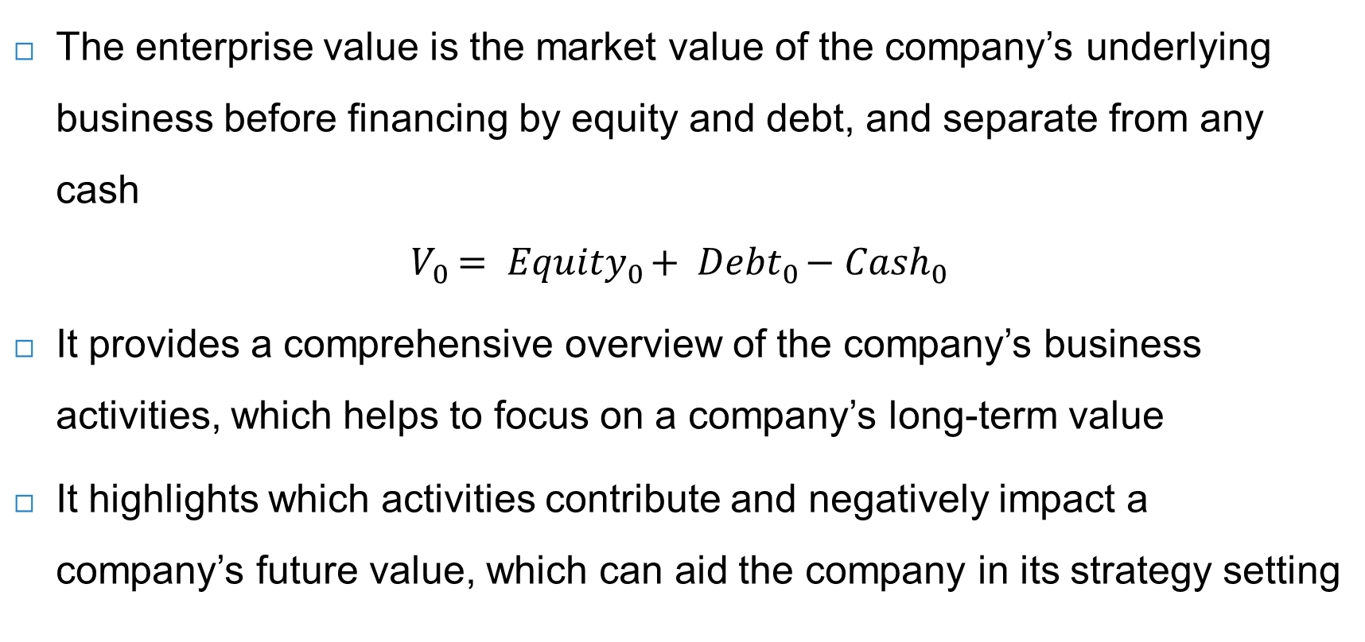
Enterprise value
The enterprise value is the market value of the company’s underlying business before financing by equity and debt, and separate from any cash
$$V_{0}= {Equity}_{0}+ {Debt}_{0}−{Cash}_{0}$$
It provides a comprehensive overview of the company’s business activities, which helps to focus on a company’s long-term value
It highlights which activities contribute and negatively impact a company’s future value, which can aid the company in its strategy setting

Slide 11
Dividend-discount model
The dividend discount-model looks at cash flows to equity investors
First, the cash flow of the dividend received
Second, the cash flow from the sale of the stock at a future date
Equation for stock price: $P_{0}= \frac{{Div}_{1}+P_{1}}{1+r_{E}}$, where:
${Div}_{1}$ is the net present value of dividends received during the year
$P_{1}$ is the stock price at the end of the year
$r_{E}$ is the cost of equity, which is the expected return of other investments in the market with similar risks
Rewriting the formula: $r_{E}=\frac{{Div}_{1}+P_{1}}{P_{0}}−1=\frac{{Div}_{1}}{P_{0}}+\frac{P_{1}−P_{0}}{P_{0}}$
Dividend yield
Capital gain

Slide 12
Multi-year dividend-discount model
The stock price is equal to the present value of the expected dividends
Assuming a constant dividend growth $g$, we get the following:
$P_{0}=\frac{{Div}_{1}}{(1+r_{E})}+\frac{{Div}_{1}∙(1+g)}{{(1+r_{E})}^{2}}+\frac{{Div}_{1}∙{(1+g)}^{2}}{{(1+r_{E})}^{3}}+…=\sum_{n=1}^{∞}{\frac{{Div}_{1}∙{(1+g)}^{n−1}}{{\left(1+r_{E}\right)}^{n}}}$
If an investor receives growing dividends into perpetuity, the equation becomes:
$$P_{0}=\frac{{Div}_{1}}{r_{E}−g}$$
Constant dividend growth model

Slide 13
Dividend payout ratio
The actual dividend depends on the payout ratio:
${Div}_{t}=\frac{{\text{Earnings}}_{t}}{{\text{Shares} \text{outstanding}}_{t}}× {\text{dividend} \text{payout} \text{ratio}}_{t}={EPS}_{t}$ $× {\text{dividend} \text{payout} \text{ratio}}_{t}$
${EPS}_{t}$ = earnings per share
An updated dividend-growth model includes share repurchases
$$P_{0}=\frac{PV \text{(}\text{total} \text{dividends} \text{and} \text{share} \text{repurchases})}{{\text{Shares} \text{outstanding}}_{0}}$$
Share repurchases are exempt of dividend tax, and are thus an efficient way of rewarding shareholders
The equity value is the present value of total dividends and share repurchases
$${Equity}_{0}=PV \text{(}\text{total} \text{dividends} \text{and} \text{share} \text{repurchases})$$

Slide 14
The discounted cash flow (DCF) model
The DCF model values a company’s assets based on their discounted future cash flows
The starting point is the earnings before interest and taxes $\text{EBIT}$
The company must pay corporate tax $τ$ on these earnings
Deduct net investment ($CAPEX$ – depreciation) and increases in net working capital $NWC$
The free cash flow $FCF$ of the company is:
$\text{FCF}\text{ = }\text{EBIT} × (1−\text{tax} \text{rate}\text{) }\text{−} CAPEX \text{+} \text{depreciation}\text{−} \text{increases} \text{in} NWC$

Slide 15
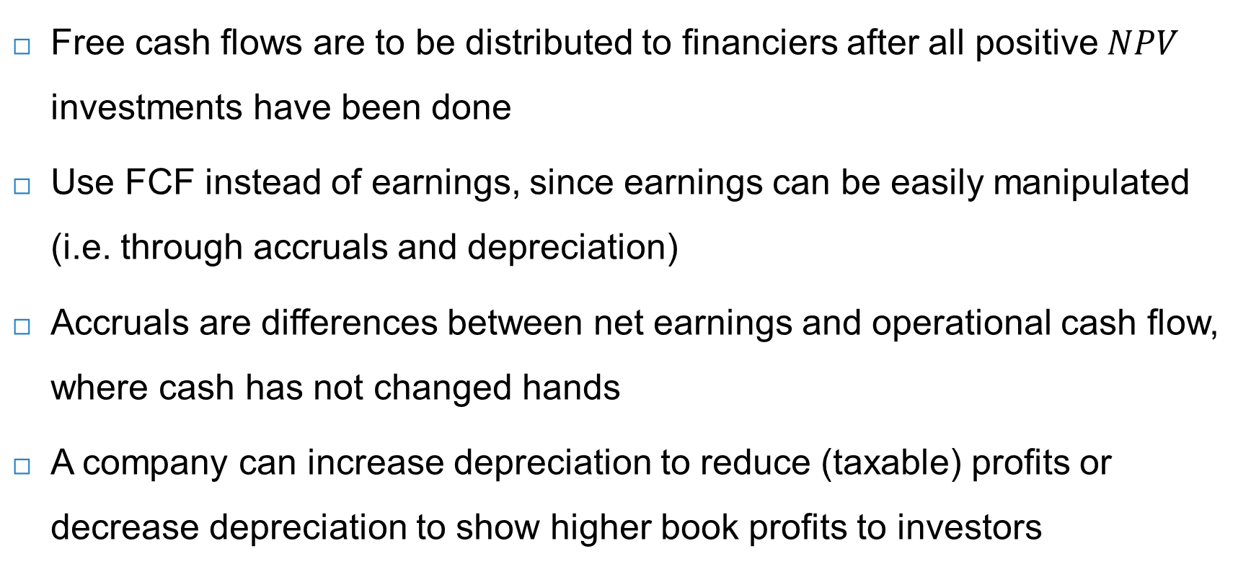
Free cash flows (FCF)
Free cash flows are to be distributed to financiers after all positive $NPV$ investments have been done
Use FCF instead of earnings, since earnings can be easily manipulated (i.e. through accruals and depreciation)
Accruals are differences between net earnings and operational cash flow, where cash has not changed hands
A company can increase depreciation to reduce (taxable) profits or decrease depreciation to show higher book profits to investors

Slide 16
Weighted average cost of capital
The free cash flows can be discounted to obtain the enterprise / company value $V_{0}$ at $t=0$:
$$V_{0}=\frac{{FCF}_{1}}{(1+WACC)}+\frac{{FCF}_{2}}{(1+WACC)^{2}}+...+\frac{{FCF}_{N}+{TV}_{N}}{(1+WACC)^{N}}$$
$WACC$ is the weighted average cost of capital, which is the rate of return demanded by the company’s financiers (of both equity and debt)
In the case of constant growth $g$:
$V_{0}=\frac{{FCF}_{1}}{WACC−g}$ $TV_{N}=\frac{{FCF}_{N+1}}{WACC−g}$
Same formula used to determine the terminal value

Slide 17
Assumptions in the DCF model
A $DCF$ valuation crucially relies on assumptions to be made on future $FCF$ and on the cost of capital $WACC$
Behavioural problem: analysts often extrapolate historical numbers into infinity
Having determined a company’s enterprise value $V_{0}$, the stock price $P_{0}$ can be determined as follows:
$$P_{0}=\frac{V_{0} − {Debt}_{0}+{Cash}_{0}}{{\text{Shares} \text{outstanding}}_{0}}=\frac{{Equity}_{0}}{{\text{Shares} \text{outstanding}}_{0}}$$

Slide 18
DCF example
$NOPLAT$ = net operating profit less adjusted taxes
$$ROIC=\frac{NOPLAT}{CAPEX − \text{depreciation}\text{ + }NWC}$$
$ROIC$ = return on invested capital

Slide 19
DCF equity valuation – changed EBIT (previously 12%)

Slide 20
Sensitivity analysis
A sensitivity analysis shows that ‘under reasonable assumptions’ the stock price can fluctuate between a range
Using DCF, Adidas’ stock price is €301.20 (based on 9% growth + 13% EBIT)
In the table below, assuming a ranging sales growth between 7% and 11% and EBIT margin between 11% and 15%, Adidas’ stock price can ‘reasonably’ fluctuate between €227.60 and €385.50

Slide 21
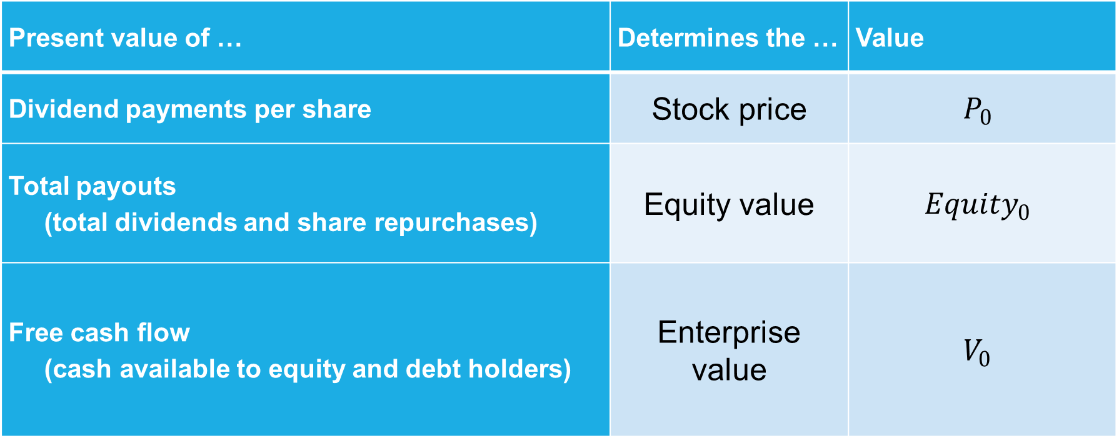
Comparing absolute valuation methods
Present value of … | Determines the … | Value
Dividend payments per share | Stock price | $$P_{0}$$
Total payouts (total dividends and share repurchases) | Equity value | $${Equity}_{0}$$
Free cash flow (cash available to equity and debt holders) | Enterprise value | $$V_{0}$$

Slide 22
Equity value multiples
In relative (or multiples) valuation, a stock value $P_{0}$ is derived from the given value of another comparable stock
$P_{0}={EPS}_{0}∗\frac{P}{E}$
A disadvantage of using the P/E ratio is that a company’s current earnings can be distorted → use forward P/E ratio instead, which are the expected earnings over the next year
Other method is the market price to book value ratio P/B, although this ratio fluctuates considerably making it imprecise and less reliable compared to P/E
Peer group’s P/E ratio
Company’s EPS

Slide 23
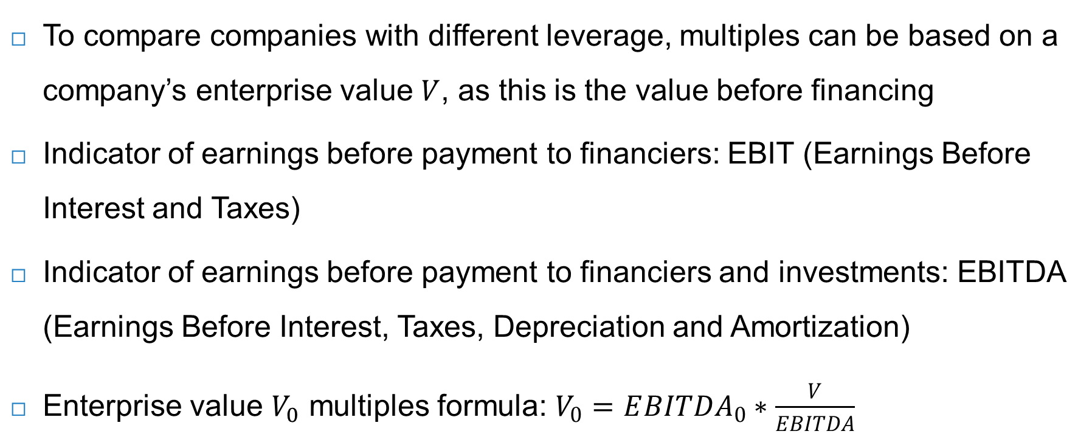
Enterprise value multiples
To compare companies with different leverage, multiples can be based on a company’s enterprise value $V$, as this is the value before financing
Indicator of earnings before payment to financiers: EBIT (Earnings Before Interest and Taxes)
Indicator of earnings before payment to financiers and investments: EBITDA (Earnings Before Interest, Taxes, Depreciation and Amortization)
Enterprise value $V_{0}$ multiples formula: $V_{0}=E{BITDA}_{0}∗\frac{V}{EBITDA}$
Peer group’s enterprise value / EBITDA
Company’s EBITDA

Slide 24
Integrating sustainability into value drivers
Adjusting value drivers on material sustainability issues allows for integration of sustainability into enterprise valuation
The value-driver adjustment provides the inward perspective on sustainability and is financially driven
Dependencies: inward
Business & financial value
Society & nature
Internalisation rate
Impacts: outward

Slide 25
Value driver adjustment (VDA) approach
Schramade’s (2016) Value Driver Adjustment (VDA) approach splits enterprise valuation into value drivers:
Sales, composed into volumes and price
Margins, analysed by type of costs and before or after depreciation, taxes, and interest paid
Capital, split into the cost of capital (discount rate) and the uses of capital (capex, working capital)
VDA approach highlights the company’s sources of competitive advantage

Slide 26
Value driver adjustment (VDA) approach
Three-step approach:
Identify and focus on the most material issues
Perform materiality analysis of the industry
Plotting likelihood of impact of each issue against its likely size
Analyse the impact of these material factors on the individual company
Assess company performance on material sustainability issues, both on absolute basis and relative to peers
Quantify competitive advantages to adjust for value driver assumptions
Make deliberate adjustments to value drivers based on company’s competitive (dis)advantages on material sustainability issues

Slide 27
Example VDA approach for medical company
Medical company assessed by analyst
Material issues: for industry - innovation, human capital, energy, circular economy
Performance: medtech’s strengths - innovation, human capital & capital management
Value driver adjustments: sales +100bps; margins +200bps; capital 0bps (see table)
Net result: increase in target stock price from €39.3 to €48.1 (see table)

Slide 28
Examples of value drivers
Novozymes Mining company
Valuation
Sales growth
Capital
Margins
Innovation
Human capital
Valuation
Sales growth
Capital
Margins
Price
Management of local stakeholders
Production volume
Environmental management

Slide 29
Integrated value calculation
Graph shows IV and its components: FV, EV, SV
Negative values of S and E raise risk of both debt and equity
S and E factors can be internalised and spill over into financial value
Integrated value
FV: enterprise value
Equity
Debt
EV
Components of S x their price
SV
Components of E x their price

Slide 30
Case-studies integrated value calculation
Case-studies integrated value
Ch6-7 – project valuation
Ch11 – company valuation Inditex
Make DCF for enterprise value FV
Make DCF for SV + EV
Integrate numbers
Ch18 – attempted take-over of Unilever by Kraft Heinz
Inditex IV calculation | Value (Euro billions)
FV (enterprise value) | 79
Positive SV | 283
Negative SV | -137
Negative EV | -183
IV (integrated value) | 42

Slide 31
Conclusions
To obtain a company’s value, equity valuations either:
Look at a company’s ‘fundamentals’ using absolute valuation models (e.g. DCF)
Compare a company to a similar company using relative valuation models (e.g. P/E ratio)
As residual claimholders, equity investors have strong incentives to help companies achieve the conditions for integrated value creation
Fundamental valuation methods - through a deeper understanding of a company’s value drivers – are most suited to sustainability integration

