Slide 1
PRINCIPLES OF
SUSTAINABLE FINANCE
Chapter 10: Banking –
new forms of lending
Principles of Sustainable Finance © Schoenmaker and Schramade 2019 Oxford University Press

Slide 2
Overview of the book
Part I: What is sustainability and why does it matter?
Sustainability and the transition challenge
Part II: Sustainability’s challenges to corporates
Externalities - internalisation
Governance and behaviour
Coalitions for sustainable finance
Strategy and intangibles – changing business models
Integrated reporting - metrics and data
Part III: Financing sustainability
Investing for long-term value creation
Equity – investing with an ownership stake
Bonds – investing without voting power
Banks – new forms of lending
Insurance – managing long-term risk
Part IV: Epilogue
Transition management and integrated thinking
Principles of Sustainable Finance © Schoenmaker and Schramade 2019 Oxford University Press

Slide 3
Learning objectives – chapter 10
explain the role of banks in screening and monitoring (potential) borrowers
explain the relevance of sustainability for banking
understand how ESG risks can be incorporated in the credit risk assessment
list the barriers and incentives to sustainable lending
understand the various forms of impact lending and microfinance
Principles of Sustainable Finance © Schoenmaker and Schramade 2019 Oxford University Press

Slide 4
Sustainability of banks
Principles of Sustainable Finance © Schoenmaker and Schramade 2019 Oxford University Press

Slide 5
Governance of banks themselves
Values-based banks
Global banks
Social capital matters
Performed worse during crisis, but better before
Principles of Sustainable Finance © Schoenmaker and Schramade 2019 Oxford University Press
Notes:
The tools are there to make the connection

Slide 6
Value based banks vs global banks

Slide 7
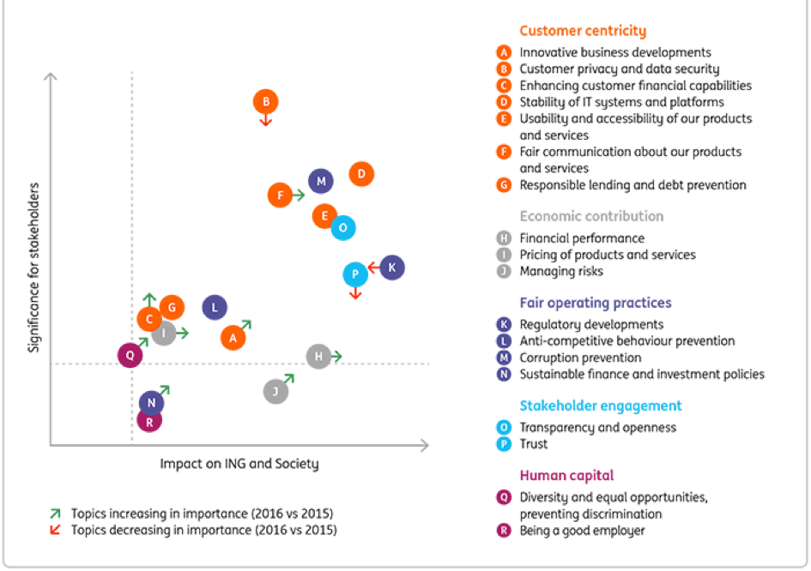
ING’s materiality matrix

Slide 8
Why does sustainability matter to lending?
Principles of Sustainable Finance © Schoenmaker and Schramade 2019 Oxford University Press

Slide 9
Relevance of sustainability to lending
Environmental, social and governance factors
Factors influencing creditworthiness
Credit risk indicators
ESG factors do not only influence creditworthiness company
But also impact on collateral value (e.g. real estate)
Principles of Sustainable Finance © Schoenmaker and Schramade 2019 Oxford University Press

Slide 10
Bank credit is important!

Slide 11
Two broad approaches
Risk based
Values based
Integrate ESG factors into credit assessment
Mission driven: impact comes first
Principles of Sustainable Finance © Schoenmaker and Schramade 2019 Oxford University Press
Notes:
The tools are there to make the connection

Slide 12
Integration of sustainability
Principles of Sustainable Finance © Schoenmaker and Schramade 2019 Oxford University Press

Slide 13
Risk-based approach
Principles of Sustainable Finance © Schoenmaker and Schramade 2019 Oxford University Press

Slide 14
Sustainability credit core system
1) Analyse company’s industry
2) Paths for average company
a) Business as usual
b) Sustainable business
c) Future sustainable business
3) Determine material (ESG) issues
4) Define weights & combine into overall credit assessment
plus vulnerabilities / opportunities
Analyse company’s industry
Paths for average company
Business as usual
Sustainable business
Future sustainable business
Determine material (ESG) issues, plus vulnerabilities / opportunities
Define weights and combine elements into overall credit assessment
Principles of Sustainable Finance © Schoenmaker and Schramade 2019 Oxford University Press

Slide 15
Sustainability policies
Several banks apply sustainability policies
General and sectoral parts
Examples of sectoral lending policies
Westpac: zero net deforestation
Rabobank: food and agri standards (see Box 10.2)
New approaches with focus on transition towards 2⁰C
Terra – look at technology scenarios for each industry
Grant loans which are consistent with projected installed base
Principles of Sustainable Finance © Schoenmaker and Schramade 2019 Oxford University Press

Slide 16
Assessment clients
Determine material ESG factors
Questions to clients on:
Meeting regulations (compliance)
Their own initiatives (commitment)
What they can do (e.g. supply chain, reporting)
Track record (e.g. incidents, media attention)
Principles of Sustainable Finance © Schoenmaker and Schramade 2019 Oxford University Press

Slide 17
Sustainability criteria for credit risk management

Slide 18
Loan facility to Philips
Lead arranger of five-year loan facility
Has conducted credit risk assessment; and
Acts as sustainability coordinator in loan syndicate
A leading sustainable corporate
‘Healthy People, Sustainable Program’
ING
Philips
If sustainability performance up, interest rate goes down
Measured by Sustainalytics
Up to 5-10% of credit spread
Loan
Principles of Sustainable Finance © Schoenmaker and Schramade 2019 Oxford University Press

Slide 20
Circular business models (Chapter 5)
The value hill in a circular economy:
Repair/maintain
Add value
Retain value
User
Retail
Reuse/redistribute
Assembly
Refurbish
Manufacturing
Remanufacture
Recycle
Extraction
Pre-use
Use
Post-use
Principles of Sustainable Finance © Schoenmaker and Schramade 2019 Oxford University Press

Slide 21
Circular business models
Closed loop supply chain
Materials remain with party that can do most with these materials
New production technologies
Longer life time products
From selling to using: payment for service models
Business components
Pre-use: design and manufacturing
Use: services
Post-use: refurbishment
Principles of Sustainable Finance © Schoenmaker and Schramade 2019 Oxford University Press

Slide 22
Financing circular business models
New challenges for financing
From asset based (collateral)
To cash flow based (clients)
Asset based (inventory)
Standardisation, modularity and flexibility
Cash flow based (strategy, network, customers)
Where is value part in product chain?
Contract terms + quality customers
Principles of Sustainable Finance © Schoenmaker and Schramade 2019 Oxford University Press

Slide 23
Sustainable lending
Evidence: Chava (2014) – lower (higher) interest rates for loans to companies with environmentally friendly products (environmental concerns)
Barriers:
Training account managers to include ESG in due diligence and calculation of credit risk premium
Status quo existing clients -> higher risk premium / ban
Maturity risk < 10 years, while ESG long term
Principles of Sustainable Finance © Schoenmaker and Schramade 2019 Oxford University Press

Slide 24
Example of old vs new thinking
Assessing a large investment in new battery facility
Traditional credit risk assessment
High risk due to large investment with business risk
Sustainable credit risk assessment
Opportunity due to transition to renewable energy
No loan or high credit risk premium
Low credit risk premium
Better!
Principles of Sustainable Finance © Schoenmaker and Schramade 2019 Oxford University Press

Slide 25
Incentives
Nudging: base rate for low ESG risk projects and extra premium for projects with ESG concerns
Example: energy-efficient mortgages
Real estate very important (60% lending portfolio)
Capital adequacy framework:
Should it be used for sustainability?
If so, green support factor or brown capital charge?
Principles of Sustainable Finance © Schoenmaker and Schramade 2019 Oxford University Press

Slide 26
Values-based banking
Principles of Sustainable Finance © Schoenmaker and Schramade 2019 Oxford University Press

Slide 27
Values-based banking: impact lending
Principles of Sustainable Finance © Schoenmaker and Schramade 2019 Oxford University Press

Slide 28
Scorecard – values based banks
Principles of Sustainable Finance © Schoenmaker and Schramade 2019 Oxford University Press

Slide 29
Scorecard – Cont’d
Principles of Sustainable Finance © Schoenmaker and Schramade 2019 Oxford University Press

Slide 30
Microfinance / microcredit
Microfinance: banking service to low-income or unemployed and micro-enterprises
Pioneers in Bangladesh (different from traditional banking)
Social control, group lending, etc.
Challenges + opportunities
Unserviceable and unreachable part of population
Small loans at affordable cost
New approaches: satellite linked with mobile vans/boats
Use mobile telephones
Principles of Sustainable Finance © Schoenmaker and Schramade 2019 Oxford University Press

Slide 31
Conclusions
Integrate sustainability in credit risk assessment
New approach for account managers
New ways of looking (transition preparedness; circular models)
Policy and technology uncertainty (future is uncertain)
Material ESG issues differ across sectors/companies
Values-based banking: impact comes first
Microfinance emerging in Asia, Latin-America and Africa
Principles of Sustainable Finance © Schoenmaker and Schramade 2019 Oxford University Press
Notes:
The tools are there to make the connection

