Slide 1
PRINCIPLES OF
SUSTAINABLE FINANCE
Chapter 12: Transition management
Principles of Sustainable Finance © Schoenmaker and Schramade 2019 Oxford University Press

Slide 2
Overview of the book
Part I: What is sustainability and why does it matter?
Sustainability and the transition challenge
Part II: Sustainability’s challenges to corporates
Externalities - internalisation
Governance and behaviour
Coalitions for sustainable finance
Strategy and intangibles – changing business models
Integrated reporting - metrics and data
Part III: Financing sustainability
Investing for long-term value creation
Equity – investing with an ownership stake
Bonds – investing without voting power
Banks – new forms of lending
Insurance – managing long-term risk
Part IV: Epilogue
Transition management and integrated thinking
Principles of Sustainable Finance © Schoenmaker and Schramade 2019 Oxford University Press

Slide 3
Learning objectives – chapter 12
understand the dynamics of transition management
explain a new vision and approaches in the financial sector
understand the need for a interdisciplinary approach
apply the concept of integrated thinking
Principles of Sustainable Finance © Schoenmaker and Schramade 2019 Oxford University Press

Slide 4
Transition governance
Principles of Sustainable Finance © Schoenmaker and Schramade 2019 Oxford University Press

Slide 5
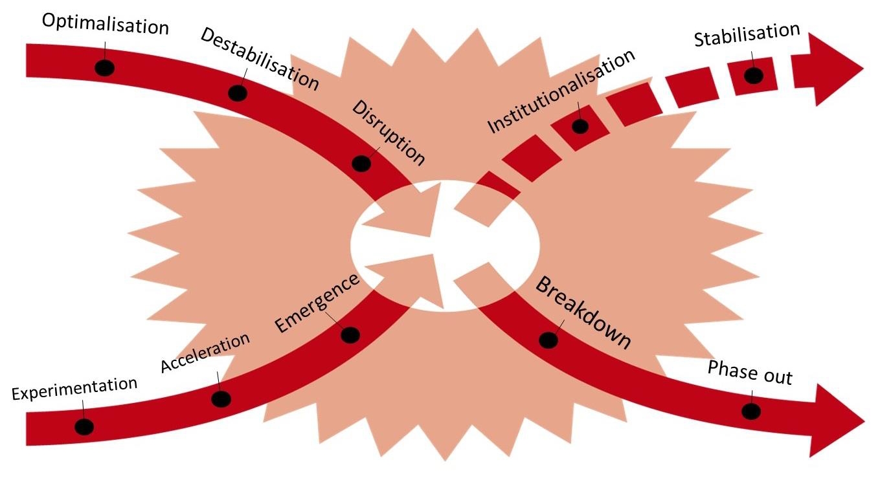
The x-curve of transition dynamics
Principles of Sustainable Finance © Schoenmaker and Schramade 2019 Oxford University Press

Slide 6
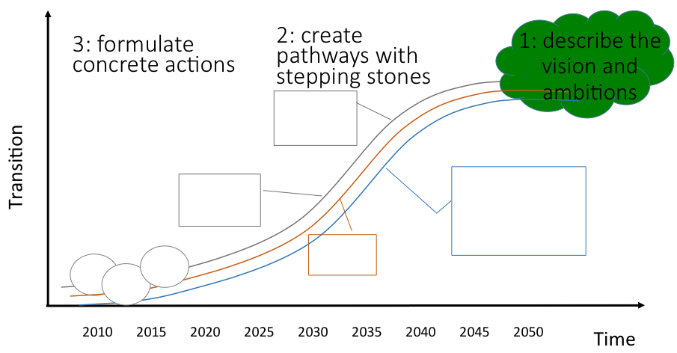
Backcasting
Principles of Sustainable Finance © Schoenmaker and Schramade 2019 Oxford University Press

Slide 7
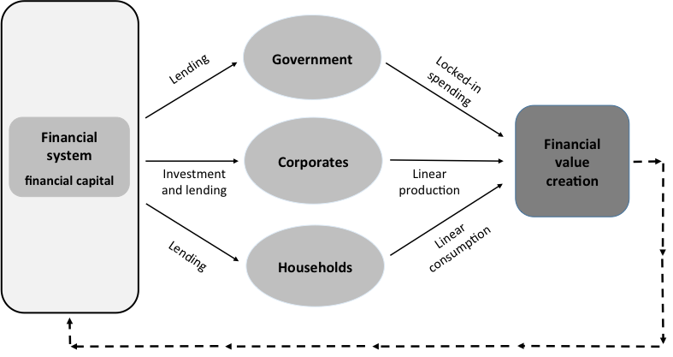
From an old vision ….
Principles of Sustainable Finance © Schoenmaker and Schramade 2019 Oxford University Press

Slide 8
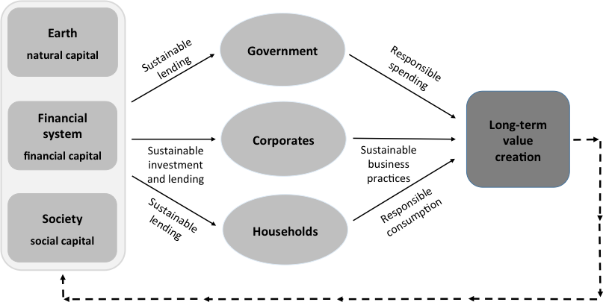
To a new vision for the financial sector
Principles of Sustainable Finance © Schoenmaker and Schramade 2019 Oxford University Press

Slide 9
Transition management
Principles of Sustainable Finance © Schoenmaker and Schramade 2019 Oxford University Press

Slide 10
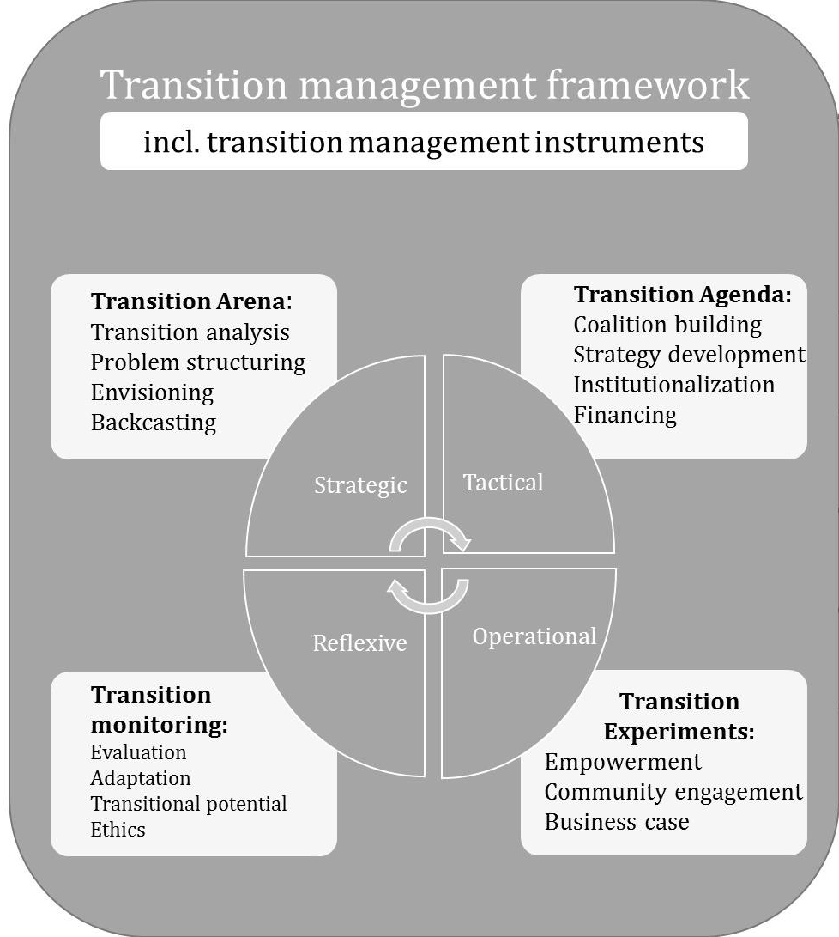
Principles of Sustainable Finance © Schoenmaker and Schramade 2019 Oxford University Press

Slide 11
Transition of the financial system
Current dominant practices and beliefs
A new regime
  Investing in market benchmarks (financial risk – return thinking)
  Sustainability comes at the expense of financial return
  Fear of entering unchartered waters
Need for leadership and changed mindset (Theory U)
Integrated thinking
Principles of Sustainable Finance © Schoenmaker and Schramade 2019 Oxford University Press

Slide 12
Integrated thinking
Portfolio managers
Engagement division
Management
Interdisciplinary teams
Integrated approach
I = F + S + E
Principles of Sustainable Finance © Schoenmaker and Schramade 2019 Oxford University Press

Slide 13
Personal change
Transformative actors adopt new approaches
Intrinsic motivation needed
Re-boot current culture
Degree of materialism is indicator for F focus
New environmental paradigm: need to preserve balance of nature
Incentives (financial) / nudging can steer behaviour, but not
sufficient for real change
Theory U: change of mindset
Responsible management education
Will also attract human talent
Principles of Sustainable Finance © Schoenmaker and Schramade 2019 Oxford University Press

Slide 14
Conclusion - transition dynamics
Principles of Sustainable Finance © Schoenmaker and Schramade 2019 Oxford University Press

