Slide 1
PRINCIPLES OF
SUSTAINABLE FINANCE
Chapter 2: Externalities - internalisation
Principles of Sustainable Finance © Schoenmaker and Schramade 2019 Oxford University Press

Slide 2
Overview of the book
Part I: What is sustainability and why does it matter?
Sustainability and the transition challenge
Part II: Sustainability’s challenges to corporates
Externalities - internalisation
Governance and behaviour
Coalitions for sustainable finance
Strategy and intangibles – changing business models
Integrated reporting - metrics and data
Part III: Financing sustainability
Investing for long-term value creation
Equity – investing with an ownership stake
Bonds – investing without voting power
Banks – new forms of lending
Insurance – managing long-term risk
Part IV: Epilogue
Transition management and integrated thinking
Principles of Sustainable Finance © Schoenmaker and Schramade 2019 Oxford University Press

Slide 3
Learning objectives – chapter 2
explain the concepts of externality and internalisation
understand the role of government regulation and taxation
understand the integrated value approach for measuring externalities
explain policy and technology uncertainty
use scenario analysis
Principles of Sustainable Finance © Schoenmaker and Schramade 2019 Oxford University Press

Slide 4
Why externalities matter
Principles of Sustainable Finance © Schoenmaker and Schramade 2019 Oxford University Press

Slide 5
Impact of people on nature
I = P * A * T
I = Impact on natural resources
P = Population (number of persons)
A = Affluence (consumption per person)
T = Technology (impact per unit consumption)
Principles of Sustainable Finance © Schoenmaker and Schramade 2019 Oxford University Press

Slide 6
Natural resources are finite
Non-renewable or abiotic resources Nª are finite
Speed of depletion T in years depends on annual demand Dª
  T = Nª / Dª
Example: T = 70 years for copper (Cu)
  But depends on new discoveries (Nª ⬆)
  And intensified use (Dª ⬆) and re-cycling (Dª ⬇)
Principles of Sustainable Finance © Schoenmaker and Schramade 2019 Oxford University Press

Slide 7
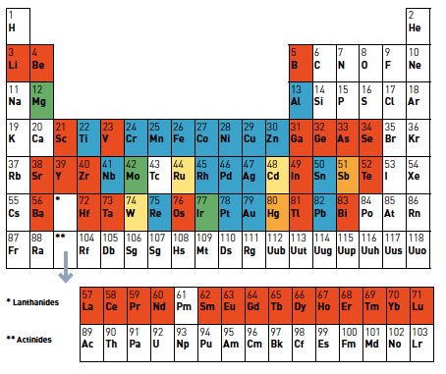

Recycling rates
Principles of Sustainable Finance © Schoenmaker and Schramade 2019 Oxford University Press

Slide 8
Social and human capitals
Goal of decent work and inclusive economic growth (SDG 8)
  Preserve social (S) and human (H) in production process
Common language: link SDGs to capitals (S, H, N)
Not only negative, but also positive externalities
  N: companies investing in renewable energy; material savings
  S + H: companies training employees; sustainable food production and improvement of health care
Principles of Sustainable Finance © Schoenmaker and Schramade 2019 Oxford University Press

Slide 9
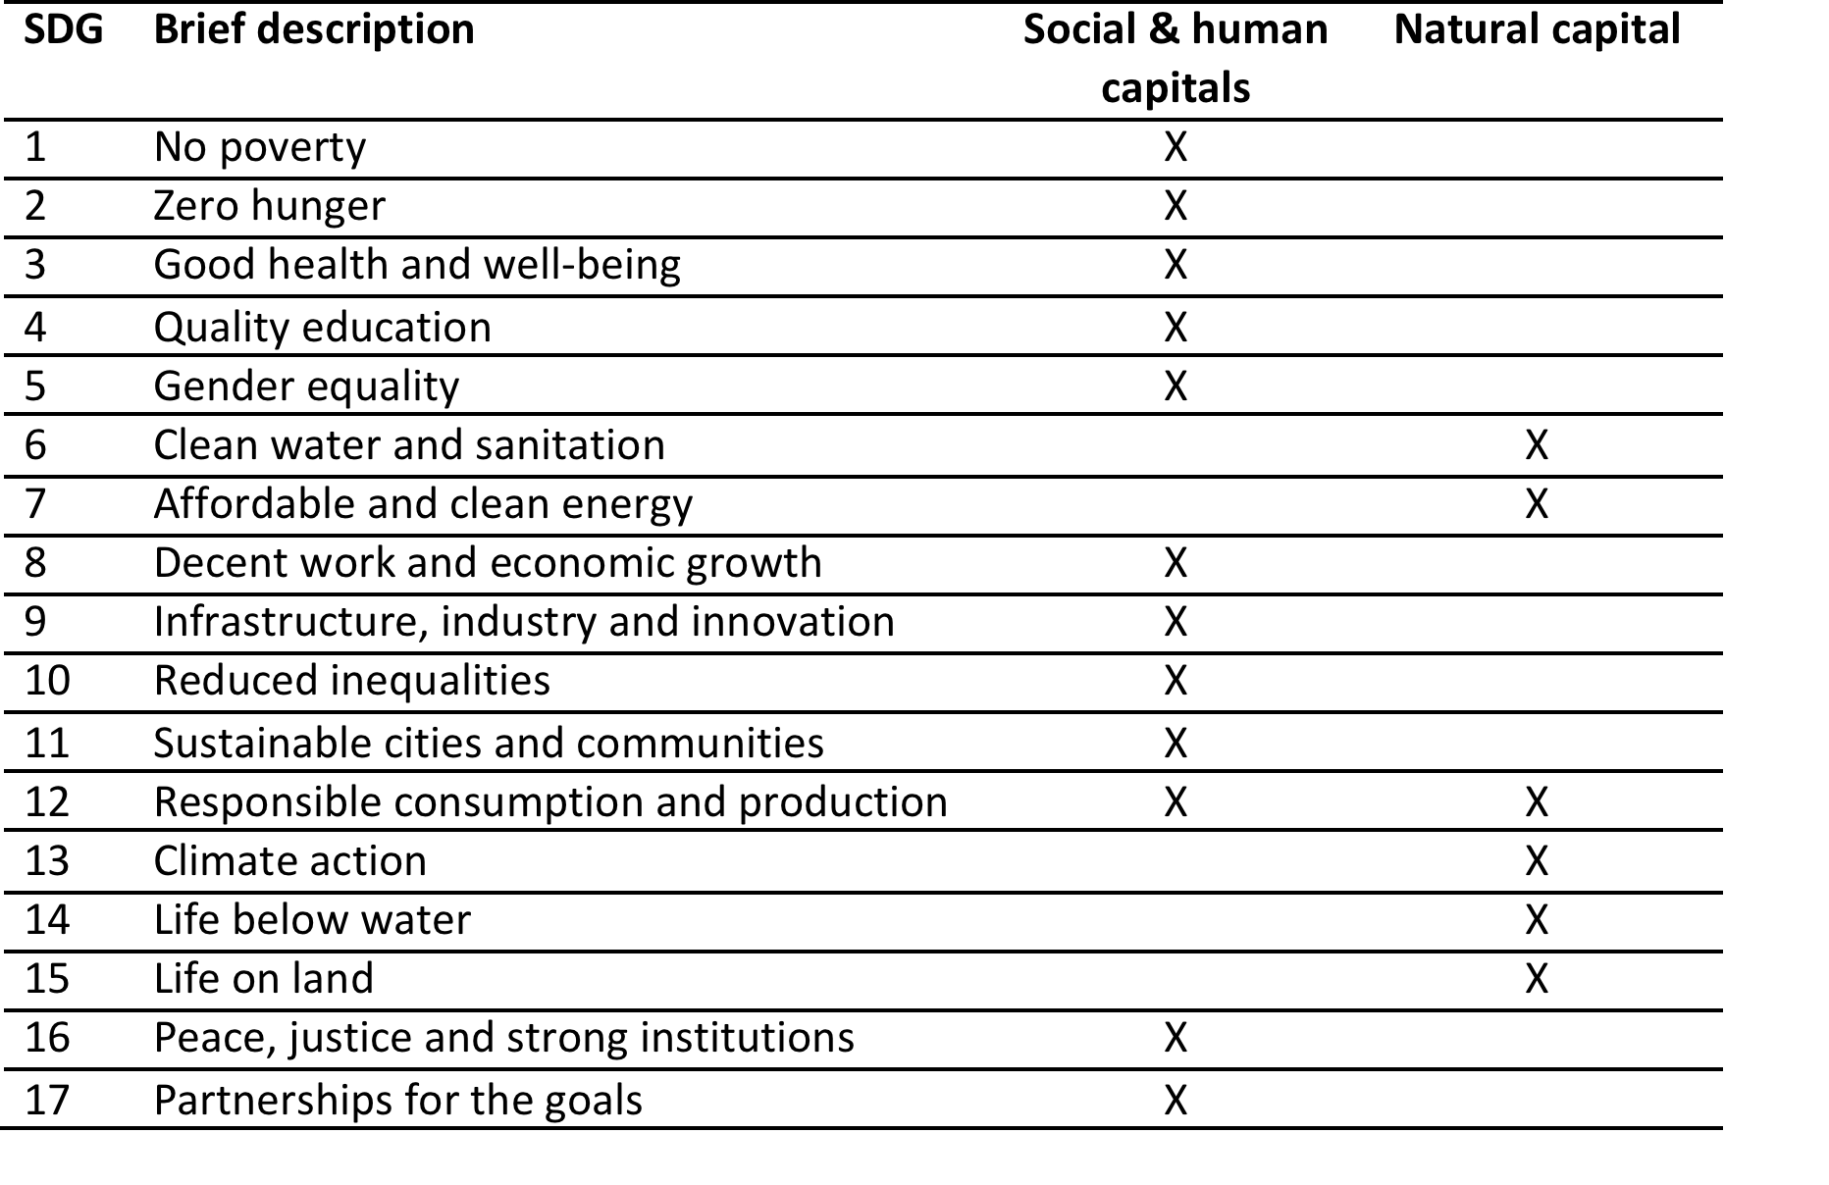
Linking SDGs and Capitals

Slide 10

Perspectives on externalities
Human rights advocate: ensuring every person’s claim to life’s essentials
Economist:
a public good which is not priced
Ecologist:
need to operate within ecological limits
F
S
E
Sustainable development: I = F + S + E
Principles of Sustainable Finance © Schoenmaker and Schramade 2019 Oxford University Press

Slide 11
Internalising externalities
Internalisation
Government: regulation or taxation
Civil society: NGOs can raise awareness (advocacy)
Financials: incorporate ESG factors in investment + lending
Corporates: incorporate costs of externalities in production
Consumers: buy sustainable products and services
Problem: externalities not reflected in market prices
Principles of Sustainable Finance © Schoenmaker and Schramade 2019 Oxford University Press

Slide 12
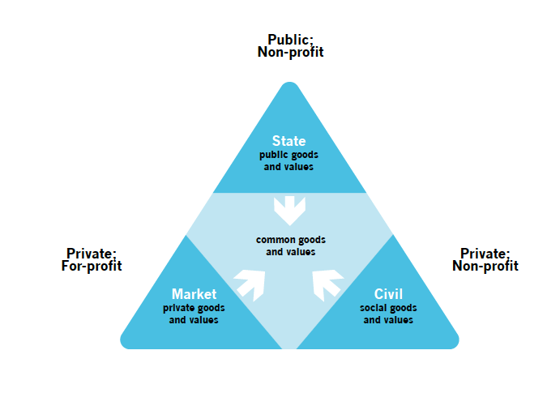
Who should act?
Principles of Sustainable Finance © Schoenmaker and Schramade 2019 Oxford University Press

Slide 13
Why integrate ESG factors?
Anticipation of regulation / taxation
(e.g. carbon tax)
Reputation – pressure from NGOs and consumers
Future-proof: transition to SDGs by 2030
Principles of Sustainable Finance © Schoenmaker and Schramade 2019 Oxford University Press

Slide 14
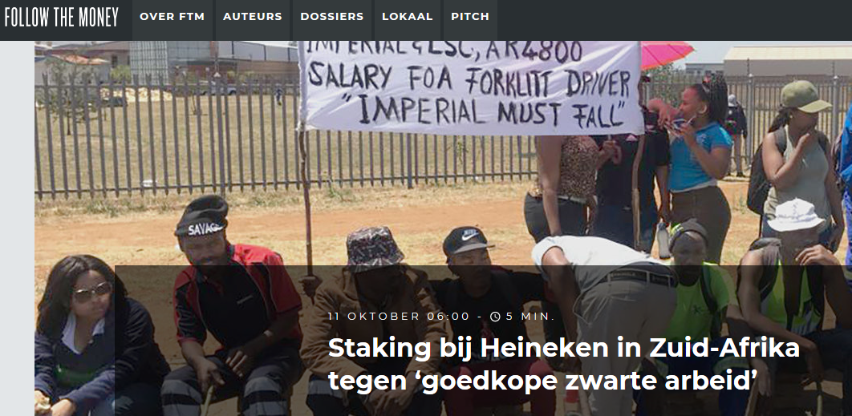
Example of reputation risk
  Violating SDG 8 - Decent work, incl. paying ‘living wage’
Principles of Sustainable Finance © Schoenmaker and Schramade 2019 Oxford University Press

Slide 15
Internalisation of social and environmental impacts
Impacts
Business
Society
Internalisation
rate
Dependencies
Principles of Sustainable Finance © Schoenmaker and Schramade 2019 Oxford University Press

Slide 16
Government intervention
Principles of Sustainable Finance © Schoenmaker and Schramade 2019 Oxford University Press

Slide 17
Government intervention
The climate economy guru - Nicolas Stern (2015):
“Why Are We Waiting? The Logic, Urgency, and Promise of Tackling Climate Change”
Main recommendations
Energy infrastructure investments lock in energy use for 20 years ➔ stop investing in fossil fuel powered utilities and networks
First best: carbon tax of $40-50 per tCO₂e by 2020 and $50-100 by 2030
Principles of Sustainable Finance © Schoenmaker and Schramade 2019 Oxford University Press

Slide 18
Basic approaches to reduce externalities
Raising prices through taxation to reduce demand
Limiting quantity directly through regulatory quotas (letting prices adjust)
They give theoretically the same result
unless the demand curve is uncertain
Principles of Sustainable Finance © Schoenmaker and Schramade 2019 Oxford University Press

Slide 19

Example regulatory approach
Principles of Sustainable Finance © Schoenmaker and Schramade 2019 Oxford University Press

Slide 20
Taxing externalities
Carbon tax is efficient way to get public good of low carbon economy
    Marginal adjustment cost = tax
Alternative is Emissions Trading Systems (ETS) – cap emissions and trade allowances
Also taxes on natural resources to prevent depletion
Principles of Sustainable Finance © Schoenmaker and Schramade 2019 Oxford University Press

Slide 21
Carbon taxes in practice
Early adopters
Laggards
Scandinavian countries started in 1990s – now at $50-130 per tCO₂e
Result: reduction in emissions, without loss of economic growth
Key is redirecting taxes: taxing carbon instead of labour
Most countries have no effective carbon taxes
Even worse: fossils fuels are subsidised up to $330 bn
Subsidies very inefficient way of income support in low-income countries
Principles of Sustainable Finance © Schoenmaker and Schramade 2019 Oxford University Press

Slide 22
Social externalities
High income countries
- max working hours
Low income countries
- underpayment
- health and safety regulation
- gender equality
- minimum wage
- human rights
- child labour
- advances in education, but…
Instruments
Living wage (SDG 8) instrumental for other SDGs (poverty, hunger, health care, education), as living wage allows families to live decently
Taxes to change behaviour: alcohol, tobacco, sugar rich beverages, etc.

Slide 23
Discussion: who acts first?
Who should act first to internalise externalities?
  Government should tax and regulate versus
  all parties should act
Principles of Sustainable Finance © Schoenmaker and Schramade 2019 Oxford University Press

Slide 24
Measuring and pricing externalities
Principles of Sustainable Finance © Schoenmaker and Schramade 2019 Oxford University Press

Slide 25
How to deal with externalities?
What can business do with remaining externalities?
Measuring and monetisation is possible through technology (IT, data) and science (life cycle analyses, environmental economics)
Pricing is possible by optimising across F, S and E dimension

Slide 26
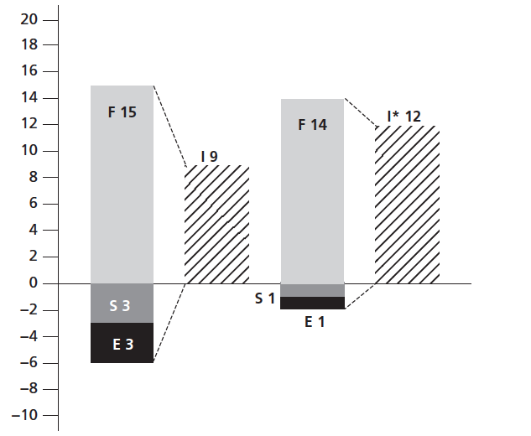
From financial value to integrated value

Slide 27
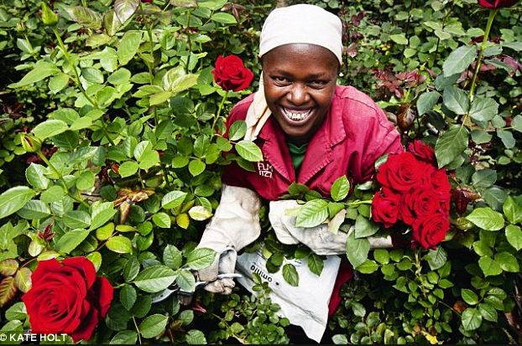
True prices of roses from Kenya
Conventional price € 0.70 (F) and true price € 0.92 (F+S+E)
Optimised true price € 0.74
Optimise production process (reducing S + E)
Transport by ship to reduce carbon emissions
Solar powered greenhouse
Closed-loop hydroponics to reduce water + fertiliser use
Training in health and safety to improve workers’ skills
Gender committees to reduce harassment + gender discrimination
Pay a basic living wage to improve wellbeing of workers
Principles of Sustainable Finance © Schoenmaker and Schramade 2019 Oxford University Press

Slide 28
Pitfalls to monetisation
Calculation done on efficiency grounds
  But also need to invest in adaptive capacity to absorb shocks
  Example: overinvest in safety to protect people & environment and
  to reduce production losses
Ethical aspects of externalities
  Difficult to monetise ethical aspects, like human rights
  Three capitals (F, S, E) are not substitutable
Perverse outcomes
  Negative impact of deforestation can be offset by large economic gains
  Use constraint of equation 1.2: SEV_{t+1} ≥ SEV_{t}
Principles of Sustainable Finance © Schoenmaker and Schramade 2019 Oxford University Press

Slide 29
Scenario analysis
Principles of Sustainable Finance © Schoenmaker and Schramade 2019 Oxford University Press

Slide 30
Policy uncertainty
Technological uncertainty
Timing: when will labour laws be tightened and carbon taxes be introduced
Reversal: policies may be reversed / changed (e.g. solar panel subsidies)
Exponential growth: new innovations and spectacular rise of renewables (solar PV, wind) ➔ Moore’s law: doubling of capacity each x years
Changes in consumer behaviour and preferences
Principles of Sustainable Finance © Schoenmaker and Schramade 2019 Oxford University Press

Slide 31
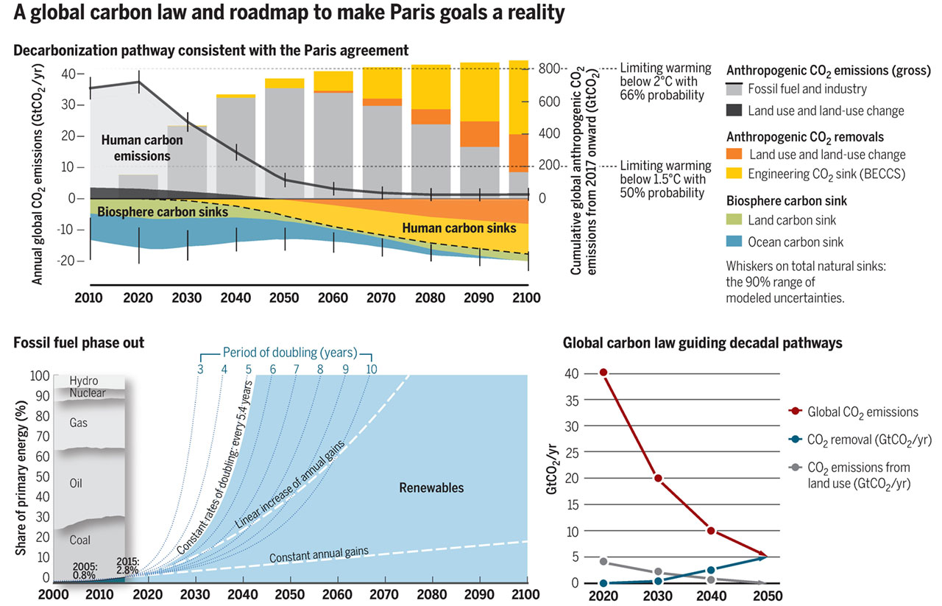
Exponential growth of renewables
Principles of Sustainable Finance © Schoenmaker and Schramade 2019 Oxford University Press

Slide 32
Stranded assets
Which assets?
Government regulation (e.g. carbon pricing), or
Technological change (e.g. reduced cost of solar PV or wind)
Carbon pricing affects all carbon-intensive assets
Broadly applicable: car parks in cities can become stranded asset (car share)
Intensive agriculture (fertiliser + irrigation) may lead to degraded land (lower soil quality), species loss and human migration
Principles of Sustainable Finance © Schoenmaker and Schramade 2019 Oxford University Press

Slide 33
Environmental exposures beyond energy sector
Environmental exposures beyond energy sector
Source: Calculations based on Eurostat data.
Notes: Real estate emissions include household heating and cooling costs

Slide 34
Scenario analysis
Scenario analysis to get insight in development of externalities over time
Strategic approach to making scenarios
  Determine most important uncertainties for the future
  Elaborate the scenarios with trends, uncertainties and possible actions
  Re-present scenarios as appealing stories about (paths to) the future
Analyst reports are the fortune tellers of investor community
  From DCF analysis of main scenario (often ‘business as usual’)
  Towards DCF analysis of 3 or 4 scenarios including disruptions and
  internalising externalities
Principles of Sustainable Finance © Schoenmaker and Schramade 2019 Oxford University Press

Slide 35
Impact of scenarios on DCF
Impact on cashflows? (e.g. loss of market share)
€
Terminal value
Impact on terminal value?
Cash in
Time
Cash out
Discount Rate
Impact on risk premium?
Principles of Sustainable Finance © Schoenmaker and Schramade 2019 Oxford University Press

Slide 36
Adverse scenario: disorderly transition
Shift to low-carbon economy requires strong reductions in carbon emissions
An early and gradual shift can facilitate a soft landing in a low carbon economy
The adverse scenario is a hard landing with large emissions cuts implemented over a short horizon
Amplified by lack of technical progress
A later transition may also pose larger physical risks from climate change
Principles of Sustainable Finance © Schoenmaker and Schramade 2019 Oxford University Press

Slide 37
Stress testing
Central banks and supervisors conduct (climate) stress tests of financial sector using extreme scenarios
Goal is to
  Raise awareness of major environmental exposures at financials
  Monitor major concentrations at financials in supervision
Possible instruments
  Large exposure rules for high carbon concentrations
  Brown capital charge for high carbon assets
Principles of Sustainable Finance © Schoenmaker and Schramade 2019 Oxford University Press

Slide 38
Conclusions
Social and environmental externalities are relevant, but absent in traditional production function and neo-classical finance
Instruments to internalise externalities
  Government: taxes and regulation first best, but not always done
  Business: incorporating S + E in decision making (integrated value)
Scenario analysis is tool to deal with uncertainties
  Calculate value company under different scenarios
  Prompt companies to reconsider strategy and take action
Principles of Sustainable Finance © Schoenmaker and Schramade 2019 Oxford University Press

