Slide 1
PRINCIPLES OF
SUSTAINABLE FINANCE
Chapter 3: Governance and behaviour
Principles of Sustainable Finance © Schoenmaker and Schramade 2019 Oxford University Press

Slide 2
Overview of the book
Part I: What is sustainability and why does it matter?
Sustainability and the transition challenge
Part II: Sustainability’s challenges to corporates
Externalities - internalisation
Governance and behaviour
Coalitions for sustainable finance
Strategy and intangibles – changing business models
Integrated reporting - metrics and data
Part III: Financing sustainability
Investing for long-term value creation
Equity – investing with an ownership stake
Bonds – investing without voting power
Banks – new forms of lending
Insurance – managing long-term risk
Part IV: Epilogue
Transition management and integrated thinking
Principles of Sustainable Finance © Schoenmaker and Schramade 2019 Oxford University Press

Slide 3
Learning objectives – chapter 3
explain behavioural biases against change
understand the changing objective of corporates
explain the role of corporate governance steering companies behaviour
explain how markets reinforce short-termism
understand the design of incentives for long-term thinking
Principles of Sustainable Finance © Schoenmaker and Schramade 2019 Oxford University Press

Slide 4
Behavioural biases
Principles of Sustainable Finance © Schoenmaker and Schramade 2019 Oxford University Press

Slide 5

Linear consumption and production
Bottleneck to transition is not technical but societal:
can we change our consumption and production patterns?
Overcome current patterns that deplete natural resources
Nudging to new patterns
  Competitive consumption (keeping up with the Joneses)
  Linear production (take, make, use and waste)
  Reinforced by lobby of incumbents
Collaborative consumption (sharing or peer-to-peer economy)
Circular production (renewable energy, re-use of materials)
Principles of Sustainable Finance © Schoenmaker and Schramade 2019 Oxford University Press

Slide 6
Investors also have behavioural biases
Assets are priced as extrapolation of recent past (thus assuming no transition)
But revolutionary changes to business models and phase transitions can and do happen
Scenario analysis (Chapter 2): useful tool to broaden and lengthen the horizon
New approaches needed:
From short to long term (this chapter)
From investing in the market index to fundamental analysis of investee companies (Chapter 7)
Principles of Sustainable Finance © Schoenmaker and Schramade 2019 Oxford University Press

Slide 7
Players in sustainability (Table 3.1)

Slide 8
Players in sustainability (Table 3.1 - Cont’d)

Slide 9
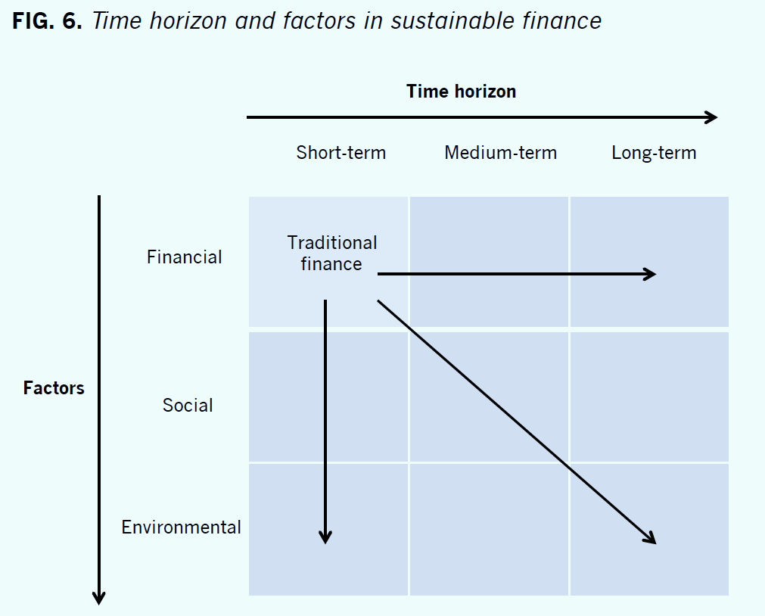
Time horizon and factors in finance

Slide 10
Role of finance
How can financial firms steer business towards sustainable business practices?
Need to include social and environmental dimensions
From short-term to long-term
Corporate governance: stewardship and engagement
Principles of Sustainable Finance © Schoenmaker and Schramade 2019 Oxford University Press

Slide 11
Objective of the corporation
Principles of Sustainable Finance © Schoenmaker and Schramade 2019 Oxford University Press

Slide 12
Shareholder model (SF 1.0)
Shareholders as residual claimants of company
Objective is maximising shareholder value
Unforeseen circumstances: shareholder interest overrides
But how to rank shareholder and other stakeholder interests?
Refined shareholder value model
Managers should cater to all stakeholders as a means to maximise firm value (enlightened value maximisation)
Principles of Sustainable Finance © Schoenmaker and Schramade 2019 Oxford University Press

Slide 13
Stakeholder model (SF 2.0)
Stakeholder model
Managers:
should balance interests of all stakeholders:
shareholders, employees, customers, society and environment
Integrated value
= financial + social + environmental value
Corporate objective:
long-term value creation -> company optimises integrated value
Principles of Sustainable Finance © Schoenmaker and Schramade 2019 Oxford University Press

Slide 14
New business language
Integration of social and environmental dimensions is dynamic
  Anticipation of regulation / taxation (e.g. carbon tax)
  Reputation – pressure from NGOs / consumers
  Future-proof: transition to SDGs by 2030 (e.g. Energiewende)
New approaches based on integrated value (I = F + S + E)
  Impact of F + S + E on value drivers of business model (Chapter 5)
  Incorporating S + E into NPV rule for investment decisions
  Integrated reporting (Chapter 6)
Principles of Sustainable Finance © Schoenmaker and Schramade 2019 Oxford University Press

Slide 15
Corporate governance
Principles of Sustainable Finance © Schoenmaker and Schramade 2019 Oxford University Press

Slide 16
Corporate governance
Cooperate governance deals with conflicts of interests between owners/shareholders and managers of a firm
Type of conflicts differ
Anglo-Saxon – widely held ownership: does the manager put in enough effort for shareholder? ➔ often shareholder model (SF 1.0)
Mainland Europe and Asia – controlling shareholders: how to protect minority shareholders? ➔ often stakeholder model (SF 2.0)
Principles of Sustainable Finance © Schoenmaker and Schramade 2019 Oxford University Press

Slide 17
Corporate governance & sustainability
Try to get the best of both worlds
  Accountability of shareholder model (take-overs)
  Broad approach of stakeholder model (all stakeholders)
  Societal test of take-overs: see next slide
Fiduciary duty of investors towards clients/beneficiaries:
clarify that sustainability factors must be incorporated
Engagement of investors with investee companies: dialogue on broad range of ESG issues (remember externalities are linked to companies)
Principles of Sustainable Finance © Schoenmaker and Schramade 2019 Oxford University Press

Slide 18
Take-over contests
Kraft Heinz (shareholder model) vs Unilever (stakeholder model)
  Without protection, shareholder model will win ➔ SF 1.0
Proposal:
Societal cost-benefit test to obtain integrated value of joint companies, based on F, S, E (e.g. using integrated value methodology of SF 2.0)
Only if sum is positive (in comparison to integrated value of stand-alone companies), take-over can go ahead
Independent advisor gives a fairness opinion on outcome
Principles of Sustainable Finance © Schoenmaker and Schramade 2019 Oxford University Press

Slide 19
Governance models
Executive contracts and compensation: incorporate sustainability as KPI (key performance indicator)
Type of shareholders: long-term investors (e.g. pension funds; Ch 4)
Reporting: integrated reporting (Chapter 6)
Non-executive monitoring:
  widen remit of audit committee towards integrated reports, or
  create sustainability committee: to monitor creation of social and environmental value by management
Principles of Sustainable Finance © Schoenmaker and Schramade 2019 Oxford University Press

Slide 20
Organisational forms
Alternatives to publicly listed company:
Private company: private equity owner appoints management and can intervene directly
Cooperation (group of people like suppliers or customers): working for mutual benefit (but cannot raise fresh equity)
B corporation: certified company meeting social and environmental standards (but no legal status)
Social enterprise with a social or environmental goal
Governmental organisation with a public objective: run for the public good, but profit motive (for operational efficiency) missing
Principles of Sustainable Finance © Schoenmaker and Schramade 2019 Oxford University Press

Slide 21
Horizon – from ST to LT thinking
Principles of Sustainable Finance © Schoenmaker and Schramade 2019 Oxford University Press

Slide 22
Tragedy of the horizon
Tragedy of the horizon (Carney, 2015) is major obstacle to sustainable finance:
  Costs of action are now, while benefits remain in the future
  Impact of social and environmental issues in long term …
  ... but managers and investors operate in a short-term framework
Principles of Sustainable Finance © Schoenmaker and Schramade 2019 Oxford University Press

Slide 23
Short-term practices
Marking-to-market of investments
Quarterly financial reporting by companies
Variable pay systems based on annual results
Supervisory treatment of illiquid investments
Monthly/quarterly benchmarks measuring investor performance
Principles of Sustainable Finance © Schoenmaker and Schramade 2019 Oxford University Press

Slide 24
Market efficiency and carbon risk
Efficient markets hypothesis (Fama, 1970)
Stock prices incorporate all relevant information
On average reflect LT fundamental value of firm
Stock price is indicator for asset selection and investor performance (Chapter 7)
Principles of Sustainable Finance © Schoenmaker and Schramade 2019 Oxford University Press

Slide 25
Market efficiency and carbon risk
Adaptive markets hypothesis (Lo, 2017)
Degree of market efficiency depends on evolutionary model of individuals adapting to a changing environment
Prices reflect as much info as number and nature distinct groups of market participants allow
If small number of groups or new risk ➔ market less efficient
Can explain why new risks (carbon) are not yet fully priced
Principles of Sustainable Finance © Schoenmaker and Schramade 2019 Oxford University Press

Slide 26
Mechanisms to reduce short-termism
Long-term oriented pay structure for executives
Deferred reward principle
Clawback provisions
Reporting on long-term goals
Avoid single focus on short-term financial results
And report on developments on all goals: F + S + E
Long-term performance measures
Measure based on 3 or 5-year moving average
Principles of Sustainable Finance © Schoenmaker and Schramade 2019 Oxford University Press

Slide 27
Discussion: barriers
What is the most important barrier to sustainable finance?
  Value: shareholder value versus stakeholder value
  Horizon: short term versus long term
Principles of Sustainable Finance © Schoenmaker and Schramade 2019 Oxford University Press

Slide 28
Conclusions
Transition to sustainable economy
  Requires overcoming behavioural bias business + consumers
  Key challenge is to move from ST to LT thinking
Corporate governance defines focus of firm
  From shareholder model ➔ financial value (F)
  To stakeholder model ➔ integrated value (I=F+S+E)
Several incentives reviewed
  New theory: from efficient markets to adaptive markets
  Longer term reporting and LT executive pay
Principles of Sustainable Finance © Schoenmaker and Schramade 2019 Oxford University Press

