Slide 1
PRINCIPLES OF
SUSTAINABLE FINANCE
Chapter 4: Coalitions for sustainable finance
Principles of Sustainable Finance © Schoenmaker and Schramade 2019 Oxford University Press

Slide 2
Overview of the book
Part I: What is sustainability and why does it matter?
Sustainability and the transition challenge
Part II: Sustainability’s challenges to corporates
Externalities - internalisation
Governance and behaviour
Coalitions for sustainable finance
Strategy and intangibles – changing business models
Integrated reporting - metrics and data
Part III: Financing sustainability
Investing for long-term value creation
Equity – investing with an ownership stake
Bonds – investing without voting power
Banks – new forms of lending
Insurance – managing long-term risk
Part IV: Epilogue
Transition management and integrated thinking
Principles of Sustainable Finance © Schoenmaker and Schramade 2019 Oxford University Press

Slide 3
Learning objectives – chapter 4
understand the role of institutional investors
explain the functioning of private coalitions
understand the mechanisms to increase the effectiveness of coalitions
Principles of Sustainable Finance © Schoenmaker and Schramade 2019 Oxford University Press

Slide 4
Institutional investors
Principles of Sustainable Finance © Schoenmaker and Schramade 2019 Oxford University Press

Slide 5
Institutional investors: the new power brokers
Traditional types of institutional investors
Pension funds
Insurance companies
Investment funds (mutual funds)
Alternative types of institutional investors
Sovereign Wealth Funds (SWFs)
Hedge funds
Exercise power through engagement with companies
Emerging trend: coordinated engagement
Principles of Sustainable Finance © Schoenmaker and Schramade 2019 Oxford University Press

Slide 6
Strong rise of institutional investment
Principles of Sustainable Finance © Schoenmaker and Schramade 2019 Oxford University Press

Slide 7
Share of institutional in equity
Principles of Sustainable Finance © Schoenmaker and Schramade 2019 Oxford University Press

Slide 8
System approach to sustainability
Principles of Sustainable Finance © Schoenmaker and Schramade 2019 Oxford University Press

Slide 9
Tragedy of the commons
Ostrom (1990): individual users behave contrary to the common good of all users by depleting the common resources
Approaches to preserve common good
First best: taxation and/or regulation – international cooperation sometimes possible (ozone layer) but often lacking (carbon tax)
Second best: cooperation among key players (rules to govern common good, monitoring and sanctions, clear group boundaries)
➔ coalition of the willing
Principles of Sustainable Finance © Schoenmaker and Schramade 2019 Oxford University Press

Slide 10
Shift of perspective
Current sustainability practices too incremental
Focus on improvement in company or value chain (measured by ESG ratings)
Inside-out perspective looks at efficiency of company / sector (numerator)
Context-based sustainability
Connects nano (personal), micro (company), meso (industry or portfolio) and macro (system) levels to determine company contributions
Outside-in perspective starts with the system boundary (denominator)
Principles of Sustainable Finance © Schoenmaker and Schramade 2019 Oxford University Press

Slide 11
Footprint method
Footprint method (McElroy, 2008) to measure a company’s sustainability performance:
Inputs:
AI is net actual impact of a company on vital capitals (N, S, H)
NI is normative impact for a company derived from system thresholds
 | Ecological quotients | Societal quotients
Sustainable | SP ≤ 1 | SP ≥ 1
Unsustainable | SP > 1 | SP < 1
Principles of Sustainable Finance © Schoenmaker and Schramade 2019 Oxford University Press

Slide 12
Threshold and allocation approach
Threshold and allocation councils to make it operational
  Determine system thresholds for various ecological ceilings and social foundations
  Allocate (proportionally) to individual companies or sectors
Example carbon budget
Derive overall carbon budget from Paris Agreement
Set common carbon budget for Fortune 500 companies
Allocate common carbon budget to individual companies
Organise monitoring performance of each company ➔ SP ≤ 1 ?
Principles of Sustainable Finance © Schoenmaker and Schramade 2019 Oxford University Press

Slide 13
Coalitions for sustainable finance
Principles of Sustainable Finance © Schoenmaker and Schramade 2019 Oxford University Press

Slide 14
Coalitions for sustainable finance
Investor coalitions on LT sustainable investment
  Develop methods and stimulate companies towards sustainability
  Next phase: coordinated engagement
Companies also form coalitions of the willing to move
Example: bank coalitions
Stimulate sustainable lending
Prevent competitive race to the bottom (e.g. undercutting standards in project finance)
Principles of Sustainable Finance © Schoenmaker and Schramade 2019 Oxford University Press

Slide 15
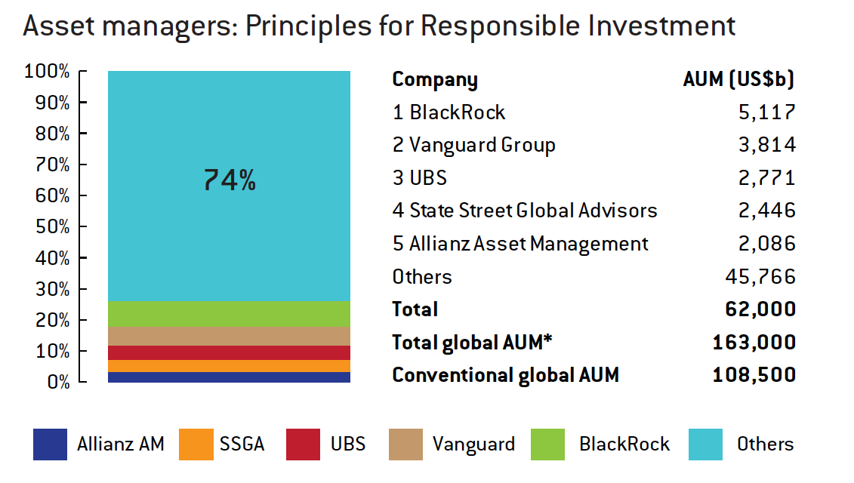
Example of large coalition: PRI

Slide 16
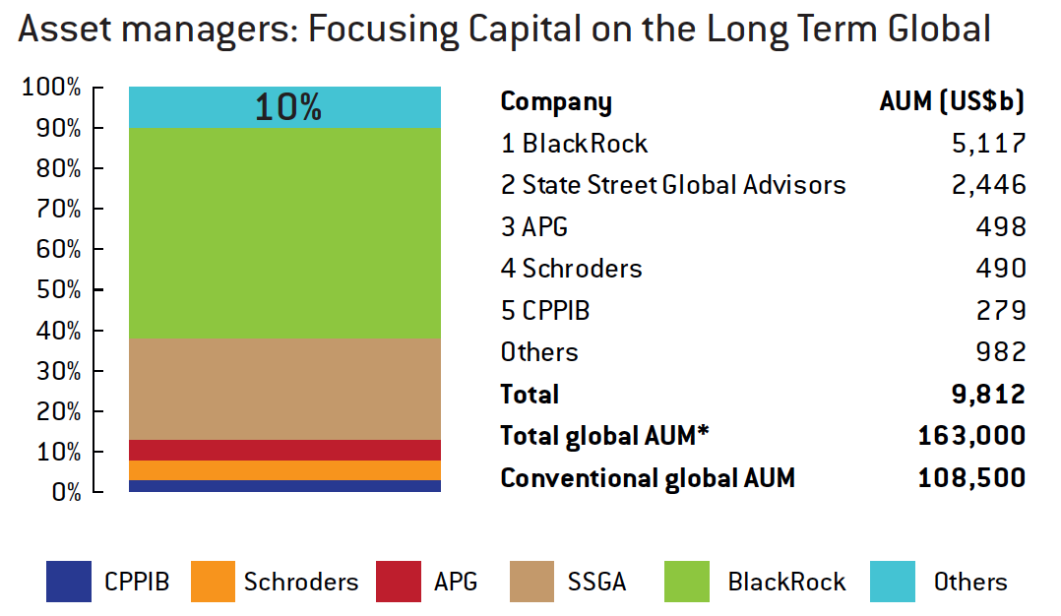
Example of dedicated coalition: FCLT

Slide 17
Why join a coalition?
Peer effect: membership of key competitors
Outside pressure: consumers and NGOs
Reputation: to be seen as leader in sustainability
Collective advocacy: coalition can push governments
Collective engagement increases success rate of ESG engagement
Principles of Sustainable Finance © Schoenmaker and Schramade 2019 Oxford University Press

Slide 18
Assessing coalitions
Assessment criteria:
Clearly defined boundaries: which % of sector covered?
Rules restricting use common good: how ambitious?
Collective choice arrangements: can members affect rules?
Monitoring: effective reporting on progress meeting rules
Sanctions and rewards: are violations punished?
Conflict resolution: have members access to arenas?
Principles of Sustainable Finance © Schoenmaker and Schramade 2019 Oxford University Press

Slide 19
Assessment of some coalitions

Slide 20
Discussion: engagement
What is the most effective way of engagement?
  Individual deep engagement versus collective engagement?
  How do you measure progress on engagement?
Principles of Sustainable Finance © Schoenmaker and Schramade 2019 Oxford University Press

Slide 21
Conclusions
Institutional investors are new power brokers
  Can steer companies towards sustainable business practices
System approach is crucial
  It is not sufficient that companies do their best (efficiency)
  They should stay within system threshold (effectiveness)
Coalitions of sustainable finance
  Sustainability leaders in finance and in business form
  coalitions of the willing to move forward
Principles of Sustainable Finance © Schoenmaker and Schramade 2019 Oxford University Press

