Slide 1
PRINCIPLES OF
SUSTAINABLE FINANCE
Chapter 5: Strategy & intangibles
Principles of Sustainable Finance © Schoenmaker and Schramade 2019 Oxford University Press

Slide 2
Overview of the book
Part I: What is sustainability and why does it matter?
Sustainability and the transition challenge
Part II: Sustainability’s challenges to corporates
Externalities - internalisation
Governance and behaviour
Coalitions for sustainable finance
Strategy and intangibles – changing business models
Integrated reporting - metrics and data
Part III: Financing sustainability
Investing for long-term value creation
Equity – investing with an ownership stake
Bonds – investing without voting power
Banks – new forms of lending
Insurance – managing long-term risk
Part IV: Epilogue
Transition management and integrated thinking
Principles of Sustainable Finance © Schoenmaker and Schramade 2019 Oxford University Press

Slide 3
Learning objectives – chapter 5
explain why and how companies should connect sustainability to their competitive position, business model, intangible assets and strategy;
loosely connect corporate sustainability performance with corporate financial performance;
identify the materiality of sustainability issues;
explain how companies can prepare for the transition to a sustainable economy.
Principles of Sustainable Finance © Schoenmaker and Schramade 2019 Oxford University Press

Slide 4
Why does sustainability matter to competitive positions, business models, intangibles and strategy?
Principles of Sustainable Finance © Schoenmaker and Schramade 2019 Oxford University Press

Slide 5
Linking sustainability and strategy
Sustainability
Competitive position, business models, intangibles
Strategy
Principles of Sustainable Finance © Schoenmaker and Schramade 2019 Oxford University Press

Slide 6
Competitive positions
Generic competitive strategies (Porter, 1985)
Differentiation
Focus
Attributes of strategic assets (Lev, 2017)
Valuable
Difficult to imitate
Cost leadership
Rare
Principles of Sustainable Finance © Schoenmaker and Schramade 2019 Oxford University Press

Slide 7
Competitive positions
Sources of competitive advantage:
Resources
Knowledge
Human capital
Networks
Principles of Sustainable Finance © Schoenmaker and Schramade 2019 Oxford University Press

Slide 8
Business models
Three components of a business model (Johnson, 2008):
Customer value proposition
Profit formula
Business model
Key resources & processes
Principles of Sustainable Finance © Schoenmaker and Schramade 2019 Oxford University Press
Notes:
Needs to work to be sustainable!

Slide 9
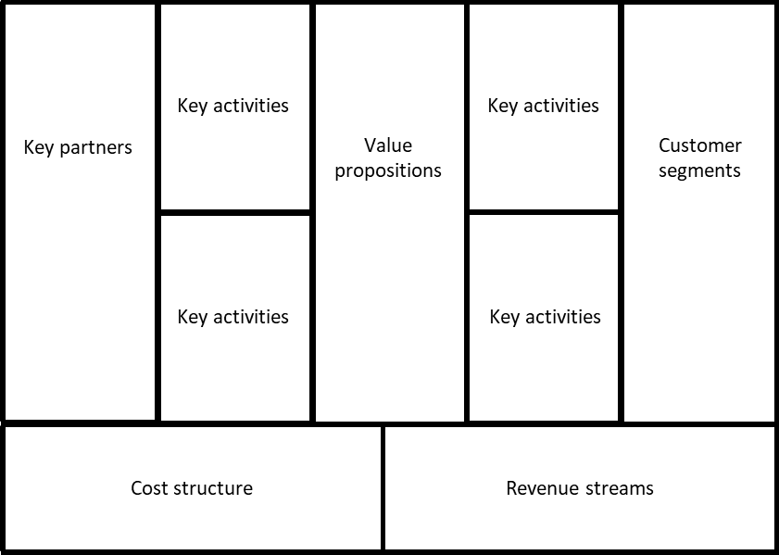
Business models
Business model canvas (Osterwalder & Pigneur, 2010):
Principles of Sustainable Finance © Schoenmaker and Schramade 2019 Oxford University Press
Notes:
Needs to work to be sustainable!

Slide 10
Intangibles
Note: all measured as a percentage of the market value of S&P 500 companies
Source: Ocean Tomo
Principles of Sustainable Finance © Schoenmaker and Schramade 2019 Oxford University Press

Slide 11
Intangibles
Intangible resources
Intangible assets
Principles of Sustainable Finance © Schoenmaker and Schramade 2019 Oxford University Press

Slide 12
Materiality
Accounting materiality
Business materiality
Market materiality
Principles of Sustainable Finance © Schoenmaker and Schramade 2019 Oxford University Press
Notes:
How important is it?

Slide 13
Materiality mix
Figure 5.6: Novozymes’ materiality matrix
Sales
Earnings
Compliance
Corporate governance
& ethics
Innovation
Water
Importance to stakeholders High
Partnerships
Product safety & stewardship
Bioethics
& gene technology
Climate change
& energy
Occupational health & safety
Labor practices & human rights
Customer relationship management
Waste
Responsible sourcing
Medium Impact on Novozymes High
Material issues with a targets / flagship initiatives
Other material issues
Principles of Sustainable Finance © Schoenmaker and Schramade 2019 Oxford University Press

Slide 14
Strategy
Strategy = The plan to achieve a desired future state
Five parts to a strategy (Hambrick & Fredrickson, 2001):
Arenas
Vehicles
Differentiators
Staging
Economic logic
Principles of Sustainable Finance © Schoenmaker and Schramade 2019 Oxford University Press

Slide 15
Typical material sustainability issues
Environmental
Social
Governance
Other
Principles of Sustainable Finance © Schoenmaker and Schramade 2019 Oxford University Press

Slide 16
Stakeholder impact maps
 | Stakeholder 1 | Stakeholder 2 | Stakeholder 3 | Stakeholder n
Positive impact
Negative impact
Short term goals
Long term goals
Principles of Sustainable Finance © Schoenmaker and Schramade 2019 Oxford University Press

Slide 17
Preparing for transformational change
Systemic change
Business sustainability typology (Dylick & Muff, 2016):
Business Sustainability Typology | Concerns (What?) | Values created (What for?) | Organisational perspective (How?)
Business-as-usual | Economic concerns | Shareholder value | Inside-out
Business Sustainability 1.0 | Three-dimensional concerns | Refined shareholder value | Inside-out
Business Sustainability 2.0 | Three-dimensional concerns | Triple bottom line | Inside-out
Business Sustainability 3.0 | Starting with sustainability challenges | Creating value for the common good | Outside-in
Key shifts involved | 1st shift: broadening the business concern | 2nd shift: expanding the value created | 3rd shift: changing the perspective
Principles of Sustainable Finance © Schoenmaker and Schramade 2019 Oxford University Press

Slide 18
Circular business models
The value hill in a linear economy (Circle Economy, 2016):
Add value
User
Destroy value
Retail
Assembly
Manufacturing
Extraction
Pre-use
Use
Post-use
Principles of Sustainable Finance © Schoenmaker and Schramade 2019 Oxford University Press

Slide 19
Circular business models
The value hill in a circular economy (Circle Economy, 2016):
Repair/maintain
Add value
Retain value
User
Retail
Reuse/redistribute
Assembly
Refurbish
Manufacturing
Remanufacture
Recycle
Extraction
Pre-use
Use
Post-use
Principles of Sustainable Finance © Schoenmaker and Schramade 2019 Oxford University Press

Slide 20
Company purpose
Maximise shareholder welfare = stakeholder model (Hart & Zingales, 2017)
Maximise profitability = shareholder model (Friedman, 1970)
Principles of Sustainable Finance © Schoenmaker and Schramade 2019 Oxford University Press

Slide 21
LT value creation
Guidelines for a company pursuing long term value creation:
1) Make the company’s purpose a key part of corporate strategy
2) Integrate sustainability and externalities in all functional business areas
3) Communicate LT goals clearly with all stakeholders
4) Deliver on what you promise
5) Build and maintain your key LT intangibles to achieve transformational change
6) Focus performance measurement on the LT and on meeting the purpose
7) Base incentives for management & employees on meeting LT objectives - get rid of ST variable pay
Principles of Sustainable Finance © Schoenmaker and Schramade 2019 Oxford University Press

Slide 22
LT capital budgeting
NPV of action
The naïve NPV of building a desalination plant: -$2.2bn
-
NPV of inaction
The NPV of NOT building the desalination plant: -$9.6bn
=
Full NPV
The full NPV of the desalination plant:
-$2.2bn + $9.6bn = $7.4bn
Principles of Sustainable Finance © Schoenmaker and Schramade 2019 Oxford University Press

Slide 23
Conclusions
Sustainability
Competitive position, business models, intangibles
Strategy
Principles of Sustainable Finance © Schoenmaker and Schramade 2019 Oxford University Press
Notes:
The tools are there to make the connection

