Slide 1
PRINCIPLES OF
SUSTAINABLE FINANCE
Chapter 6: Integrated reporting - metrics and data
Principles of Sustainable Finance © Schoenmaker and Schramade 2019 Oxford University Press

Slide 2
Overview of the book
Part I: What is sustainability and why does it matter?
Sustainability and the transition challenge
Part II: Sustainability’s challenges to corporates
Externalities - internalisation
Governance and behaviour
Coalitions for sustainable finance
Strategy and intangibles – changing business models
Integrated reporting - metrics and data
Part III: Financing sustainability
Investing for long-term value creation
Equity – investing with an ownership stake
Bonds – investing without voting power
Banks – new forms of lending
Insurance – managing long-term risk
Part IV: Epilogue
Transition management and integrated thinking
Principles of Sustainable Finance © Schoenmaker and Schramade 2019 Oxford University Press

Slide 3
Learning objectives – chapter 6
describe the benefits and limitations of traditional reporting
explain the emergence and relevance of integrated reporting
explain the obstacles integrated reporting faces
illustrate the characteristics of an integrated report
Principles of Sustainable Finance © Schoenmaker and Schramade 2019 Oxford University Press

Slide 4
Why does reporting matter?
Principles of Sustainable Finance © Schoenmaker and Schramade 2019 Oxford University Press

Slide 5
Reporting
Double entry book keeping
Joint stock companies
Growth of capital markets
Accounting standards
Healthcare companies
Technology companies
Challenges
Legitimacy?
Tangible assets
Intangible assets
Principles of Sustainable Finance © Schoenmaker and Schramade 2019 Oxford University Press

Slide 6
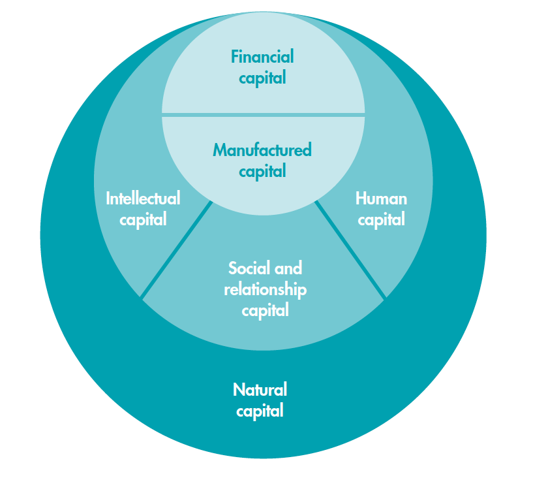
Emergence of integrated reporting
Guiding principles
Elements of an integrated report
IIRC, GRI, SASB
6 capitals
Principles of Sustainable Finance © Schoenmaker and Schramade 2019 Oxford University Press

Slide 7
7 guiding principles of <IR>
Strategic focus & future orientation
Connectivity of information
Stakeholder relationships
Materiality
Conciseness
Reliability & completeness
Consistency & comparability
Principles of Sustainable Finance © Schoenmaker and Schramade 2019 Oxford University Press

Slide 8
8 elements of an integrated report
Organisational overview & external environment
Governance
Business model
Risks & opportunities
Strategy & resource allocation
Performance
Outlook
Basis of presentation
Principles of Sustainable Finance © Schoenmaker and Schramade 2019 Oxford University Press

Slide 9
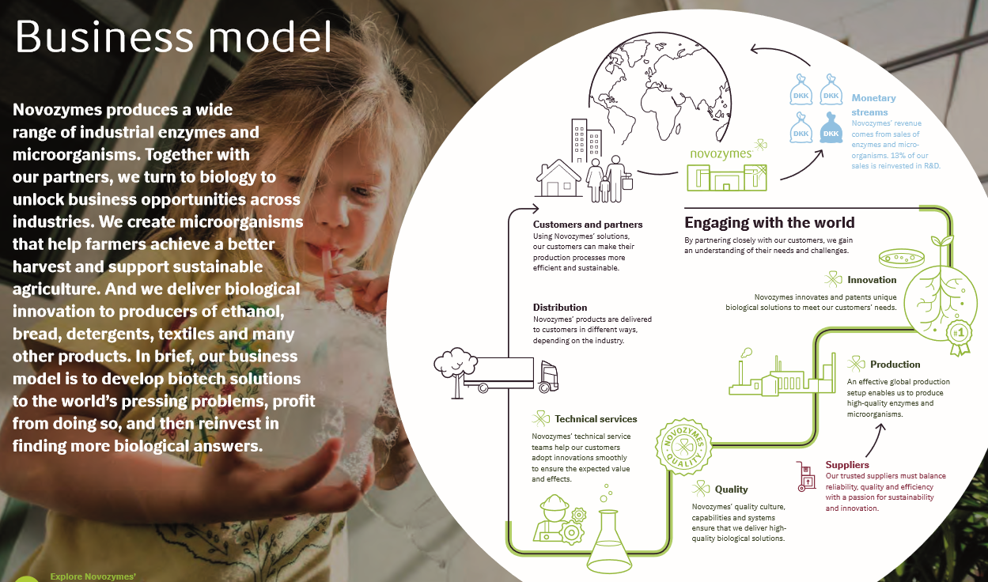
Example of <IR> in practice: Novozymes
Principles of Sustainable Finance © Schoenmaker and Schramade 2019 Oxford University Press

Slide 10
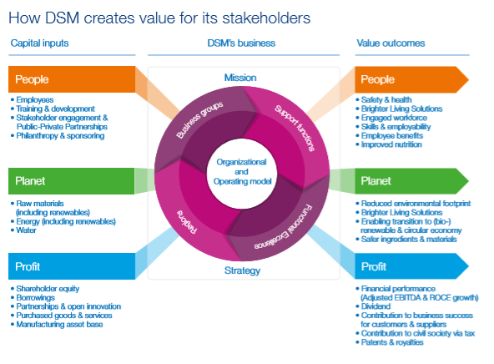
Example of <IR> in practice: DSM
Principles of Sustainable Finance © Schoenmaker and Schramade 2019 Oxford University Press

Slide 11
Imagining a 6 capitals balance sheet (1)
Traditional balance sheet
Assets |  |  |  | Liabilities & Equity
Cash | 800 |  |  | Interest-bearing debt | 1500
Inventory | 200 |  |  | Environmental liabilities | 500
Property, plant & equipment (PP&E) | 4000 |  |  | Equity | 3000
Total assets | 5000 |  |  | Total liabilities & equity | 5000
Market value balance sheet
Assets |  |  |  | Liabilities & Equity
Net Present Value of projects | 12000 |  |  | Interest-bearing debt | 1500
 |  |  |  | Environmental liabilities | 500
 |  |  |  | Equity | 10000
Total assets | 12000 |  |  | Total liabilities & equity | 12000
Principles of Sustainable Finance © Schoenmaker and Schramade 2019 Oxford University Press

Slide 12
Imagining a 6 capitals balance sheet (2)
Six capitals balance sheet
Assets |  |  |  | Liabilities & Equity
Financial capital (cash+inventory) | 1000 |  |  | Negative financial capital (debt) | 1500
Manufactured capital (PP&E at replacement cost) | 7500 |  |  | Negative natural capital (liabilities) | 4500
Social & relationship capital | 1500 |  |  | Equity | 7500
Human capital | 500
Intellectual capital | 3000
Total assets | 13500 |  |  | Total liabilities & equity | 13500
Reminder: Traditional balance sheet
Assets |  |  |  | Liabilities & Equity
Cash | 800 |  |  | Interest-bearing debt | 1500
Inventory | 200 |  |  | Environmental liabilities | 500
Property, plant & equipment (PP&E) | 4000 |  |  | Equity | 3000
Total assets | 5000 |  |  | Total liabilities & equity | 5000
Principles of Sustainable Finance © Schoenmaker and Schramade 2019 Oxford University Press

Slide 13
<IR>: success or failure?
Problems:
In favour:
Lack of certification;
Limited adoption;
More meaning;
Too much focus on investors?
More to come…
Principles of Sustainable Finance © Schoenmaker and Schramade 2019 Oxford University Press

Slide 14
Examples of metrics
Environmental
GHG emissions: Scope 1, 2 & 3 vs emissions saved
Social
Employee attrition
Health & safety data
Governance
Voting rights, board structure, etc.
Principles of Sustainable Finance © Schoenmaker and Schramade 2019 Oxford University Press

Slide 15
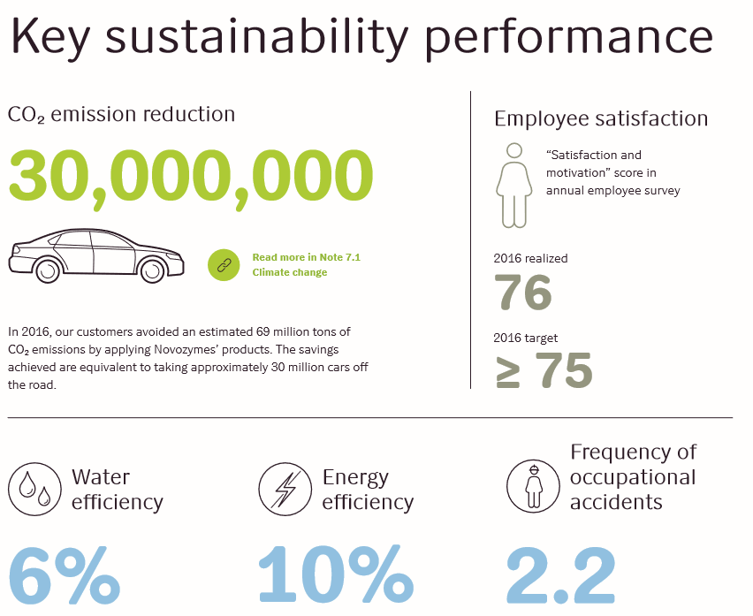
Examples of metrics in practice: Novozymes
Principles of Sustainable Finance © Schoenmaker and Schramade 2019 Oxford University Press

Slide 16
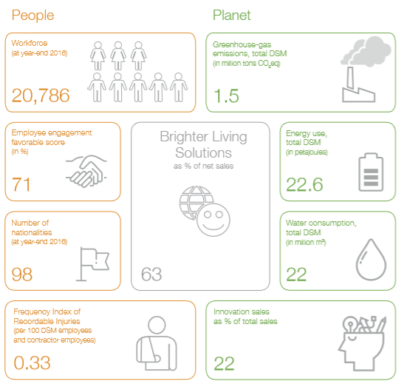
Examples of metrics in practice: DSM
Principles of Sustainable Finance © Schoenmaker and Schramade 2019 Oxford University Press

Slide 17
Examples of metrics in practice: Philips
Operational carbon footprint by scope (in kilotonnes CO₂-equivalent)
Principles of Sustainable Finance © Schoenmaker and Schramade 2019 Oxford University Press

Slide 18
Sustainability data providers
Principles of Sustainable Finance © Schoenmaker and Schramade 2019 Oxford University Press

Slide 19
Example of sustainability scoring
Overall score: 74
Environmental score: 76
(35% weight)
Environmental policy
(1.08% weight)
Environmental management system (EMS)
(2.15% weight)
Social score: 64
(40% weight)
Governance score: 86
(25% weight)
EMS certification
(2.15% weight)
etc.
Principles of Sustainable Finance © Schoenmaker and Schramade 2019 Oxford University Press

Slide 20
Value drivers: Novozymes
Valuation
Sales growth
Capital
Margins
Innovation
Human capital
Principles of Sustainable Finance © Schoenmaker and Schramade 2019 Oxford University Press

Slide 21
Value drivers: Mining
Valuation
Sales growth
Capital
Margins
price
management of local stakeholders
production volume
environmental management
Principles of Sustainable Finance © Schoenmaker and Schramade 2019 Oxford University Press

Slide 22
Conclusions
Current reporting is incomplete
<IR> is a step in the right direction
Integrated thinking is even more important than integrated reporting
Principles of Sustainable Finance © Schoenmaker and Schramade 2019 Oxford University Press

