Slide 1
PRINCIPLES OF
SUSTAINABLE FINANCE
Chapter 7: Investing for long-term value creation
Principles of Sustainable Finance © Schoenmaker and Schramade 2019 Oxford University Press

Slide 2
Overview of the book
Part I: What is sustainability and why does it matter?
Sustainability and the transition challenge
Part II: Sustainability’s challenges to corporates
Externalities - internalisation
Governance and behaviour
Coalitions for sustainable finance
Strategy and intangibles – changing business models
Integrated reporting - metrics and data
Part III: Financing sustainability
Investing for long-term value creation
Equity – investing with an ownership stake
Bonds – investing without voting power
Banks – new forms of lending
Insurance – managing long-term risk
Part IV: Epilogue
Transition management and integrated thinking
Principles of Sustainable Finance © Schoenmaker and Schramade 2019 Oxford University Press

Slide 3
Learning objectives – chapter 7
explain why the financial system needs to adapt
discuss what the obstacles to adaptation are and how they can be overcome
explain the key differences between active and passive investment approaches
identify the different parties in the investment chain
list and understand the conditions for long-term value creation by investors
contrast traditional performance measures with alternative ones
Principles of Sustainable Finance © Schoenmaker and Schramade 2019 Oxford University Press

Slide 4
Why invest for long-term value? And how?
Principles of Sustainable Finance © Schoenmaker and Schramade 2019 Oxford University Press

Slide 5
LTVC
F
S
IV
E
To optimise financial, social and environmental value subject to risk
Principles of Sustainable Finance © Schoenmaker and Schramade 2019 Oxford University Press

Slide 6
Traditional versus long-term investing
Dimension | Traditional investing | Long-term value creation
Typology | Sustainable Finance 1.0 | Sustainable Finance 2.0
Market framework used | Efficient Markets Hypothesis | Adaptive Markets Hypothesis
Pricing of social (S) and environmental (E) dimension | Irrelevant or already priced in | Priced as market participants learn
Value maximisation | Max F | Max IV = F + S + E
Value indicator | Earnings per Share (EPS) | Sophisticated DCF with scenarios for internalisation
Investment chains | Long and complicated | Short and simple
Portfolios | Extremely diversified | More concentrated
Dialogues with corporates | Limited | Deep
Performance horizon | 12 months | Years or decade
Principles of Sustainable Finance © Schoenmaker and Schramade 2019 Oxford University Press

Slide 7
The current financial system fails to achieve societal goals
Externalities not priced
Overreliance on market metrics (7.1)
Limitations to current inclusion of ESG factors (7.2)
Social and environmental capital strongly undervalued
Principles of Sustainable Finance © Schoenmaker and Schramade 2019 Oxford University Press

Slide 8
Overreliance on market metrics
Current investment practices have no role for E and S: unrealistic in a full world
Pricing
EMH assumes all relevant info is priced
Implies passive investing
Allocation
Modern portfolio theory / CAPM: risk is driven by volatility past stock returns
Implies diversification and passive investing
Performance measurement
Benchmarking to a market index
Metrics driven by past risk/return characteristics
Busted by behavioural & sustainability anomalies
But still dominates communication & thinking
Principles of Sustainable Finance © Schoenmaker and Schramade 2019 Oxford University Press

Slide 9
Long & complicated investment chains
Figure 7.1: A stylised investment chain. It looks simple..
Beneficiaries / clients
Asset owners (pension funds, insurers, investment funds)
Asset managers
Equities - companies
Bonds - companies
Principles of Sustainable Finance © Schoenmaker and Schramade 2019 Oxford University Press

Slide 10
Long & complicated investment chains
Figure 7.1: A stylised investment chain. It looks simple..
…but it is much more complicated in practice
Beneficiaries / clients
Asset owners (pension funds, insurers, investment funds)
Asset managers
Equities - companies
Bonds - companies
# clients: billions - who have multiple products at multiple firms
# parties: thousands
# FTEs: thousands each
# products: hundreds each
Ratings agencies
Consultants
Supervisors
Along the chain, a lot of valuable information is lost
Principles of Sustainable Finance © Schoenmaker and Schramade 2019 Oxford University Press

Slide 11
Limitations to approaches for inclusion of ESG factors
ESG tools:
ESG ratings
ESG indices
Problem 1: they are add-ons that do not address core issues
Problem 2: Design limitations
Limited focus on materiality
Based on reported data & policies only
Industry neutral
Focused on operations, not products
More problems:
Bias to large companies
Intuitively wrong scores
Failure to spot material weaknesses
Principles of Sustainable Finance © Schoenmaker and Schramade 2019 Oxford University Press

Slide 12
Solving it with an active investing approach
Pricing: from EMH to AMH
Allocation 1) from ESG factors to fundamental ESG analysis
Allocation 2) from extremely diversified to more concentrated portfolios
Alternative measures of performance
Engagement
Simpler investment chains
Principles of Sustainable Finance © Schoenmaker and Schramade 2019 Oxford University Press

Slide 13
Pricing: from EMH to AMH
EMH
Instantaneous incorporation of all relevant information
All ESG information is either irrelevant or already priced
AMH
Degree of market efficiency depends on market ecology
Pricing of ESG information depends on the number and quality of market participants that take ESG seriously
Unrealistic
Plausible
Principles of Sustainable Finance © Schoenmaker and Schramade 2019 Oxford University Press

Slide 14
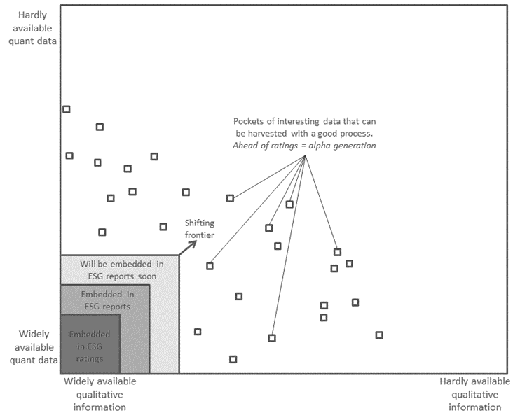
Allocation 1): from ESG factors to fundamental ESG analysis
ESG factors
should improve over time
Need to be complemented by fundamental ESG analysis
Fundamental ESG analysis:
Materiality assessment
Hit investment process in all stages – including valuation
Challenges: mindsets and data – see chapter 8
Principles of Sustainable Finance © Schoenmaker and Schramade 2019 Oxford University Press

Slide 15
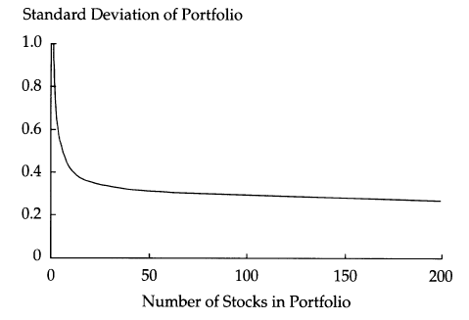
Allocation 2) from extremely diversified to more concentrated portfolios
Pension funds may hold thousands of different securities
Serious engagement not feasible…
… While not necessary from a diversification perspective….
Principles of Sustainable Finance © Schoenmaker and Schramade 2019 Oxford University Press

Slide 16
Engagement
Investors and corporates to exchange funds & ideas:
Pressure to end unsustainable practices
Improve reporting
Share best practices
Engagement is costly:
Time intense
Requires deep knowledge, patience & coordination
Ideally:
Integrated process from analysis and selection to engagement
Integrated teams for portfolio management and engagement
Engagement in practice:
Not feasible for large portfolios
Shallow (disconnected from investment case) and/or narrow: voting, not dialogue
Principles of Sustainable Finance © Schoenmaker and Schramade 2019 Oxford University Press

Slide 17
Alternative measures of performance
Alternative financial performance metrics
Versus peers & groups of indices
Absolute return
Non-financial performance metrics
Performance on specific KPIs
Externality valuation frameworks
Contribution to global sustainability goals
Principles of Sustainable Finance © Schoenmaker and Schramade 2019 Oxford University Press

Slide 18
Conditions for LTVC
Long-term value creation
1. Long investment horizons
4. Performance analysis of value-added in the real economy
5. Long-term alignment of mandate asset owner and manager
6. Keep the investment chain short
2. Active management in concentrated portfolio
3. Effective engagement
Principles of Sustainable Finance © Schoenmaker and Schramade 2019 Oxford University Press

Slide 19
Conclusions
LTVC requires moving from maximising financial value to integrated value
Obstacles are the overreliance on market metrics and complex investment chains
Principles of Sustainable Finance © Schoenmaker and Schramade 2019 Oxford University Press

