Slide 1
PRINCIPLES OF
SUSTAINABLE FINANCE
Chapter 8: Equity
- investing with an ownership stake
Principles of Sustainable Finance © Schoenmaker and Schramade 2019 Oxford University Press

Slide 2
Overview of the book
Part I: What is sustainability and why does it matter?
Sustainability and the transition challenge
Part II: Sustainability’s challenges to corporates
Externalities - internalisation
Governance and behaviour
Coalitions for sustainable finance
Strategy and intangibles – changing business models
Integrated reporting - metrics and data
Part III: Financing sustainability
Investing for long-term value creation
Equity – investing with an ownership stake
Bonds – investing without voting power
Banks – new forms of lending
Insurance – managing long-term risk
Part IV: Epilogue
Transition management and integrated thinking
Principles of Sustainable Finance © Schoenmaker and Schramade 2019 Oxford University Press

Slide 3
Learning objectives – chapter 8
describe the state of ESG integration into equities and explain how it could improve both financial and non-financial returns
explain the link between ESG integrated analysis, understanding of companies, their value drivers, and their investment case
explain how and why the societal function of finance can be exercised more thoroughly in a fundamental approach to equity investing than in quant or passive approaches
describe the difference between ESG investing and impact investing
Principles of Sustainable Finance © Schoenmaker and Schramade 2019 Oxford University Press

Slide 4
Basics of equity
Public equity: $70 trillion
Equities
Private
Public
Fundamental - choice of business fundamentals
Quant - choice of quant factors
Passive - choice of index
Principles of Sustainable Finance © Schoenmaker and Schramade 2019 Oxford University Press

Slide 5
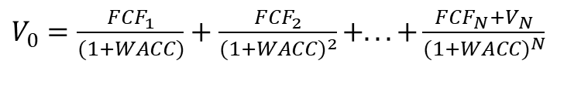
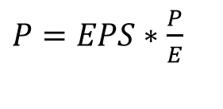
Equity valuation
Relative valuation
Absolute valuation
$P=EPS∗\frac{P}{E}$
$V_{0}=\frac{{FCF}_{1}}{(1+WACC)}+\frac{{FCF}_{2}}{(1+WACC)^{2}}+...+\frac{{FCF}_{N}+V_{N}}{(1+WACC)^{N}}$
Principles of Sustainable Finance © Schoenmaker and Schramade 2019 Oxford University Press

Slide 6
DCF Equity valuation

Slide 7
DCF Equity valuation – changed EBIT

Slide 8
Why does sustainability matter to equity investing?
Principles of Sustainable Finance © Schoenmaker and Schramade 2019 Oxford University Press

Slide 9
Relevance of sustainability to equity
Business models
ESG
Finance
Principles of Sustainable Finance © Schoenmaker and Schramade 2019 Oxford University Press

Slide 10
Relevance of sustainability to equity
Material sustainability issues
Competitive positions &
business models
Value drivers
Company purpose, products & stakeholders
Principles of Sustainable Finance © Schoenmaker and Schramade 2019 Oxford University Press

Slide 11
Evidence
1. ESG performance
scores / ratings
material vs immaterial
2. Value drivers
sales growth
margins
3. stock performance
approach: ESG integrated vs ethical
cost of capital
4. investor performance
type of companies
Principles of Sustainable Finance © Schoenmaker and Schramade 2019 Oxford University Press

Slide 12
ESG integration into equities
Why? Does it happen? How?
Suitability of the approach | Fundamental equities | Quant equities | Passive equities | Explanation
Exclusionary screening | High | Medium-high | Medium-high | Can be done on scores
Best in class | High | Medium | Low | Can be done on scores, to a certain degree
Thematic investing | High | Medium | Low | Fundamental analysis is needed
Active ownership | High | Low | Low | Fundamental analysis is needed, which can be bought externally with loss of quality
Impact investing | High | Very low | Very low | Fundamental analysis is needed
ESG integration | High | Very low | Not at all | Fundamental analysis is needed
Principles of Sustainable Finance © Schoenmaker and Schramade 2019 Oxford University Press

Slide 13
ESG integration into fundamental equities
Steps in the Value driver adjustment (VDA) approach:
1) Identify & focus on the most material issues
2) Analyse the impact of these material issues on the individual company
3) Quantify competitive (dis)advantages to adjust for value driver assumptions
4) Have an active dialogue
Principles of Sustainable Finance © Schoenmaker and Schramade 2019 Oxford University Press

Slide 14
ESG integration into fundamental equities
KUKA VDA example:
Value driver | Sales growth | Margins | Cost of capital | Target price
Benchmark (i.e. performance excluding ESG advantage) | 5-6% | 5-6% | 10% | EUR 67
Impact from ESG factors | Innovation & high-growth markets: +200bps | Innovation: +100bps | Capital management -100bps | EUR 32
Total | 7-8% | 6-7% | 9% | EUR 99
Principles of Sustainable Finance © Schoenmaker and Schramade 2019 Oxford University Press

Slide 15
ESG integration into quant equities
algorithims
factors
data
Quant stock portfolio
Data limitations
Principles of Sustainable Finance © Schoenmaker and Schramade 2019 Oxford University Press

Slide 16
ESG integration into passive equities
ESG indices
Proxy voting
Passive ESG investing
This is not really integration, but it does move capital away from the worst companies
Principles of Sustainable Finance © Schoenmaker and Schramade 2019 Oxford University Press

Slide 17
Impact investing
GIIN impact criteria
Intentionality to make the world better
Return expectations (i.e. not charity)
Range of return expectations & asset classes
Impact measurement
Principles of Sustainable Finance © Schoenmaker and Schramade 2019 Oxford University Press

Slide 18
Impact investing: challenges
Data
Scale
Barriers to change
Perception problems
Complex investment chains
Principles of Sustainable Finance © Schoenmaker and Schramade 2019 Oxford University Press

Slide 19
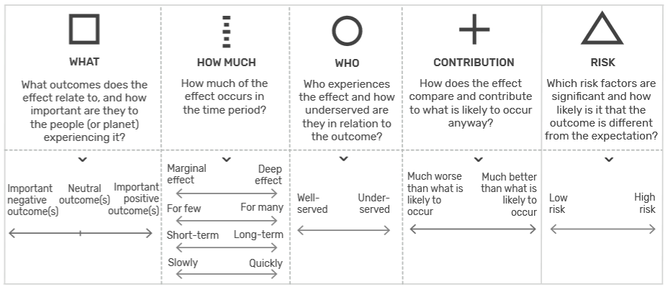
Impact investing
Criteria by the Impact Management Project:
Principles of Sustainable Finance © Schoenmaker and Schramade 2019 Oxford University Press

Slide 20
Impact investing example (1)
NN IP’s impact criteria applied to Novozymes:
Impact criterion | Company assessment
Material: relevance to value drivers sales, profits, capex, and risk | Superior performance and energy savings at clients help Novozymes grow twice as fast as the chemicals industry at twice the profitability
Intentional: deliberate choice, strategy, purpose | Corporate strategy and business model are built on providing more environmentally friendly solutions Novozymes was involved in setting the SDGs Works with partners to develop and drive adoption of proven biological innovations that improve feed efficiency and animal health One of few companies that reports on its impact, with serious targets
Transformational: does the company drive major change for the better by means of its business model, technology, scale or standards? | Enzymes have the potential to replace nearly all chemical processes, which would mean much less environmental footprint (CO2 emissions and waste).
Principles of Sustainable Finance © Schoenmaker and Schramade 2019 Oxford University Press

Slide 21
Impact investing example (2)
NN IP’s impact KPIs applied to Novozymes:
 | Emissions saved, SDG 7 | Innovation, SDG 9 | Health & well-being, SDG 3
Ideal impact KPI | Emissions saved | Value of innovations to society | Improvement in human health
Actual KPIs reported | Emissions saved | #transformative innovations; #active patent families; R&D/sales; #R&D employees; pipeline | #people reached with biological solutions
Number | 69 mn ton | 8 new products in 2016; 13% R&D/sales; 1400 R&D employees; 1123 active patent families | Reached approximately 5 billion consumers with more than one of their solutions on a weekly basis – 100 million more than in 2015
Target | Save 100 mn ton in 2020 | Deliver 10 transformative innovations from 2015 to 2020 | 6 billion people reached with biological solutions by 2020
Engagement on KPIs | Not needed | Get more granularity | Get detail on quality - focus
Principles of Sustainable Finance © Schoenmaker and Schramade 2019 Oxford University Press

Slide 22
Conclusions
Equity investors have strong incentives to help companies achieve the conditions for long-term value creation
However, most equity investors fail to properly take material sustainability issues into account
Fundamental equity investing is more suitable for ESG integration than quant and passive
Impact investing is essentially an extreme form of sustainability integration that starts with the intention to make the world better
Principles of Sustainable Finance © Schoenmaker and Schramade 2019 Oxford University Press

