Slide 1
PRINCIPLES OF
SUSTAINABLE FINANCE
Chapter 9: Bonds
- investing without voting power
Principles of Sustainable Finance © Schoenmaker and Schramade 2019 Oxford University Press

Slide 2
Overview of the book
Part I: What is sustainability and why does it matter?
Sustainability and the transition challenge
Part II: Sustainability’s challenges to corporates
Externalities - internalisation
Governance and behaviour
Coalitions for sustainable finance
Strategy and intangibles – changing business models
Integrated reporting - metrics and data
Part III: Financing sustainability
Investing for long-term value creation
Equity – investing with an ownership stake
Bonds – investing without voting power
Banks – new forms of lending
Insurance – managing long-term risk
Part IV: Epilogue
Transition management and integrated thinking
Principles of Sustainable Finance © Schoenmaker and Schramade 2019 Oxford University Press

Slide 3
Learning objectives – chapter 9
explain the state of play on ESG integration, potentially improving both financial and societal returns
understand how ESG integration into bonds can bring a deeper understanding of issuers
explain that bond investors are more focused on downside protection and lack voting power
explain that bond investors have more capital to move and can choose from a wider range of issuers and projects
Principles of Sustainable Finance © Schoenmaker and Schramade 2019 Oxford University Press

Slide 4
Basics of bonds
Bonds: >$90 trillion
Debt
Private debt
Bonds
(public debt)
Government bonds
Corporate bonds
Supranational
Sovereigns
Municipal bonds
Secured corporate bonds
Unsecured corporate bonds
Principles of Sustainable Finance © Schoenmaker and Schramade 2019 Oxford University Press

Slide 5
Bond valuation
$$P=\frac{CPN}{\left(1+{YTM}_{1}\right)}+\frac{CPN}{{\left(1+{YTM}_{2}\right)}^{2}}+…+\frac{CPN+FV}{{\left(1+{YTM}_{n}\right)}^{n}}$$
Coupon
Yield to maturity
Risk
Ratings
Principles of Sustainable Finance © Schoenmaker and Schramade 2019 Oxford University Press

Slide 6
Bond valuation: drivers
Government bonds
Corporate bonds
Default risk
Liquidity risk
level of economic development & stability
GDP growth
Inflation
External debt
Default history
Per capita income
Principles of Sustainable Finance © Schoenmaker and Schramade 2019 Oxford University Press

Slide 7
Why does sustainability matter to bond investing?
Principles of Sustainable Finance © Schoenmaker and Schramade 2019 Oxford University Press

Slide 8
Relevance of sustainability to bonds
Environmental, social and governance factors
Factors influencing creditworthiness
Credit risk indicators
Principles of Sustainable Finance © Schoenmaker and Schramade 2019 Oxford University Press

Slide 9
Traditional factors of bonds
 | Corporate & sovereign | Mostly sovereign | Mostly corporate
Factors influencing creditworthiness | Cash reserves | Economic strength Economic growth prospects Balance of trade Fiscal performance External debt Foreign liquidity Monetary flexibility Implicit liabilities from social security* | Profitability Employee productivity Competitive advantage Cost of capital Leverage Intangibles*
Credit risk indicators | Credit ratings CDS spreads Bond yields Bond prices Volatility |  | Default probability Breach of covenants
Principles of Sustainable Finance © Schoenmaker and Schramade 2019 Oxford University Press

Slide 10
Relevance of sustainability to bonds
 | Corporate & sovereign | Mostly sovereign | Mostly corporate
Environmental | Climate change Biodiversity Energy resources & management Biocapacity & ecosystem quality Air / water / physical pollution Renewable & non-renewable natural resources | Natural disasters Land system change* | Product stewardship* Redemption of used products*
Social | Human rights Education & human capital Health & safety Innovation management* | Political freedoms Demographic change Employment levels Social exclusion & poverty Trust in society / institutions Crime Food security Implicit or explicit promises made by the political establishment* | Product responsibility Diversity Employee relations & access to skilled labour Community/stakeholder relations Consumer relations
Governance | Financial policy Accounting standards | Institutional strength Corruption Regime stability Political rights & civil liberties Rule of law Regulatory effectiveness & quality | Shareholder rights Incentives structure Audit practices Board expertise Independent directors Transparency /disclosure & accountability Business integrity
Principles of Sustainable Finance © Schoenmaker and Schramade 2019 Oxford University Press

Slide 11
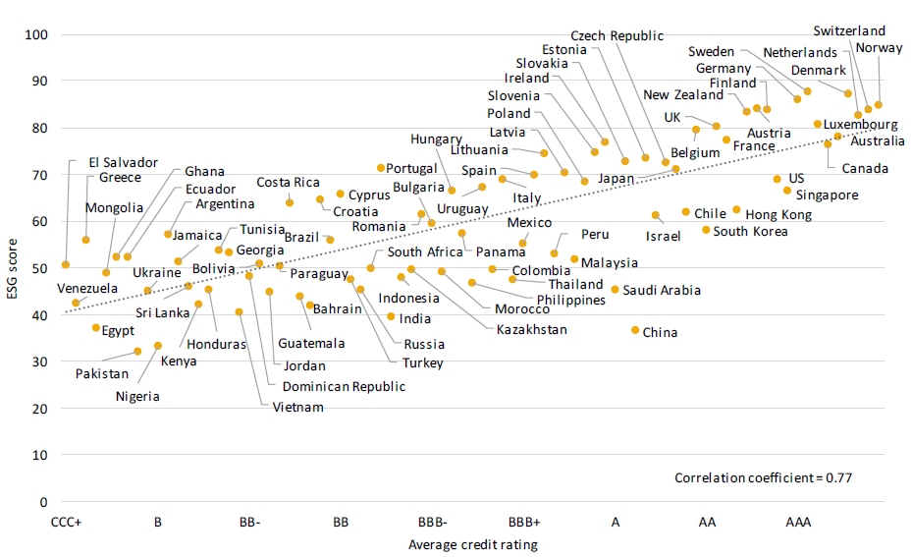
ESG scores and credit ratings
Principles of Sustainable Finance © Schoenmaker and Schramade 2019 Oxford University Press

Slide 12
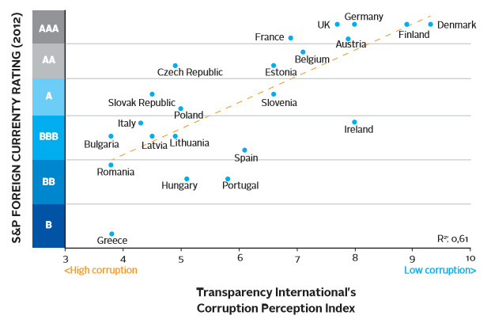
Corruption indices and credit ratings
Principles of Sustainable Finance © Schoenmaker and Schramade 2019 Oxford University Press

Slide 13
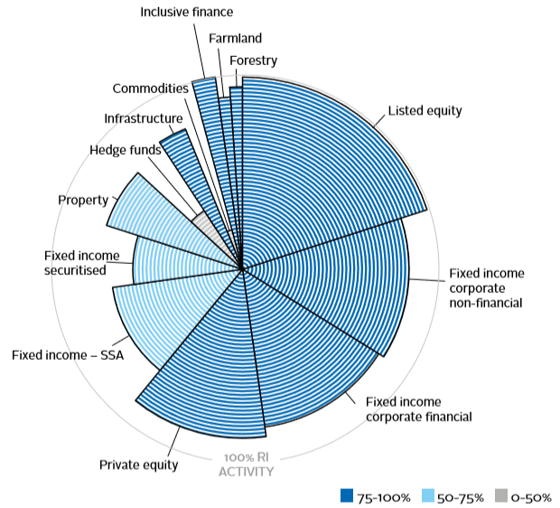
ESG integration into bond investing
Proportion of reporting PRI investment managers conducting some level of responsible investment by asset class in 2016
Principles of Sustainable Finance © Schoenmaker and Schramade 2019 Oxford University Press

Slide 14
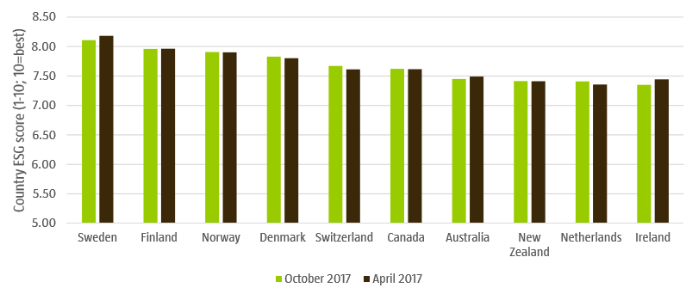
ESG integration into government bond investing
RobecoSAM country sustainability ranking
Principles of Sustainable Finance © Schoenmaker and Schramade 2019 Oxford University Press

Slide 15
ESG integration into government bond investing
RobecoSAM country sustainability framework
Sub-indicator level |  | Indicator level | Dimension level | Country Sustainability Score
Emissions | Biodiversity | Environmental status (10%) | Environmental (15%) | Country Sustainability Score (100%)
Energy use | Energy sources | Energy (2.5%)
Exposure to environ-mental risks | Risk mitigation | Environmental risk (2.5%)
Human welfare | Work and equality | Social indicators (10%) | Social (25%)
Education | Life expectancy | Human development (10%)
Confidence in government | Local job market | Social unrest (5%)
Rights and liberties | Inequality | Liberty and inequality (10%) | Governance (60%)
Human capital and innovation | Physical capital | Competitiveness (10%)
Internal risks and inefficiencies | External conflicts | Political risks (10%)
Management of public goods | Policy responses | Effectiveness (2.5%)
Protection of property rights | Judicial system | Rule of law (2.5%)
Democratic participation | Civil society | Accountability (2.5%)
Corruption level | Transparency / policies | Corruption (2.5%)
Terrorism and political crimes | Government stability | Stability (2.5%)
Competition / liberalisation | Business regulations | Regulatory quality (2.5%)
Demographic profile | Age-related policies | Aging (10%)
Monetary policy independence | Other institutions | Institutions (5%)

Slide 16
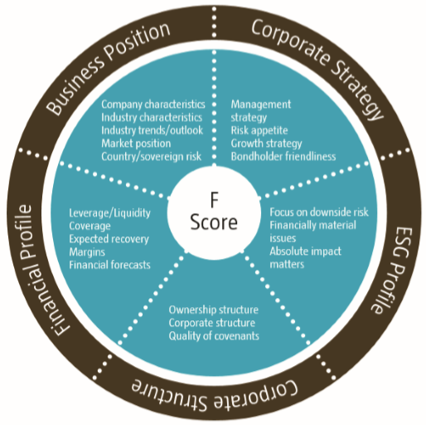
ESG integration into corporate bond investing
Robeco F-score
Principles of Sustainable Finance © Schoenmaker and Schramade 2019 Oxford University Press

Slide 17
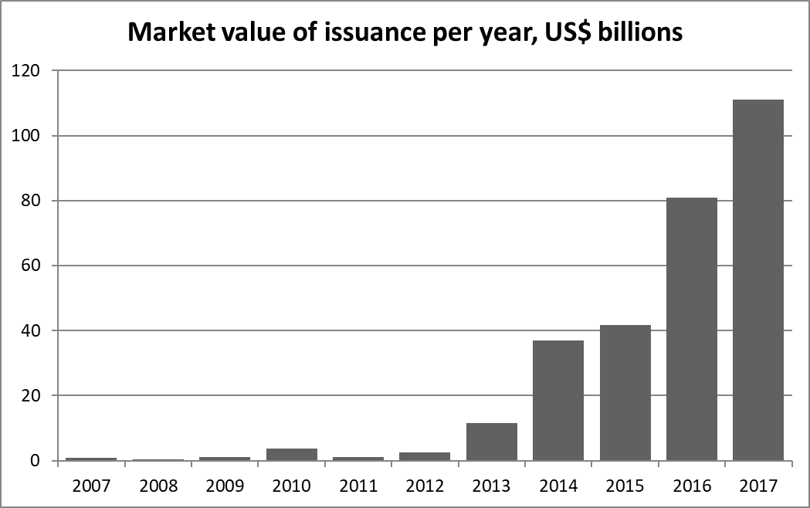
Green bonds
Principles of Sustainable Finance © Schoenmaker and Schramade 2019 Oxford University Press

Slide 18
Green bonds
The Green Bond Principles (GBP, 2017) give four criteria:
Use of proceeds
Process for project evaluation and selection
Management of proceeds
Reporting
are exclusively for green projects, which should be appropriately described in the legal documentation for the security
the issuer should clearly communicate to investors:
2) the process to determine how the project fits the eligible green projects categories;
3) the eligibility criteria
the net proceeds of the green bond should be credited to a sub-account, and subsequently be tracked and verified
mandatory on the use of the proceeds
1) what the environmental objectives are;

Slide 19
Conclusions
At first sight, sustainability seem less relevant for bonds than for equity, but, sustainability does matter in bonds
As bond markets are even bigger than equity markets, the impact in bonds is potentially bigger than in equity
Some things make ESG integration harder in bonds than in equities, such as the lack of voting power, and illiquid markets
There is exciting innovation in the form of green bonds and social bonds
Principles of Sustainable Finance © Schoenmaker and Schramade 2019 Oxford University Press

